Slide 1
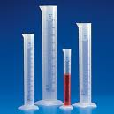
Science Instrument Uses
Graduated cylinder-used to measure liquid volume. It is expressed in milliliters (mL).

Slide 2
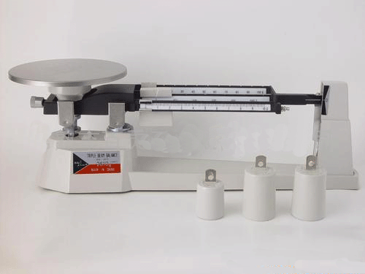
Triple beam balance-used to determine the
amount of matter (mass) in an object. It is
expressed in grams.

Slide 3
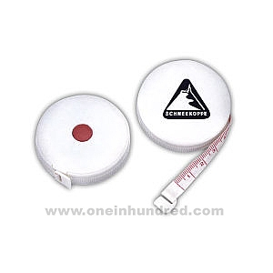
Measuring tape-a flexible form of a ruler.
It measures distance.

Slide 4
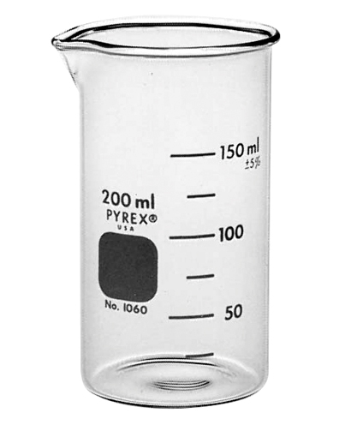
Beaker-a wide glass cylinder with a flat
bottom . It has a pouring lip, and is
measured in milliliters.

Slide 5
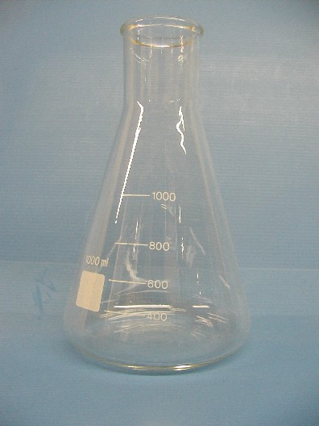
flask-a glass bottle that has a rounded body
and a narrow neck. It is measured in
milliliters (mL).

Slide 6
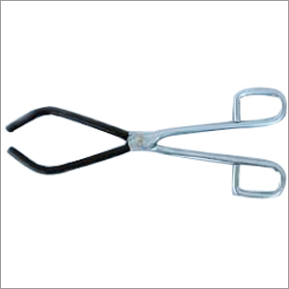
6. Beaker tongs-used to hold a hot beaker

Slide 7
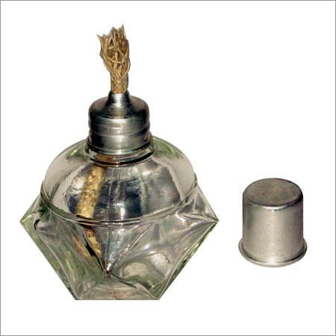
alcohol burner-an easy to use burner that
provides a hot and consistent flame. It has a
wick and uses 90% rubbing alcohol as it’s
fuel.

Slide 8
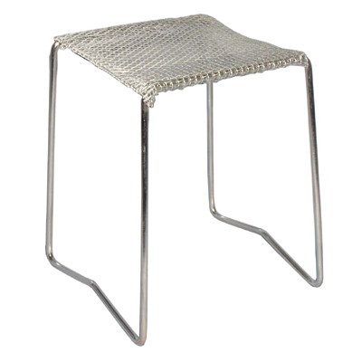
alcohol burner stand-goes over the alcohol
burner. It allows you to heat objects.

Slide 9
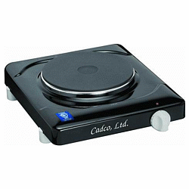
Hot plate (electric burner)-used to dissolve solids in liquids

Slide 10
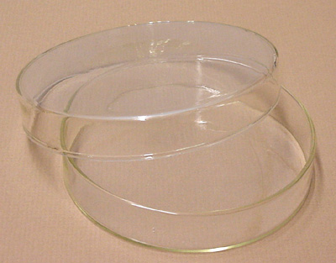
Petri dish-a shallow, circular container with a removable cover. It is used to grow bacteria and other microorganisms.

Slide 11
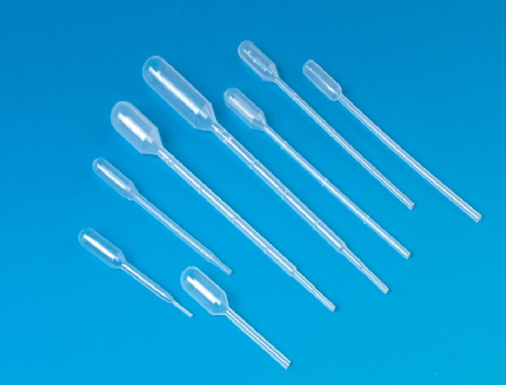
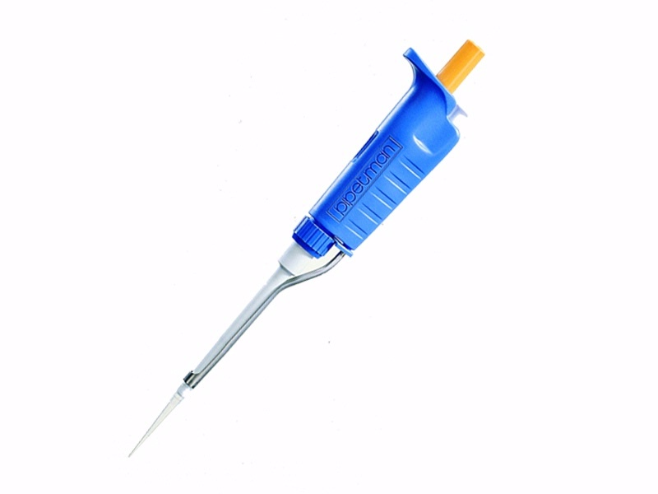
pipette-a laboratory instrument used to
transport a measured volume of liquid

Slide 12
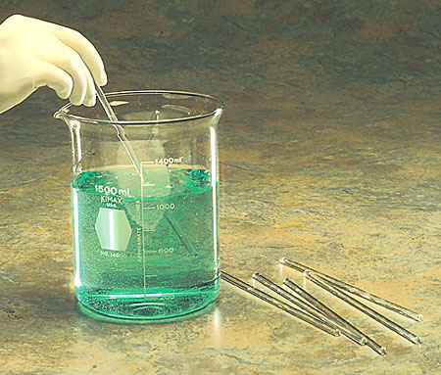
12. stirring rod-used to mix chemicals and
liquids in lab

Slide 13
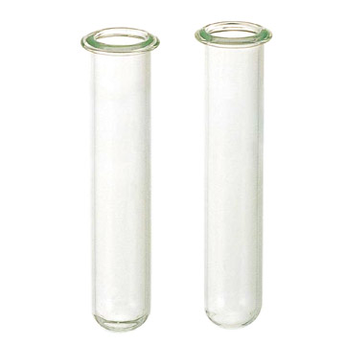
test tube-a glass tube that is rounded at
one end and open at the other

Slide 14
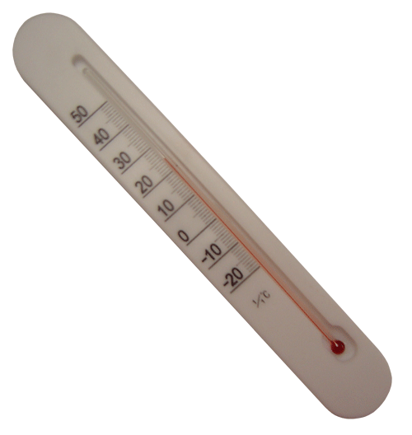
thermometer-used for measuring
temperature. It is measured in celsius or
farhenheit.

Slide 15
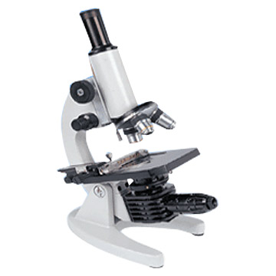
microscope-an instrument used for
viewing objects that are too small to view
with the naked eye.

Slide 16
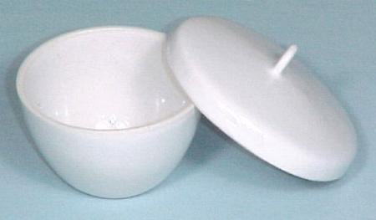
crucible- a dish or other vessel in which
substances can be heated to a high
temperature.

