Slide 1
Good Nutrition
Nutrients-substances that provide the materials needed for life processes
Nutrients are grouped into 6 classes:
Carbohydrates-chemical composed of simple sugars
simple carbohydrates-sugars (easily digested and give you quick energy)
complex carbohydrate-made up of many sugar molecules linked together (digested slowly and give you long lasting energy)

Slide 2
Proteins-nutrients used to build and repair your body.
Fats-energy storage nutrients
store and transport vitamins, produce hormones, keep skin healthy, provide insulation, and energy.
saturated fat-raise blood cholesterol
unsaturated fat-lower blood cholesterol

Slide 3
SATURATED FATS
These are the biggest dietary cause of high LDL levels ("bad cholesterol"). When looking at a food label, pay very close attention to the percentage of saturated fat and avoid or limit any foods that are high.
Saturated fat should be limited to 10% of calories.
Saturated fats are found in animal products such as butter, cheese, whole milk, ice cream, cream, and fatty meats. They are also found in some vegetable oils -- coconut, palm, and palm kernel oils. (Note: Most other vegetable oils contain unsaturated fat and are healthy.)

Slide 4
UNSATURATED FATS
Fats that help to lower blood cholesterol if used in place of saturated fats. However, unsaturated fats have a lot of calories, so you still need to limit them. Most (but not all) liquid vegetable oils are unsaturated. (The exceptions include coconut, palm, and palm kernel oils.)
There are two types of unsaturated fats:
Monounsaturated fats: Examples include olive and canola
oils.
Polyunsaturated fats: Examples include fish, safflower,
sunflower, corn, and soybean oils.

Slide 5
Water-transport substances & regulates body temperature. You cannot live without it.
8 glasses of water recommended daily
Minerals-elements that are essential for good health.

Slide 6
You need six minerals in large amounts:
Calcium (bones and teeth)
Chloride –helps keep the fluid inside and outside the cell in balance
Magnesium
Sodium Help the body use proteins
Potassium-regulates heartbeat & muscle movement
Iron-red blood cell production

Slide 7
Vitamins-only vitamin D can be made by the body. The rest you have to get from food.
Look at Table 1

Slide 8
How many calories do you need per day
Most teenage girls need about 2,200 calories.
Most boys need about 2,800 calories.
It depends on height, weight, age, and level of activity.

Slide 9
Reading Food Labels
Packaged food must have nutrition fact labels.
It shows in what amount each nutrient is in one serving of that food.
It helps you in selecting healthy foods.

Slide 10
Malnutrition
This occurs when someone does not eat enough of the nutrients needed by the body.
Types:
anorexia-an eating disorder categorized by self-starvation and an intense fear of gaining weight.
bulimia nervosa-a disorder categorized by binge eating followed by induced vomiting.
They may use laxatives or diuretics to rid their bodies of food and water.
Damages teeth, digestive system, kidneys, and heart.

Slide 11
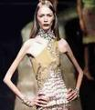
Anorexia
and
Bulimia Nervosa
They cannot do it alone. They need help.

Slide 12
Obesity
Having an extremely high percentage of body fat.
Causes:
Being inactive
Not eating foods with the correct amount of nutrients.
Heredity
Side effects:
Increases the risk of high blood pressure, heart disease, and diabetes.

Slide 13
The key to getting better is getting help.

Slide 14
What is a Drug?
It is any substance that causes a physical or psychological change.
Drugs are classified by their effects:
Analgesics-relieve pain
Antibiotics-fight bacterial infections
Antihistamines-control cold and allergy symptoms
Stimulants-speed up central nervous system
Depressants-slow down CNS

Slide 15
Addiction
It is the loss of control of drug-taking behavior.
A person becomes physically dependent upon a drug.
They can have withdraws of nausea, vomiting, pain, and tremors.
A person can also become psychologically dependent upon a drug. They feel powerful cravings for the drug.

Slide 16
Types of Drugs
Herbal Medicines-healing properties
Over-the-Counter-can be bought without a prescription from your doctor
Prescription Drugs-a doctor prescribes the drug with a written prescription

Slide 17
Tobacco
nicotine-is a chemical in tobacco that increases your heart rate and blood pressure and is extremely addictive
Smoking decrease physical endurance, increases the chance of lung cancer, emphysema, chronic bronchitis, and heart disease.
Chewing tobacco also is addictive and causes health problems like mouth and throat cancer and gum disease.

Slide 18
Alcohol-slows down the CNS and can cause memory loss
Excessive use can damage liver, pancreas, brain, nerves, and cardiovascular system.
Alcoholism-means that they are physically and psychologically dependent on alcohol.

Slide 19
Marijuana-it is an illegal drug that comes from the Indian hemp plant
It increase anxiety or causes feelings of paranoia.
It slows reaction time, impairs thinking, and causes a loss of coordination.

Slide 20
Cocaine-is made from the coca plant
This drug is illegal and highly addictive.
It produces feelings of intense excitement followed by anxiety or depression.
It is often times referred to as crack.
It increase heart rate and blood pressure and can cause heart attacks.

Slide 21
7. Narcotics-drugs made from the opium plant
Some used to treat severe pain.
They are illegal unless prescribed by a doctor.
Some are never legal like heroin. It is usually injected and users often share needles, so they have a high risk of hepatitis and AIDS.

Slide 22
8. Hallucinogens-a drug that distorts the senses and causes mood changes.
LSD and PCP are powerful illegal hallucinogens.
Users have hallucinations.
These can cause serious brain damage.

Slide 23
Drug abuse can lead to problems with friends, family, school, and handling money.
These problems often lead to depression and social isolation.

Slide 24
The first step to quitting drugs is to admit to abusing drugs, and then to decide to quit.
The addict needs to get proper medical treatment like: going to a drug treatment center.
Look at page 165 figure 10

Slide 25
Withdrawal symptoms are often painful, and powerful cravings for the drug can continue long after a person quits.
But, they will lead happier and healthier lives without drugs.

Slide 26
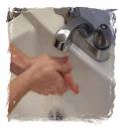
Healthy Habits
Hygiene-the science of preserving and protecting your health.
Includes: using sunscreen, shampooing your hair, brushing and flossing your teeth, and washing your hands.

Slide 27
Taking Care of Your Body
Good Posture
Look at page 166 fig. 1
Exercise
Aerobic exercise-a vigorous, constant exercise for at least 20 minutes
need to do at least 3 times/week(ie. walking , running, swimming, or biking)
increases heart rate, burns calories, and over time
strengthens lungs, heart, and bones

Slide 28
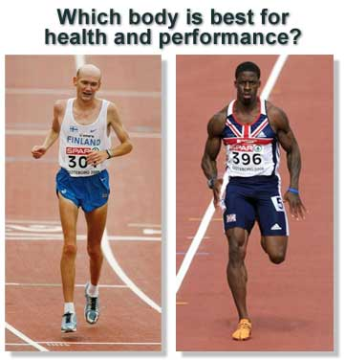
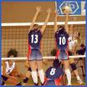
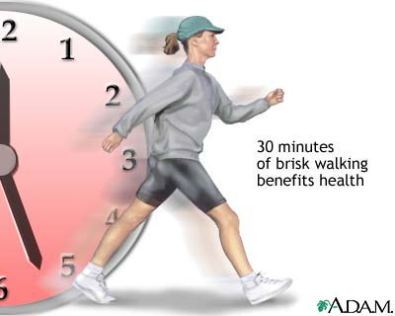
Aerobic Exercise

Slide 29
Sleep-teenagers need more sleep than younger children (about 9.5 hours each night)
If you do not sleep long enough you will not enter the deepest sleep.

Slide 30
Stress
Stress is the physical and mental response to pressure.
It prepares your body for difficult or dangerous situations.
Excess stress is harmful to your health.

Slide 31
How to deal with Stress
First, you have to identify the source of the stress.
Talk things over with someone you trust.
Make a list of things you want to get done.
Sleep & Exercise
Make time to relax or practice relaxation techniques.

Slide 32
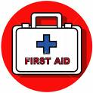
When Accidents Happen
Call for Help: 911
Take a First Aid or CPR class

Slide 33
