Slide 1
Body Defenses and Disease
Chapter 6

Slide 2
Disease
It causes your normal body functions to be disrupted.

Slide 3
2 Types of Diseases:
Noninfectious Diseases-are not spread from one person to another.
Causes:
genetic disorder ie. hemophilia (blood does not clot)
Smoking
Lack of physical activity
High-fat diet
All of these increase your chances of getting certain noninfectious diseases.

Slide 4
Bubble Boy

Slide 5
Infectious Disease-a disease that is caused by a pathogen and can be passed from one living thing to another.
Causes:
Pathogens-a virus, microorganism, or other organism that causes disease.
Look at page 132 figure 1

Slide 6
Infectious Diseases
Noninfectious Diseases
A disease that is not spread from one person to another.
A disease that can be passed from one living thing to another.

Slide 7
Pathways to Pathogens
Air Look at page 133 Figure 2
Contaminated Objects-a person who is sick can leave bacteria or viruses on many objects like doorknobs, telephone, remote, combs, towels . . .
Person to Person-direct contact with an infected person
Animals-can carry pathogens
like:
ringworm (a fungus from handling an infected dog)
Lyme disease-a bacteria that ticks carry
Rocky Mountain spotted fever-also from infected tick

Slide 8
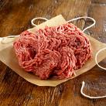
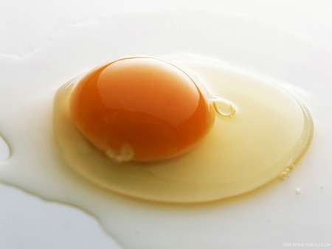
Food and Water-drinking water in the U.S. is fairly safe because we have treatment plants.
When problems arise:
Flooding can allow microorganisms to enter the water supply.
Meat, fish, and eggs that are not cooked enough can contain dangerous bacteria or parasites.
Leaving food out at room temperature can give bacteria like salmonella a chance to grow

Slide 9
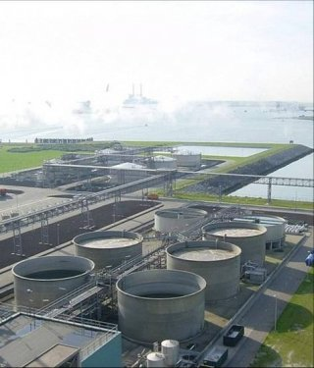
Water Treatment Plant

Slide 10
What can you do?
Refrigerate foods (slows growth)
Wash foods with soap and rinse before you eat.
Wash all cooking surfaces and tools after preparing food (a cleaner with chlorox in it is best for counters).
Completely cook meats and eggs. Cooking kills dangerous bacteria or parasites living in meat, fish, and eggs.

Slide 11
Putting Pathogens in Their Place
Until 20th century, patients undergoing surgery often died of bacterial infections (staph infection).
They prevent the spread of diseases by:
ultraviolet radiation
boiling water
chemicals
hand sanitizer
hand washing

Slide 12
Pasteurization
Louis Pasteur discovered:
pasteurization- a method of using heat to kill most of the bacteria in the wine
This method is still used. Milk is pasteurized.

Slide 13
Pasteurization You Tube

Slide 14
Vaccines and Immunity
Edward Jenner-studied the disease smallpox
He found that people who had been infected with cowpox seemed to have protection (a resistance) against smallpox.
immunity-the ability to resist or recover from an infectious disease
This led to the 1st vaccine.
vaccine-a substance that helps your body develop immunity to a disease

Slide 15
Antibiotics
It is a substance that kills bacteria or slows the growth of bacteria.
Strep throat is a bacterial infection. Antibiotics are used to treat it.
Always follow your doctors instructions on taking antibiotics. If you stop too soon, all the pathogens may not be killed.
Viruses are not affected by antibiotics. Antibiotics only kill living things and viruses are not alive.

Slide 16
Your Body’s Defenses
1st Line of Defense: The Skin
The outer layer of skin is dead, so pathogens have a hard time entering. Skin is made of flat cells.
Pathogens enter your mouth and eyes, but are destroyed by special enzymes.
Pathogens that enter you nose are washed down the back of your throat by mucus. Mucus carries the pathogens to your stomach where they are digested.

Slide 17
As new skin cells grow, dead skin cells drop off taking the viruses with them.
Skin glands secrete oil that kills pathogens too.
Look at page 136 figure 1

Slide 18
How does the 1st Line of Defense Fail?
Cut
Puncture
Body’s reaction:
Blood flow to the injured area is increased.
Platelets in the blood seal (clot) the opening of the wound so not more pathogens can enter.
The increased blood flow brings cells that belong to the immune system (the fighters).
Immune system-body system that fights pathogens.
It is a team of individual cells, tissues, and organs that work together to keep you safe from invading pathogens.

Slide 19
Immune System
Consists of 3 types of cells:
Macrophages
they engulf and digest many microorganisms or viruses that enter your body.
T-cells
coordinate the immune system and attack many infected cells.
B-cells
immune-system cells that make antibodies
antibodies-proteins that attach to specific antigens
antigens-substances that stimulate an immune response

Slide 20
Look at page 137 figure 2
An antibody’s shape is specialized. It matches an antigen like a key fits a lock.

Slide 21
Responding to a Virus
The process that your immune system uses to fight an invading virus in summarized in on page 138 and 139.

Slide 22
Path of a Virus
Helper T cells have receptor proteins that recognize the shape of the viral antigen on the macrophages. These helper T cells begin two responses: a T cell response and a B cell response.
Macrophage Macrophage B Cell Response
engulfs virus
T-cell Response
A virus can take one (activates) killer
of two paths T cells
Virus infects Killer T cells recognize the
body cell the viral antigen on infected cells
Body Cell The killer T cells destroy the
infected cells.
so that the virus particles
inside the cell cannot replicate.
When virus particles invade the body, some of the particles are engulfed by macrophages. Others infect body cells. Macrophages that have engulfed virus particles, infected body cells, or virus particles all display viral antigens.
Antibodies bind
To the viral antigens on
the viruses. The
Antibodies bound to the
viruses Cause the viruses
to clump together.
Clumping marks the virus
particles for destruction.
Helper T cells
activate B cells.
They divide and
make antibodies.

Slide 23
Virus
Immune System You Tube

Slide 24
Fevers
When macrophages activate the helper T cells, they send a chemical signal that tells your brain to turn up the thermostat.
In just minutes, your body temperature can rise several degrees.
Moderate fevers help you get well faster because it slows the growth of some pathogens. It also helps B and T cells multiply faster.

Slide 25
Memory Cells
During a 1st encounter with a new pathogen, specialized B cells make antibodies that fight against that pathogen. The process takes about 2 weeks, which is too long to prevent infection.
Memory B cells (a few B cells become these)-cells in your immune system that remember how to make an antibody for a particular pathogen. It will only take 3 or 4 days.

Slide 26
Challenges to the Immune System
allergies-the inappropriate overreaction by the immune system to antigens that are not dangerous to the body.
Allergy examples are: peanuts, pollen, dust, mold, certain trees, certain foods , and medicines.

Slide 27
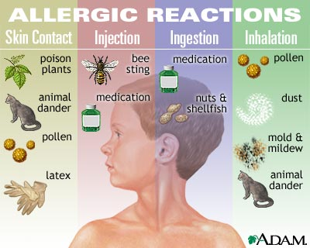

Slide 28
autoimmune diseases-a disease in which the immune system attacks the body’s own cells
Immune-system cells mistake body cells for pathogens.
Types of autoimmune diseases are: rheumatoid arthritis, Type 1 diabetes, multiple sclerosis, and lupus.

Slide 29
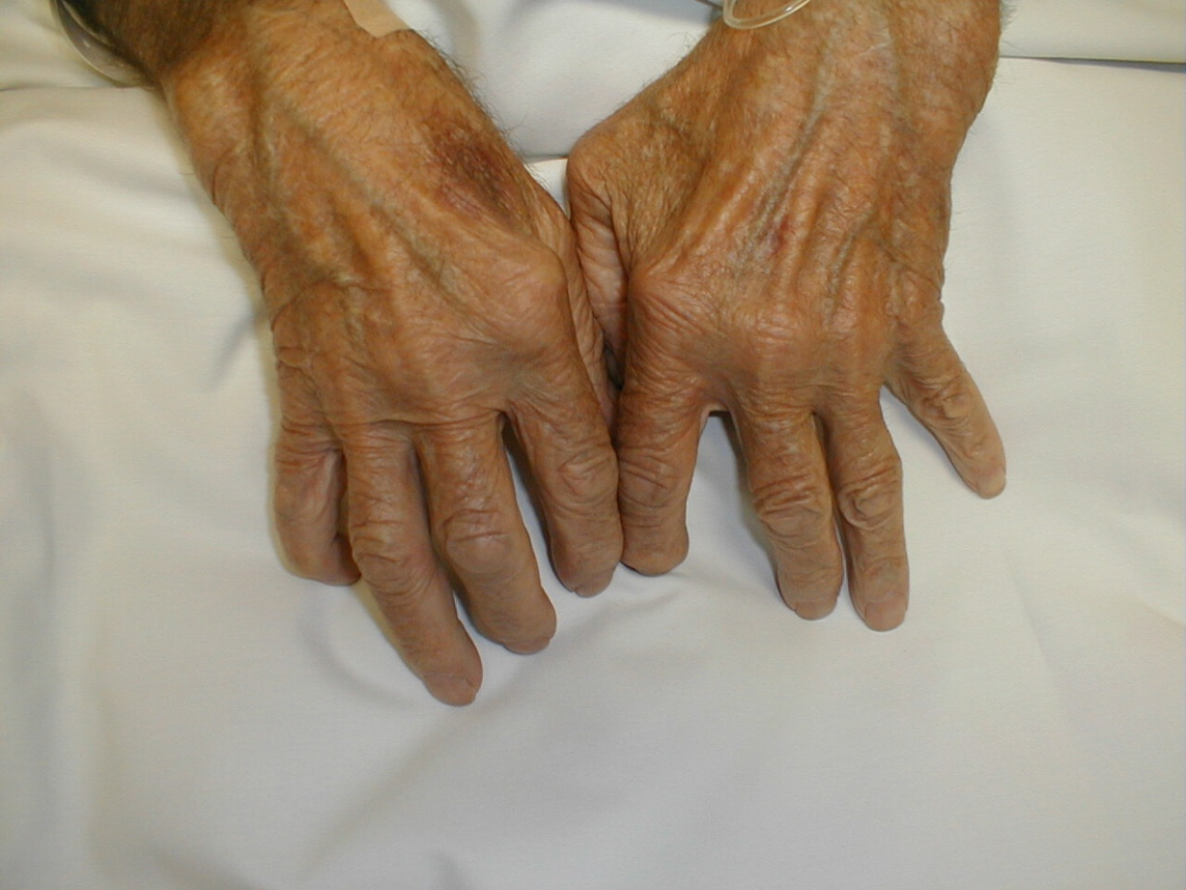
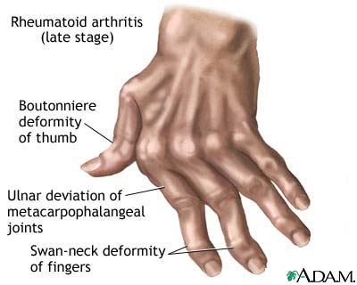
Rheumatoid Arthritis

Slide 30
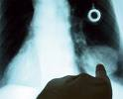
Cancer
Lung Cancer
Mass
a condition in which cells divide at an uncontrolled rate. Killer T cells destroy the cancer cells, but sometimes cannot control the division rate.
Many invade tissues, cardiovascular system, or lymphatic system which allows it to travel to other places in the body.
Surgery, radiation, and certain drugs can remove, kill, or slow the cancer cells division.

Slide 31
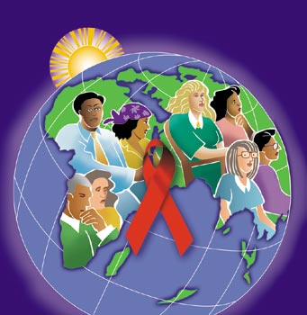
Aids
Human immunodeficiency virus(HIV) causes acquired deficiency syndrome (AIDS).
HIV infects the immune system using helper T cells as factories to produce more viruses. Helper T cells are destroyed.
People with AIDS have very few helper T cells (no activation of B cells or killer T cells).
People with AIDS don’t usually die of AIDS. They die of other diseases that they are unable to fight off.

