Slide 1
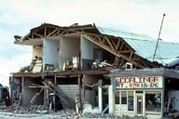
Chapter 5 Earthquakes: Section 2
Earth's Crust in Motion
Earthquake Measurement
Earthquake Hazards

Slide 2
Effects of the 1989 San Francisco Earthquake
The effects of the 1989 earthquake included: - 67 Deaths - 6,000 Homes damaged / destroyed - 2000 people made homeless - Upper deck of the Nemitz highway collapsing onto the lower deck crushing people in their cars - A section of the San Francisco-Oakland Bay Bridge collapsing - Fire resulting from gas explosions - Massive economic costs ($4.4 billion) - Damage to infrastructure - electricity / gas and water mains cut

Slide 3
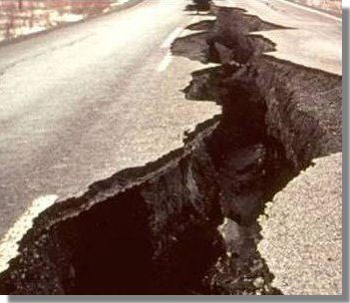
Earthquake damage

Slide 4
Measuring Earthquakes
Seismic waves are vibrations that travel through the earth carrying energy released during an earthquake.
They carry the energy of an earthquake away from the focus, through the interior and across the surface
Three kinds of seismic waves: P waves, S waves, and surface waves

Slide 5
Kinds of Seismic Waves
P Waves are Primary waves (compression waves). Travel fastest. Can travel through solids and liquids.
S Waves are Secondary waves (transverse waves). Slower than P waves. Can only travel through a solid.
Surface Waves. P waves or S waves that reach the surface change into surface waves. Travel slower than P or S waves. Surface appears to roll like ocean waves, or shake buildings from side to side.

Slide 6
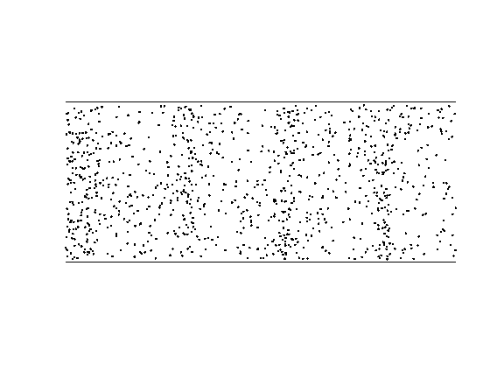
P Waves -- Primary Waves Compression or longitudinal Waves
The medium is vibrating and particles are compressed and decompressed.
Seismic waves can be longitudinal. These are called P-waves. They travel faster than S-waves and arrive first at distant seismic stations. P-waves can travel through solids liquids or gasses.

Slide 7
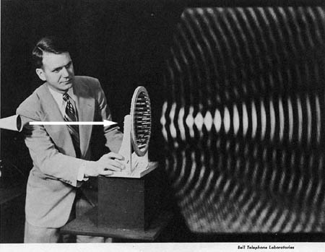
Even though this picture shows a sound wave, the fact that the waves spreads out in all directions is the important thing.

Slide 8
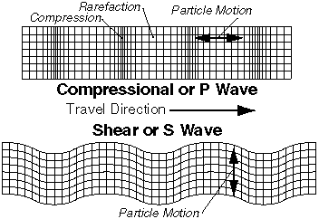
P waves shake the ground in the direction they are moving (parallel)
S waves shake perpendicularly or “transverse” to the direction they are moving.

Slide 9
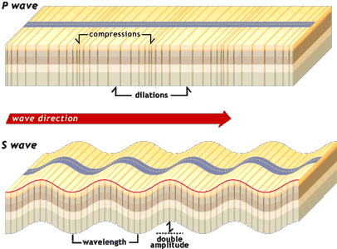
S Waves are Secondary waves (transverse or shear waves). These waves are slower than P waves… And can only travel through a solid.
Earthquakes generate seismic waves that are transverse. These are called s-waves, they are the second waves to arrive at a seismograph.
S-waves travel through solids they do not travel through liquids or gasses.
Compare the two types of waves and how the medium is moving in each case.

Slide 10
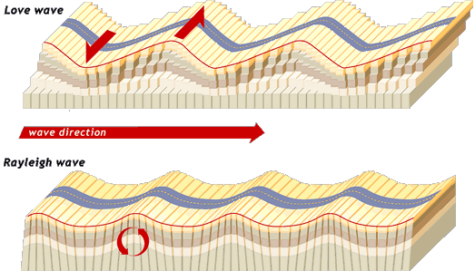
There are seismic waves that exist only at the surface. These surface seismic waves travel slower than both P-waves and the S-waves but can be very destructive.
Surface Waves

Slide 11
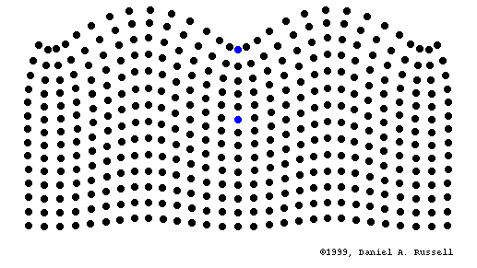
Surface Wave in an Earthquake
How would this feel if you were in an earthquake? If you watched a surface wave move through a very large parking lot, what would it look like?

Slide 12
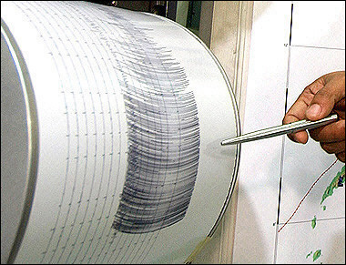
A Seismograph is for recording the magnitude and intensity of an earthquake
This picture shows the drum of a seismograph. The drum moves with the earth, but the pen that makes the mark does not move. The more the drum shakes, the bigger the earthquakes.

Slide 13
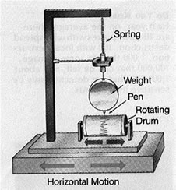
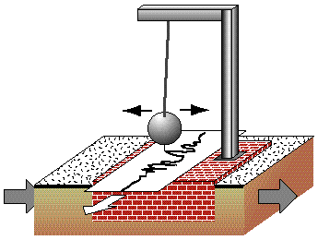
A seismograph, or seismometer, is an instrument used to detect and record earthquakes. Generally, it consists of a mass attached to a fixed base. During an earthquake, the base moves and the mass does not. The movement of the drum is recorded on paper, magnetic tape, or another recording medium. This record is proportional to the motion of the seismometer mass relative to the earth.

Slide 14
Locating the Epicenter
Epicenter is located on the surface of the earth over where the earthquake occurred.
Focus is the point where the earthquake occurred.

Slide 15
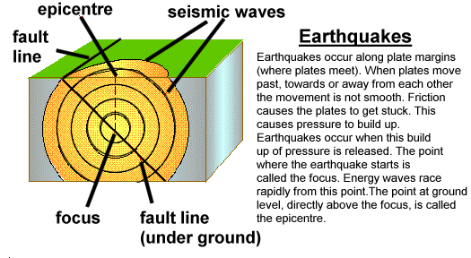

Slide 16
Locating an Epicenter
Scientists need readings from three or more stations to determine the location. A circle is drawn around each station. The radius of each circle is equal to the station’s distance from the epicenter.
The point of intersection is the location of the epicenter.

Slide 17
S-P Time Method
The __________________________ method is one of the simplest methods by which seismologists find an earthquake’s epicenter.
How does it work?
The 1st step is to collect several seismograms of the same quake from different locations (stations).
Then, the seismograms are placed on a time-distance graph. It uses the start time difference of P and S waves to determine the distance from the epicenter to each station.
After finding out the distance, the seismologist can locate the earthquake’s epicenter.

Slide 18
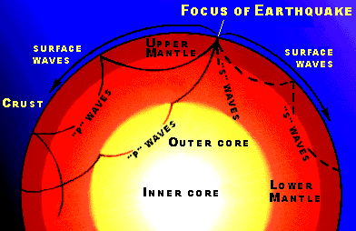
This picture shows earthquake waves moving out from the focus of an earthquake. Note the movement of the P, S, and Surface waves.

Slide 19
Measuring Earthquakes
Several kinds of scales
The Mercalli Scale rates earthquakes according to intensity. Not very precise, but describes how an earthquake affects people, buildings, and land surfaces.
The Richter Scale rates the size of the seismic wave on a seismograph. Best for small or nearby earthquakes.
The Moment of Magnitude Scale rates the total energy released by an earthquake of all sizes, far or near. Used by scientists today

Slide 20
The Modified Mercalli Scale measures the amount of damage
Earthquakes can also be described by the amount of damage they cause. The Modified Mercalli scale describes the intensity of an earthquake using the amount of structural and geologic damage in a location.

Slide 21
The Richter Scale measures the strength or magnitude
An increase of one magnitude on the Richter scale means that 32 times more energy is released.
An earthquake of magnitude 6 is 32 x 32 x 32 times greater than an earthquake with a magnitude of 3.

Slide 22
Magnitude
The height of the lines traced on the paper of a seismograph is a measure of the energy that is released, or the magnitude of an earthquake.

Slide 23
Earthquake Belts Worldwide

Slide 24
Tsunamis
Earthquakes which occur on the ocean floor produce giant sea waves called tsunamis. Tsunamis can travel at speeds of 700 to 800 km per hour. As they approach the coast, they can reach heights of greater than 20 meters.
The Tsunami Warning Center is located in Hilo, Hawaii.

Slide 25
Quake Resistant Structures
Buildings can be built with alternating layers of steel and rubber. The rubber acts like a cushion to absorb the waves. They can withstand up to an 8.3 earthquake.

Slide 26
Before an Earthquake
To reduce the damage from falling objects, heavy objects should be moved from high shelves to low.,
Learn how to turn off the gas, water and electricity in your home.
To prevent broken gas lines, make sure the appliances are held securely.
Newer technology puts sensors on lines to automatically shut off lines if gas is detected.

Slide 27
Protecting Yourself During an Earthquake
Drop, cover, and hold to protect yourself indoors during an earthquake. If possible, crouch under a desk or table, or against an interior wall or bathroom plumbing that extends floor to ceiling.
Avoid windows, mirrors, wall hangings, and furniture that might topple.
After a major earthquake, go outside and wait.
Avoid vehicles, power lines, trees, and buildings, especially with brick chimneys or walls.

Slide 28
After an Earthquake
If the gas lines are damaged, the valves should be shut off.
If you smell gas, leave the building and call someone.
Wear boots to keep from cutting your feet.
Stay away from beaches, due to the threat of a tsunami.

Slide 29
Simulations and Questions to Answer
Go to http://earthquake.usgs.gov/learn/animations/ Copy and paste into a new window
Click on Amplification
What kind of ground will amplify or strengthen a seismic wave?
What kind of ground will muffle or weaken an seismic wave?
Why would the river valley ground amplify the wave? What kind of ground do you have in a river valley?
What happens to the earthquake wave as it moves through the mountain? What kind of ground do you have in a mountain?
Click on Divergent Plate Boundary.
Why does the crust move in opposite directions as the lava flows out of the rift valley?
Click on Elastic Rebound
Describe what is happening in this animation.
Click on the Foreshocks animation
Define foreshock, mainshock, and aftershock.
How long do aftershocks occur?
Continued on next slide

Slide 30
Simulations and Questions continued
Click on the Horst and Graben animation
describe what you see.
Click on the Liquefaction
Why would tall buildings and underground storage tanks be in danger if liquefaction occurs?
What causes liquefaction?
Click on Normal fault
Describe what you see.
What would a fence line that crossed a normal fault look like after an earthquake?
Click on Shadow Zone
Would a seismic recording station note an earthquake if it were in the shadow zone?
Does the shadow zone move depending on the earthquake?
Click on the Strike Slip Fault
How is this different from a Horst and Graben or a normal fault?
What would a fence line that crossed a strike slip fault look like after an earthquake?
Click on Thrust fault
How is this different from a normal fault?

Slide 31
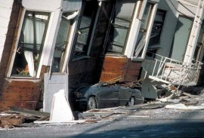
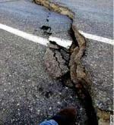
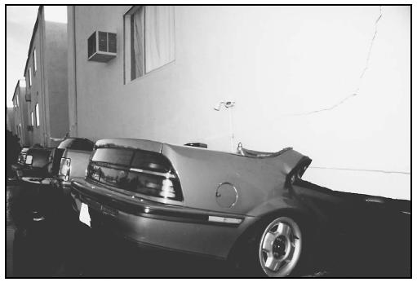
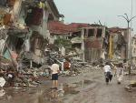
Different types of earthquake damage

Slide 32
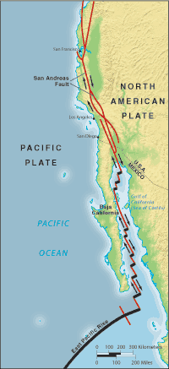
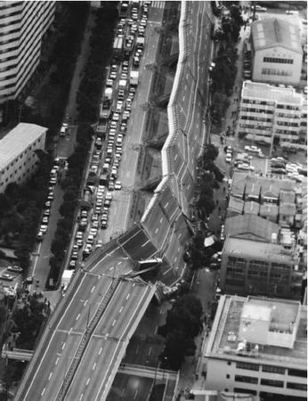
This slide shows the San Andreas Transform fault. Here is a picture of a road that collapsed due to the shaking.

Slide 33
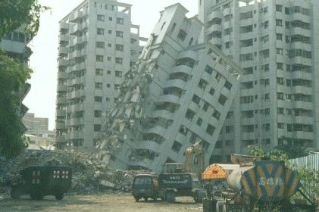
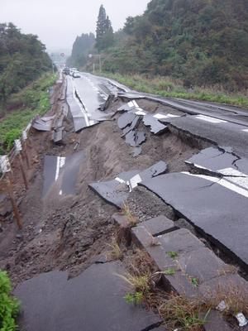
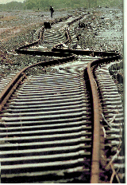
Question to answer: Why do you think only a couple of these buildings fell, and not all?
Question to answer: What kind of earthquake wave would cause the railroad tracks to curve as in the picture here?

Slide 34
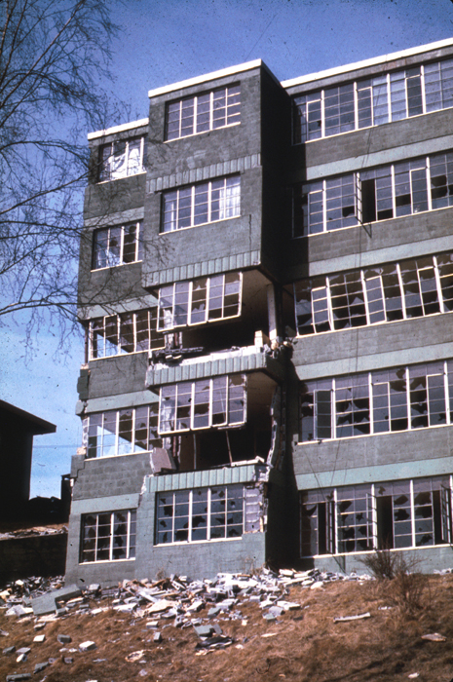
Answer this question: Why do you suppose the middle levels of this building sustained the greatest damage in this earthquake?
Hint: think about a bowl of jello that is being wiggled…where would the greatest motion be observed in the jello and why?
Answer this question: What would be the safety issue in each of these locations?
by windows
in doorways
right outside next to the building
Underneath a table

Slide 35
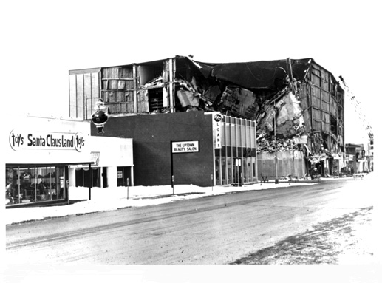
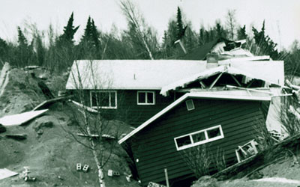
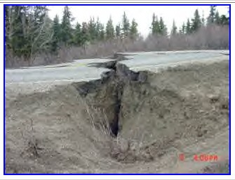
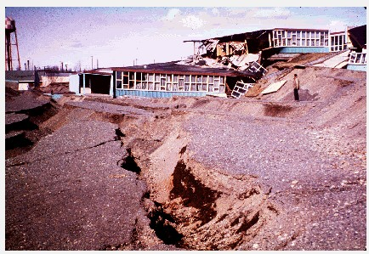
Alaskan Earthquake in the early 1960s.

Slide 36
Pictures of past earthquakes
http://dsc.discovery.com/guides/planetearth/earthquake/photogallery/slide.html
Youtube videos not able to be viewed in the computer lab http://www.youtube.com/watch?v=H0o_9sILvLY http://www.youtube.com/watch?v=NPySVL-c3Lg

