Slide 1
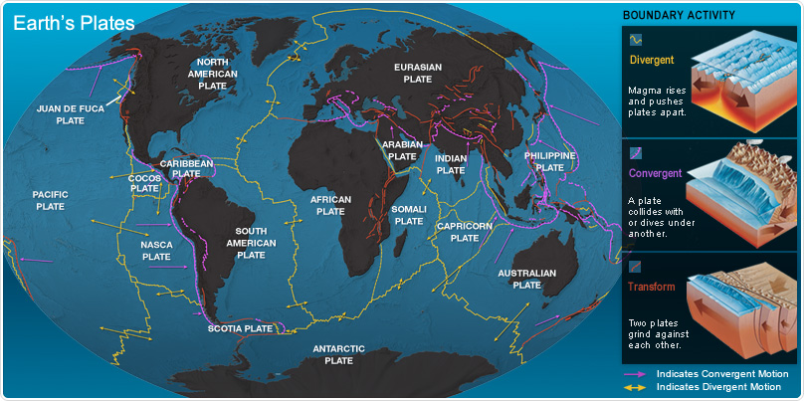
Section 1
What Are Earthquakes? (Faults)
Where Do Earthquakes Occur?
Tectonic Plates: Most earthquakes take place near the edges of tectonic plates along features called faults
Why?
As a result of tectonic plate movements, numerous features called faults exist in the Earth’s crust
A fault is a break in the Earth’s crust. Along faults blocks of the crust slide relative to one another
Earthquakes occur along faults because of this sliding
Go to next slide

Slide 2
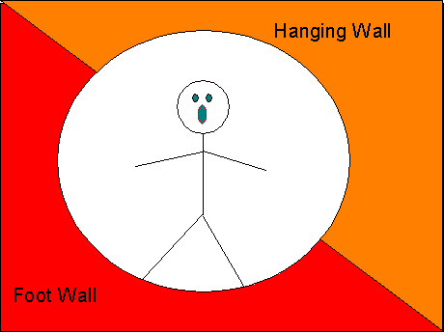
Section 1
What Are Earthquakes? (Faults Continued)
Comprehension Check! Answer the following detail-type question in your notes: Where Do Earthquakes Occur?
Oh no! It’s my fault!
Answer is an anagram: gnola stluaf
The anatomy of a fault: a fault consists of three parts:
A fault plane or crack in the Earth’s crust
A foot wall: the foot wall is always below the hanging wall
A hanging wall: the hanging wall is always above the foot wall
Fault Plane
Go to next slide

Slide 3
Fault-a break in the Earth’s crust along which blocks of the crust slide relative to one another
Earthquakes occur along faults because of this sliding.

Slide 4
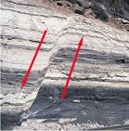
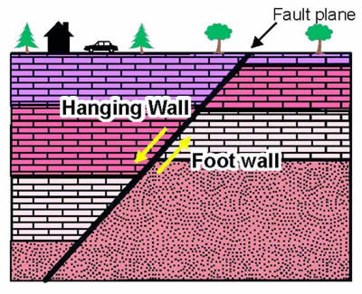
Section 1
What Are Earthquakes? (Normal Fault)
A Normal Fault
The hanging wall moves downward relative to the foot wall.
Go to next slide

Slide 5
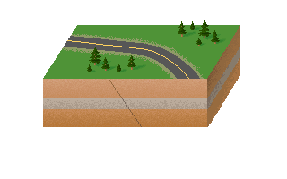
Section 1
What Are Earthquakes? (Normal Fault)
A Normal Fault
The hanging wall moves downward relative to the foot wall.
Go to next slide

Slide 6
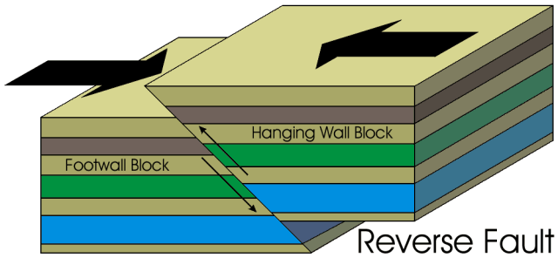
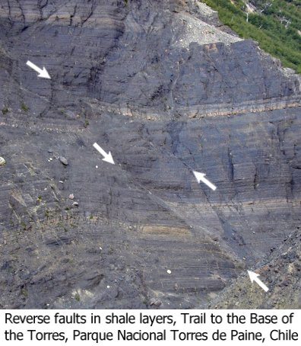
Section 1
What Are Earthquakes? (Reverse Fault)
A Reverse Fault
The hanging wall moves upward relative to the foot wall.
Go to next slide

Slide 7
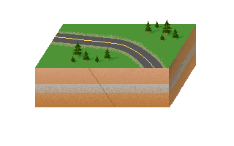
Section 1
What Are Earthquakes? (Reverse Fault)
A Reverse Fault
The hanging wall moves upward relative to the foot wall.
Go to next slide

Slide 8
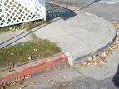
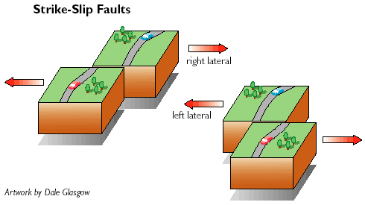
Section 1
What Are Earthquakes? (Strike - Slip Fault)
A Strike - Slip Fault
The blocks of crust slide by one another.
Go to next slide

Slide 9
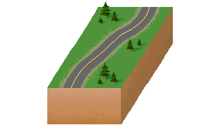
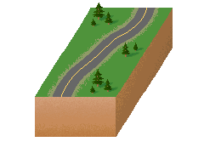
Section 1
What Are Earthquakes? (Strike - Slip Fault)
A Strike - Slip Fault
The blocks of crust slide by one another.
Go to next slide

Slide 10
Section 1
What Are Earthquakes? (The Cause)
What Causes Earthquakes?
Deformation: Elastic deformation leads to earthquakes.
Elastic Rebound: The sudden return of elastically deformed rock to its original shape is called elastic rebound. Imagine stretching a rubber band and then releasing it.
Go to next slide

Slide 11
Section 1
What Are Earthquakes? (The Cause Continued)
View the elastic rebound animation in your online textbook:
Go to Chapter 5, Section 1
Click on Visual Concepts
Select Elastic Deformation and Elastic Rebound
Read the text and then play the animation
Have you read the text and viewed the animation ? Then your ready for the cloze activity.
Rewrite the two sentences with the correct responses in your note.
Elastic deformation is the bending of the Earth's crust in an elastic manner in which rock responds to stress like a rubber band. Elastic deformation often results in ______ ______. Elastic rebound is the sudden return of elastically _______ ______ to its ________ _________. During elastic rebound, rock releases energy that causes an earthquake.
Go to next slide

Slide 12
Section 1
What Are Earthquakes? (Boundaries & Faults)
Faults and Tectonic Plate Boundaries
Transform plate motion at a transform boundary causes a strike-slip fault.
Convergent plate motion at a convergent boundary causes a reverse fault.
Divergent plate motion at a divergent boundary causes a normal fault.
Go to next slide

Slide 13
Earthquake Zones
Most earthquakes happen in the earthquake zones along tectonic plate boundaries. Earthquake zones are places where a large number of faults are located.

Slide 14
Section 1
What Are Earthquakes? (Boundaries & Faults)
View the plate motion and earthquake characteristics animation in your online textbook:
Go to Chapter 5, Section 1
Click on Visual Concepts
Select Plate Motion and Earthquake Characteristics Elastic
Read the text and then play the animation
Have you read the text and viewed the animation ? Then your ready to go to your next slide.
Go to next slide

Slide 15
Section 1
What Are Earthquakes? (Seismic Waves)
How Do Earthquakes Travel?
P Waves - are waves that travel through solids, liquids, and
gases are called P waves (pressure waves).
P Waves are also called primary waves.
S Waves -after being deformed from side to side, the rock
springs back to its original position and S waves are created.
S waves, or shear waves, are the second-fastest seismic
waves.
S Waves are also called secondary waves

Slide 16
Surface waves-they move along the Earth’s surface and produce motion mostly in the upper few kilometers of the Earth’s crust.
Surface waves travel more slowly and
are more destructive.

Slide 17
Section 1
What Are Earthquakes? (Seismic Waves Continued)
View the plate motion and earthquake characteristics animation in your online textbook:
Go to Chapter 5, Section 1
Click on Visual Concepts
Select Seismic Waves: Surface Waves
Read the text and then play the animation
Select Body Waves: S Waves and P Waves
Have you read the text and viewed the animation ? Then your ready to go to the next slide and complete the cloze activity.
Go to next slide

Slide 18
Section 1
What Are Earthquakes? (Seismic Waves Continued)
Rewrite the five sentences with the correct responses in your note.
Seismic waves are earthquake waves that travel out from the focus of an earthquake in all directions. Surface waves are seismic waves that can only move through ________.
_____ _____ are seismic waves that travel through the interior of the Earth. There are two types of body waves: ______ ______, or ________ waves are seismic waves that cause particles of rock to move in a _____ _____ _____ direction. P waves are the fastest seismic waves and can travel through solids, liquids, and _____. S waves, or _______ waves, are seismic waves that cause particles of rock to move in a _____ _____ _____ direction. S waves are the second-fastest seismic waves and can travel only through solids.

Slide 19
Section 1
What Are Earthquakes? (Student Objectives)
After completing this unit you should be able to answer the following prompts
Explain where earthquakes take place (Slides 5 & 6)
Explain what causes earthquakes (Slides 16 & 17)
Identify three different types of faults that occur at plate boundaries (Slides 7-15, and Slides 18 & 19)
Describe how energy from earthquakes travels through the Earth (Slides 20-22)

Slide 20
Japanese building
Earthquake Video

