Slide 1
Chapter 5 Reproduction and Development
Start-up Activity page 107
If a species is going to survive, its members must reproduce.

Slide 2
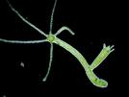
Asexual Reproduction
A single parent has offspring that are genetically identical to the parent.
Kinds of Asexual Reproduction:
1. budding-happens when part of the
parent organism pinches off and
forms a new organism
An example is hydra.
Look at figure 1 on page 108

Slide 3
2. fragmentation-parts of an organism
break off and then develop into a new
individual that is identical to the
original one
An example is flatworms called
planaria.

Slide 4
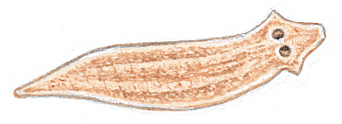
The planaria is the simplest of all flatworms. Most planaria are found in freshwater or salt water, but a few live in moist soils on land.

Slide 5
How do Planaria reproduce?
Regeneration!
When conditions are favorable, the organism will attach its tail-end to the ground and pull forward with its head-end until it tears itself in half. Each end will then regenerate its missing half. This is a form of asexual reproduction called fission. The two “new” planaria are clones of each other, both possessing identical genes.

Slide 6
Regeneration(similar to fragmentation)-when an organism is capable of regenerating. It loses a body part that may develop into an entirely new organism.
For example, if a sea star loses a body part it can develop into an entirely new organism.

Slide 7
Starfish, also known as sea stars, (they are not fish) are capable of regenerating even one arm into a whole new body. This is only possible if the arm includes part of the central disc. If you cut off only the tip of an arm, that tip will not regenerate, but the animal will grow another arm. I have seen a single arm nearly 8 inches long with small 1/2 inch arms growing off of it, it will eventually become a whole new sea star. If you cut a sea star in quarters, right down the center, each piece will grow into a whole new sea star. I do not know how many pieces one can cut any one starfish into and still have each regenerate. As long as a piece has part of the central disk, it should regenerate into a whole organism. But if you cut a starfish in half, and then let it grow into an whole one before cutting it in half again, one should be able to do that indefinitely.

Slide 8
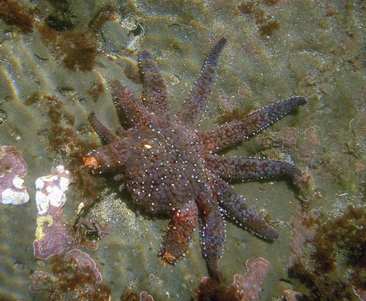
Sea Star
Regeneration

Slide 9
http://www.faculty.umb.edu/yvonne_vaillancourt/Biology/HHplanaria_regen_activity.pdf
Regeneration Activity: Planaria

Slide 10
Sexual Reproduction
offspring are formed when genetic information from more than one parent combines.
In animals, sexual reproduction usually requires two parents: a male and a female.

Slide 11
Female Parent
produces the sex cells called eggs.

Slide 12
Male Parent
produces sex cells called sperm.

Slide 13
When an egg’s nucleus and a sperm’s nucleus join, a fertilized egg, called a
zygote is created.
fertilization-is the joining of an egg and a sperm.

Slide 14
Human Cells
Except for eggs, sperm, and mature red blood cells, human cells contain 46 chromosomes.

Slide 15
Meiosis
Is a copying process that produces cells with half the usual number of chromosomes. Each sex cell receives ½ of each pair.
For example, a human egg cell has 23 chromosomes, and a sperm cell has 23 chromosomes. The new cell that forms when an egg cell and a sperm cell join has 46 chromosomes.
When an egg and sperm join to form the zygote, the original 46 chromosomes are restored.

Slide 16
Genes
This is where genetic information is found.
They are located on chromosomes, which is made of the cell’s DNA.
The combination of genes from the two parents results in a zygote that grows into a unique individual.
Look at figure 3 on page 109

Slide 17
External Fertilization
When the sperm fertilizes the eggs outside the female’s body.
It must take place in a moist environment so that the delicate zygote won’t dry out.
Look at page 110 Figure 4.

Slide 18
An example is the frog, the female releases her eggs, and at the same time the male frog releases his sperm over the eggs to fertilize them. Frogs leave their zygotes to develop on their own. In about 2 weeks, they develop into tadpoles.

Slide 19
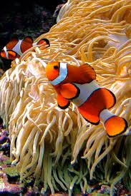
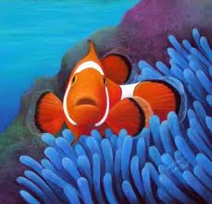
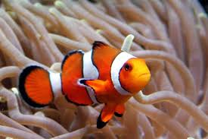
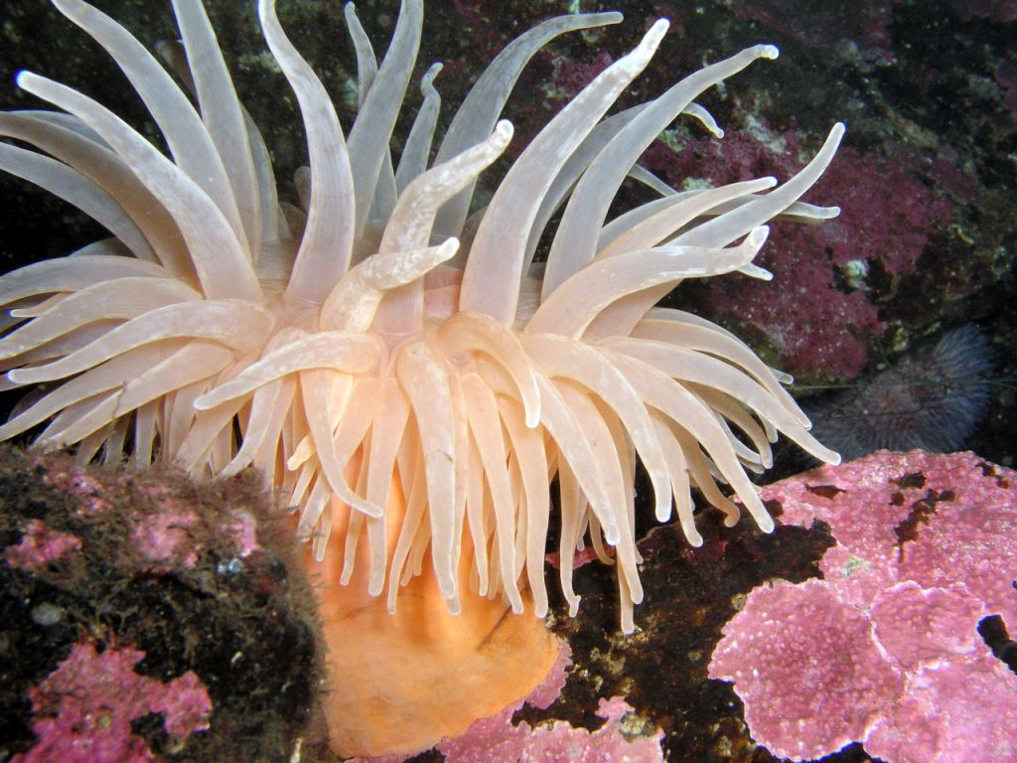
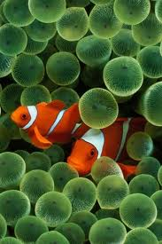

Slide 20
Clownfish live in groups
There is a hierarchy.
Female is the largest
Then, 2nd largest male
Male non-breeders get progressively smaller.
Each fish is born male, but will only change to a female if the sole breeding female dies.

Slide 21
When the female dies, the breeding male changes sex and becomes the breeding female and the largest nonbreeder becomes the breeding male.

Slide 22
Internal Fertilization
When an egg and a sperm join inside the female’s body.
It allows the female animal to protect the developing egg inside her body.
Examples are: reptiles, birds, mammals, and some fish.
Many animals that use internal fertilization lay fertilized eggs.
Many mammals give birth to young that are well developed. Look at page 110 figure 5

Slide 23
Mammals
All mammals reproduce sexually.
They nurture their young with milk.

Slide 24
All Mammals Reproduce in one of the Following Ways:
Monotreme- mammals that lay eggs. Young are nourished by milk that oozes from the pores on the mother’s belly.
Examples: echidnas and platypuses

Slide 25
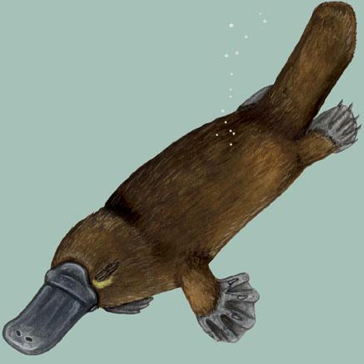
Montreme Information
http://www.ucmp.berkeley.edu/mammal/monotreme.html
Monotremes

Slide 26
Marsupial-mammals that give birth to partially developed live young. Most marsupials have pouches where their young continue to develop after birth.
Examples are: opossums, kangaroos,
wombats,and tasmanian devils

Slide 27
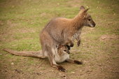
http://www.ucmp.berkeley.edu/mammal/marsupial/marsupial.
htmlhttp://www.kidzworld.com/article/20244-amazing-marsupials

Slide 28
Placental Mammal-more than 4,000 mammals. They are nourished inside their mother’s body before birth. These are more developed than monotremes and marsupials.
Examples are: armadillos, humans, and bats.

Slide 29
Section 2: Human Reproduction
Male Reproductive System
produces sperm and delivers it to the female reproductive system
Testosterone is the main male sex hormone . It regulates the production of sperm and the development of male characteristics
Male Reproductive Organs
testes-a pair of organs that make sperm and testosterone
penis-external organ that transfers semen into the
female’s body (also carries urine out of the body)

Slide 30
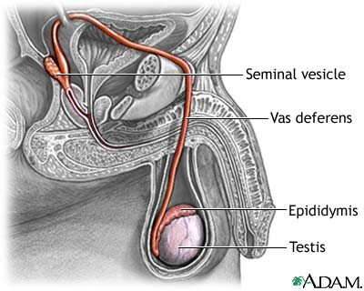
Male
urinary bladder
prostate gland
penis
urethra
scrotum

Slide 31
Route of Sperm:
1. Sperm leaves the testes.
2. Then it goes to the epididymis (sperm matures here).
Sperm are stored in this tube.
3. Next, it goes to the vas deferens-another tube that
passes from the epididymis into the body
and through the prostate gland.
4. The prostate gland surrounds the neck of the
bladder.
5. As sperm moves through the vas deferens, it
mixes with fluids from other glands (including
prostate).
6. This mixture of sperm and fluids is called semen.

Slide 32
6. To leave the body, the semen passes through the vas deferens into the urethra.
7. urethra-tube that runs through the penis.

Slide 33
Male
urinary bladder
prostate gland
penis
urethra
scrotum

Slide 34
The Female Reproductive System
This system produces eggs, nurtures fertilized eggs (zygotes), and gives birth.

Slide 35
Female Reproductive Organs:
ovaries-organs that make the eggs
These also release estrogen and progesterone (main female sex hormones).
2. uterus-organ where the zygote develops into a baby
3. vagina-the canal between the outside of the body and the uterus.

Slide 36
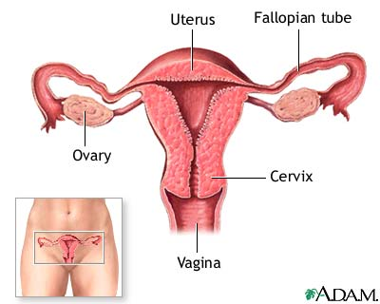
Female

Slide 37
Egg’s Journey
Ovulation-an egg is released from an ovary and passes into a fallopian tube.
The fallopian tube goes from each ovary (2) to the uterus.
The egg passes through the fallopian tube through the uterus.
Fertilization usually occurs in the fallopian tube.
If the egg is fertilized, the zygote enters the uterus.

Slide 38
A Baby is Born
A baby, then passes from the uterus through the vagina to the outside of the body.

Slide 39
The ovaries are about the size and shape of an almond and sit just above the fallopian tubes -- one ovary on each side of the uterus. Every month during ovulation, either the right or left ovary produces a single mature egg for fertilization.

Slide 40
What does it mean to have your tubes tied?
Fallopian tubes are cut, and then sealed shut. After the tubes have been cut and egg can no longer travel down the tubes into the uterus, the female no longer become pregnant. The egg cannot be fertilized.

Slide 41
Menstrual Cycle
From puberty to late 40’s or 50’s, a female’s reproductive system goes through monthly changes.
menstrual cycle-changes that prepare the body for pregnancy
It is a monthly discharge of blood and tissue from the uterus. It lasts about 5 days.
Ovulation occurs about the 14th day of the cycle.
If egg is not fertilized within a few days, the egg is flushed away when menstruation begins.
The menstration cycle usually takes about 28 days.

Slide 42
Multiple Births
Twins are the most common multiple births.
Births of quintuplets or more happen once in 53,000 births.

Slide 43
Identical Twins
Identical twins(and triplets!) come from the splitting of only one fertilized egg. These twins are called identical because, of course, they will have the same identical DNA (genes). Fraternal twins will look similar, but like brothers. Identical twins usually look very much alike.
About 1/3 of all twin births are identical.

Slide 44
Identical Twins

Slide 45
Fraternal Twins
Fraternal twins come from the fertilization of two different eggs, whether it happens in the lab, as with in vitro fertilization, or spontaneously during a double ovulation (1 in 80-90 pregnancies).
More common than Identical Twins.
For every 1,000 births, 30 sets of twins.

Slide 46
Fraternal Twins

Slide 47
Reproductive System Problems
1. STD-Sexually transmitted diseases
Is a disease that can pass from a person who is infected with STD to an uninfected person during sexual contact.
Types of STD:
Chlamydia, herpes, AIDS, and hepatitis B (a liver disease caused by a virus, but is spread in different ways)
Look at Table 1 on page 114

Slide 48
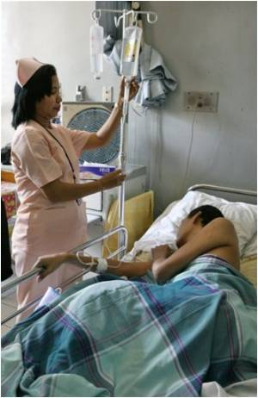
AIDS
Aquired Immune Deficiency
It is caused by the human immunodeficiency
virus.

Slide 49
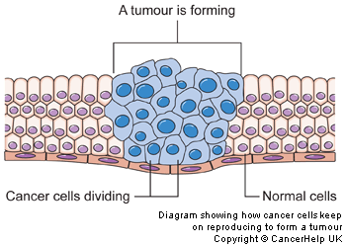
Cancer cells don't stop reproducing
Unlike normal cells, cancer cells do not stop reproducing after they have doubled 50 or 60 times. This means that a cancer cell will go on and on and on doubling. So one cell becomes 2, then 4, then 8, then 16....
Cancer-is a disease in which cells grow at an uncontrolled rate
Cancer cells don't stop reproducing
Unlike normal cells, cancer cells do not stop reproducing after they have doubled 50 or 60 times. This means that a cancer cell will go on and on and on doubling. So one cell becomes 2, then 4, then 8, then 16....

Slide 50
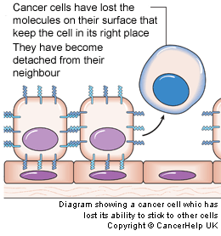
Cancer cells don't stick together
Cancer cells can lose the molecules on their surface that keep normal cells in the right place. So they can become detached from their neighbors.
This partly explains how cancer cells spread to other parts of the body.

Slide 51
More Information of Cancer Cells
Cancer cells don't specialize, but stay immature
Unlike normal cells, cancer cells do not carry on maturing once they have been made. In fact, the cells in a cancer can become even less mature over time. With all the reproducing, it is not surprising that more of the genetic information in the cell can become lost. So the cells become more and more primitive and tend to reproduce more quickly and even more haphazardly. Grade and cancer cells
You may hear your doctor talk about the grade of your cancer. This means how well developed or mature the cells look under a microscope. The more the cancer cells look like a normal cell, the more they will behave like one The more normal a cancer cell looks, the lower its grade
The more abnormal or less well developed a cancer cell is, the higher its grade

Slide 52
Two most common cancers for men: Testes and Prostate Gland
Two most common cancers for women: Breast and Cervix

Slide 53
Infertility
About 15% of married couples have difficulty producing a child.
Many are infertile (unable to have a child).
A woman may not ovulate normally.
A man may not produce enough healthy sperm.
STD can lead to infertility in women.

Slide 54
Fertilization to Embryo
Male deposits sperm into a woman’s
vagina.
A few hundred sperm make it through the uterus into the fallopian tube.
A few sperm cover the egg.
One sperm gets through the outer coating of the egg.
A membrane forms around the egg to keep other sperm from entering.
When the sperm’s nucleus joins with the nucleus of an egg, the egg becomes fertilized.

Slide 55
Look at Figure 1: Implantation
The fertilized egg (zygote) travels down the fallopian tube toward the uterus.
This takes 5 to 6 days.
11 to 12 days after fertilization, the zygote has become a tiny ball of cells called an embryo.
Implantation occurs when the zygote embeds itself in the thick, nutrient-rich lining of the uterus.

Slide 56
From Embryo to Fetus(look at Figure 2 on Page 117)
After implanation:
Placenta begins to grow.
Placenta-a special two-way exchange organ
It has a network of blood vessels that provide the embryo with oxygen and nutrients from the mother’s blood.
Waste produced by the embryo is removed in the placenta. The mother’s blood carries it out, then it is excreted.
Mother’s blood and embryo’s blood do not normally mix.

Slide 57
Weeks 1 and 2
Doctor counts the beginning of a woman’s pregnancy from the 1st day of her last menstrual period.
A normal pregnancy lasts about 280 days or 40 weeks.
Fertilization takes place around the end of week 2.

Slide 58
Weeks 3 and 4
The zygote moves to the uterus.
It divides many times becoming a ball of cells, and implants itself in the wall of the uterus.
Zygote is now an embryo.
Embryo’s blood cells begin to form.

Slide 59
Weeks 5 to 8
The embryo becomes surrounded by a thin membrane called the amnion.
Amnion is filled with amniotic fluid and protects the growing embryo from injury.
During week 5, umbilical cord forms.
Umbilical cord-a cord that connects the embryo to the placenta.
The heart, brain, and other organs begin to form.
At 5-6 weeks, eyes, ears, spinal cord, and buds begin to form.
At 8 weeks, muscles, nerves, fingers, and toes start developing.
The embryo can swallow and blink.
Look at figure 2 on page 117

Slide 60
Week 9 to 16
Begins to make tiny movements
After week 10, the embryo is called a fetus.
It’s face begins to look more human.
More muscles & can start to make a fist
At week 10, it is about 35mm long.
At week 16, it is about 108mm long.

Slide 61
Week 17 to 24
Fetus can make faces
Mother can start feeling movements.
Fetus can hear sounds.
If a fetus was born at 24 weeks, it may survive.
23-30cm in long

Slide 62
Week 25 to 36
At 25 to 26 weeks, the fetus’s lungs are well developed.
It will not take it’s first breath until it is born.
At 32 weeks, it can open and close it’s eyes.
At 36 weeks, the fetus is almost ready to be born.

Slide 63
Birth
37 to 38 weeks-it is fully developed
Full term = 40 weeks
labor-a series of muscular contractions that begin the birthing process.
These push the fetus through the mother’s vagina and out.
The umbilical cord is cut (which is connected to the placenta) and tied.
This will dry up and will leave you with a belly button.
The mother will expel the placenta and the labor is complete.

Slide 64
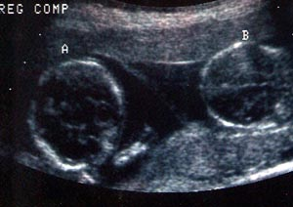
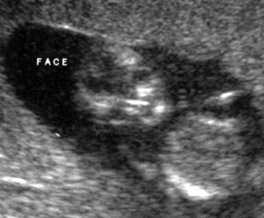
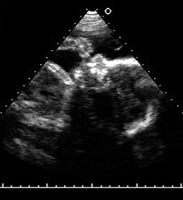
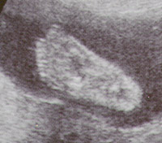
14 Weeks
Thumb Sucker
foot
Ultrasounds

Slide 65
Ultrasounds by week
Fertilization

Slide 66
After Birth
Infancy: birth to age 2
teeth appeared and you became more
coordinated
Childhood: age 2 to puberty
Permanent teeth & muscles became
more coordinated
Adolescence: puberty to adulthood
In boys, occurs between the ages of 11 & 16.
In girls, occurs between the ages of 9 & 14.

Slide 67
Adulthood:
From age 20 to 40 (young adult) peak of physical development
Around age 30: loss of flexibility, deterioration of eyesight, increase body fat, and loss of hair.
40-65 middle age: gray hair, athletic abilities decrease, & skin wrinkles
Over 65 is considered an older adult.

