Slide 1
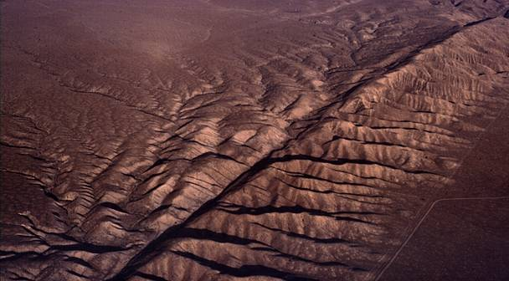
Plate Tectonics
Chapter 4 Section 1 & 2

Slide 2
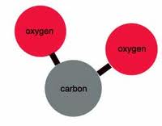
The Earth is divided into layers based on the compounds that make up each layer.
compound-a substance composed of two or more elements
carbon dioxide

Slide 3
I. Inside the Earth
The Earth is made up of 3 layers.
1. Crust: The thin solid
outermost layer of
the earth (less dense).
It is made up of oxygen,
silicon, and aluminum
It makes up less than 1% of Earth’s mass.

Slide 4
2 Types of Crust
Oceanic crust: Thinner and denser than continental crust.
Continental crust: Thicker, but less dense than oceanic crust.
*A plate can contain both oceanic and continental crust.

Slide 5
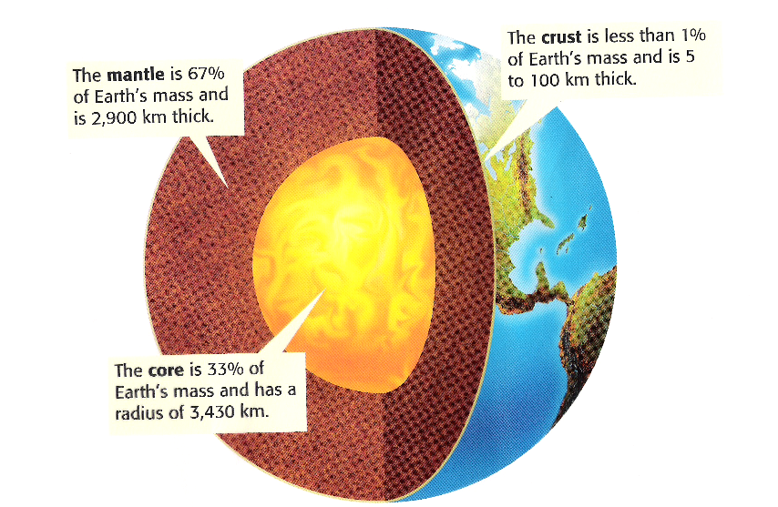
2. The Mantle: The layer of rock between the Earths crust and core (more dense).
It is made up of Magnesium, and less silicon and oxygen than crust.
It makes up 67% of Earth’s mass.

Slide 6
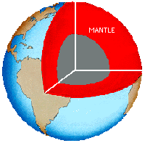
How do we learn about the mantle?
Scientists can study mantle rock that has pushed to the surface.
Scientists can study the ocean floor. Magma flows out of active volcanoes on the ocean floor.

Slide 7
Core: The central part of the Earth below the mantle (densest layer).
It is made mostly of iron.
It makes up 1/3 of Earth’s mass.

Slide 8
Properties of Earth’s 3 Layers
Generally speaking…
Crust: Lowest density, pressure, and temperature.
Mantle: More dense, pressure, and higher temperatures than the crust.
Core: Highest density, pressure, and temperature.
Least
Most

Slide 9
The Physical Structure of the Earth
1. Lithosphere: The solid, outer layer of the Earth that consists of the crust and the rigid upper part of the mantle. It is divided into pieces called tectonic plates.
2. Asthenosphere: The soft layer of the mantle on which the tectonic plates move. It is made of solid rock that moves very slowly.

Slide 10
3. Mesosphere: The lower part of the mantle that extends from the bottom of the asthenosphere to the Earth’s outer core.

Slide 11
4. Outer Core: Liquid layer of the Earths core that surrounds the inner core.
5. Inner Core: Solid, dense center of our planet.

Slide 12
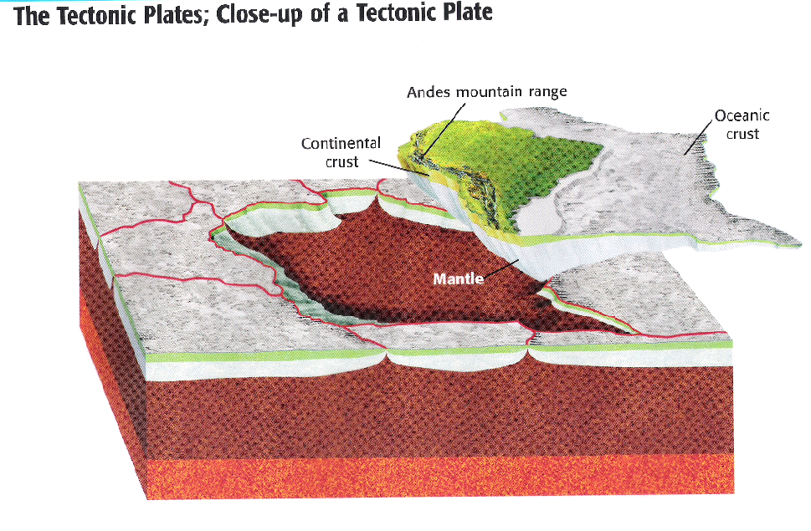
Tectonic Plates: pieces of the lithosphere that move around on top of the asthenosphere

Slide 13
Tectonic Plates
-The surface of the Earth can be compared to a giant jigsaw puzzle.
Holt Online:
Tectonic plates and
Plate Tectonics

Slide 14
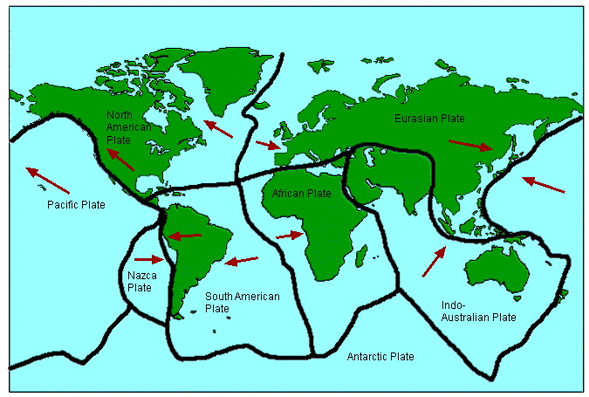

Slide 15
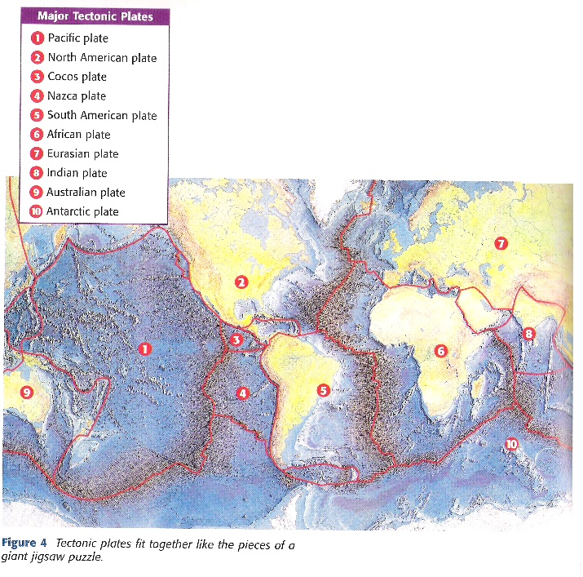
Major Tectonic Plates

Slide 16
Plate Tectonics

Slide 17
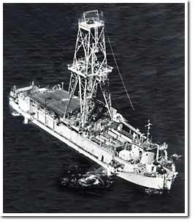
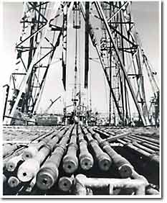
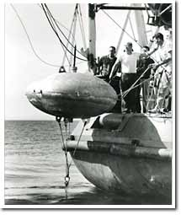
Project Mohole 1958-66
Attempt to drill to the Mohorovicic Discontinuity (Moho) which is the boundary between the crust and mantle.
Deepest the project penetrated was 600 feet.

Slide 18
Mapping the Earth’s Interior
The deepest hole ever drilled has penetrated the Earth’s crust only 12 kilometers (7.5 miles) by Soviet scientists.
If scientists have not even drilled through the Earth’s crust, how do we know so much about the mantle and the core?
Holt online: Seismographs and Mapping the Earths layers

Slide 19
Answer: Earthquakes!
Earthquakes produce vibrations called seismic waves.
Seismic waves travel at different speeds through the earth.
Speed depends on density and composition of material as they pass through.
A seismic wave will travel faster through a solid than a liquid.

Slide 20
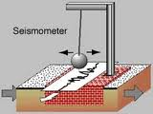
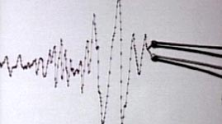
When an Earthquake happens:
machines called seismographs measure the times at which seismic waves arrive at different distances from an earthquake.

Slide 21
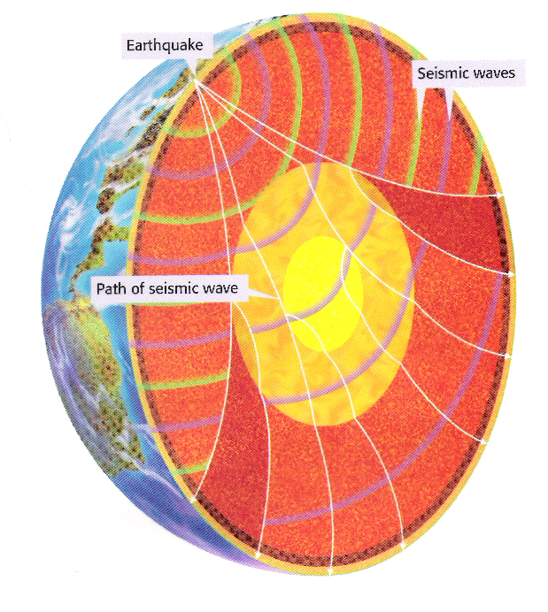
By measuring changes in the speed of seismic waves that travel through Earth’s interior, seismologists have learned that the Earth is made of different layers.
Inside the Earth Video Clips

Slide 24
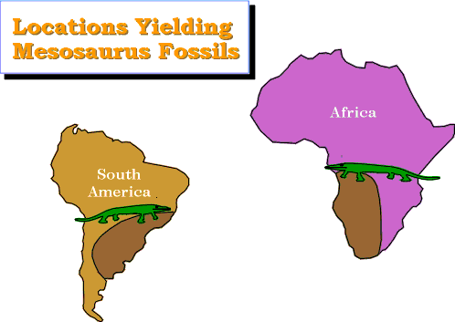
Evidence
Fossils:
1. Mesosaurus fossils had been discovered on east coast of S. America and west coast of Africa.
It was a freshwater
reptile-could not
have swam across
Atlantic Ocean.

Slide 25
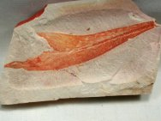
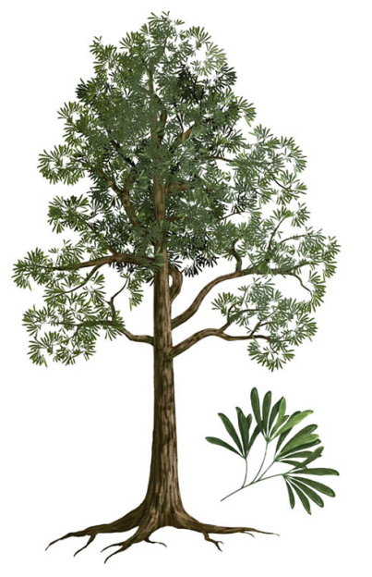
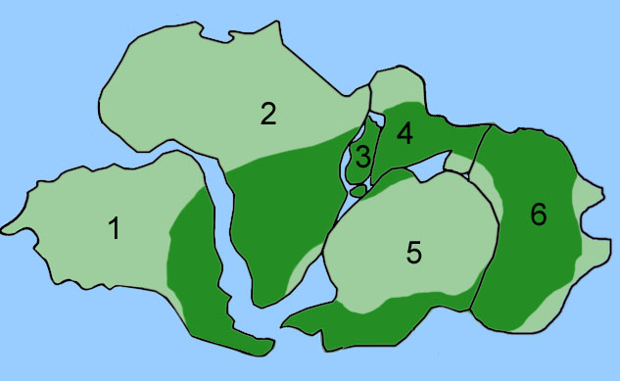
2. Glossopteris (a type of fern)
had been found in Australia,
India, Antarctica, Africa, & South America.
The seed was too big to be carried by the wind and too fragile to survive in the ocean

Slide 26
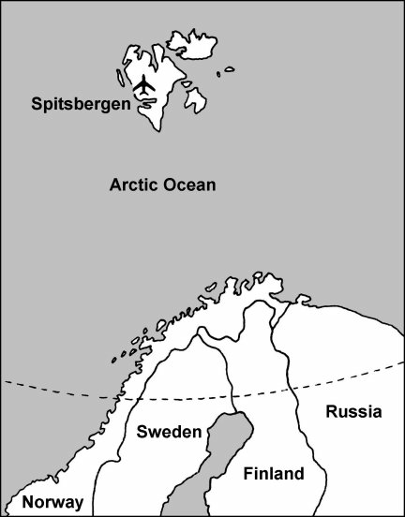
Climate:
1. On island of Spitsbergen in the Arctic Circle, they have found fossils of tropical plants.
The only explanation is
this island was once
in a tropical climate.

Slide 27
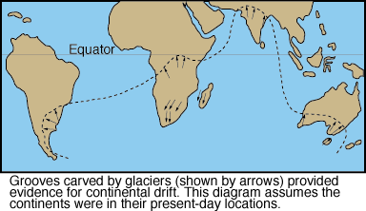
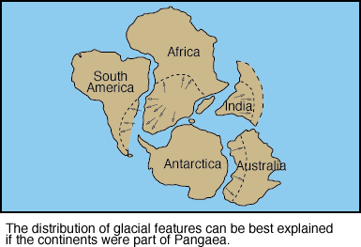
2. South Africa today has a warm climate, and there are rocks there that
were scratched by ice sheets.

Slide 28
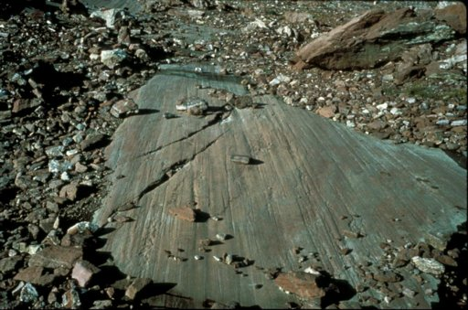
When glaciers move across an area they leave behind evidence of their presence. One sign is glacial striations. The weight of ice (often over a half mile thick) scoured any exposed bedrock creating glacial striations. These striations are small grooves create by the weight of glacier and the movement of ice and rocks embedded in the glacier. The direct of grooves show geologists the direction the glaciers moved.
Glacial striations have been found in locations like South America, Africa, Australia, India, and Antarctica. The striations in these locations all date back to about 200 million years ago. The direction of the striations point to the fact that during this time period these continents and land masses must have all been closer to the South Pole and connected to one another.

Slide 29
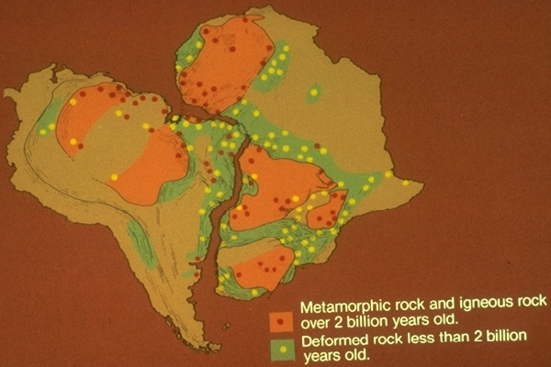
Geology:
1. Rocks found in Brazil match rock in
Western Africa.

Slide 30
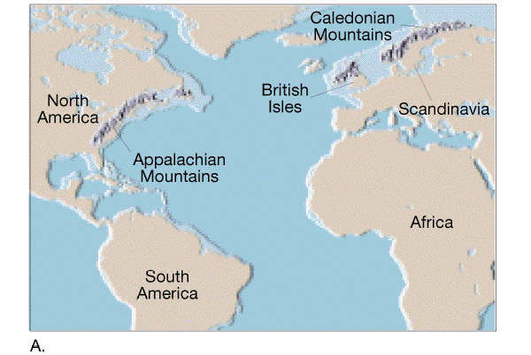
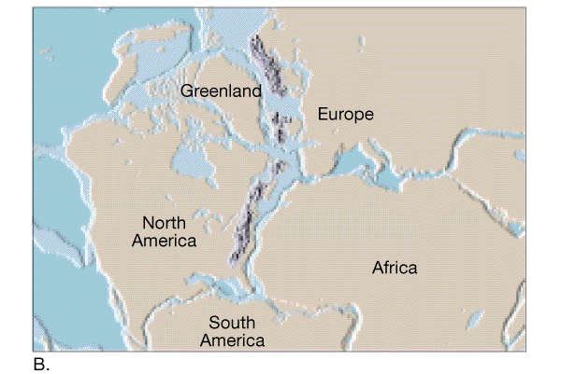
2. Similar age, structure and rock types in Appalachian Mountains and mountains in Scotland and Scandinavia match.

Slide 31
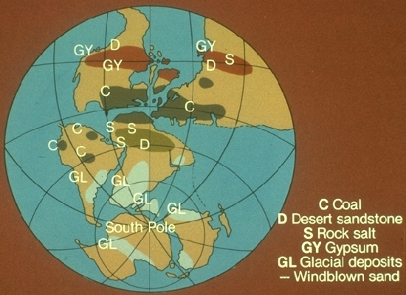
3. Coal deposits in North America
matched coal deposits in Europe.

Slide 32
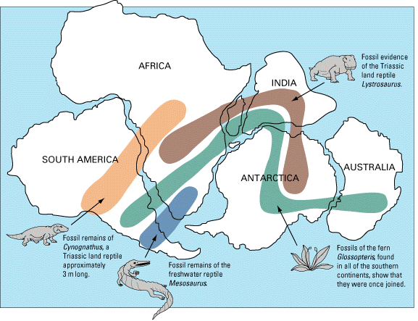

Slide 34
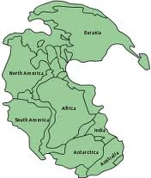
Pangaea

Slide 35
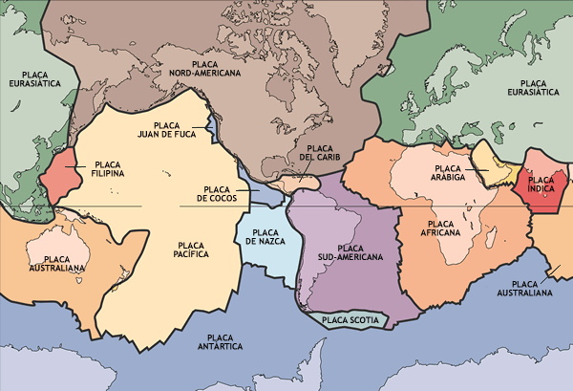

Slide 37
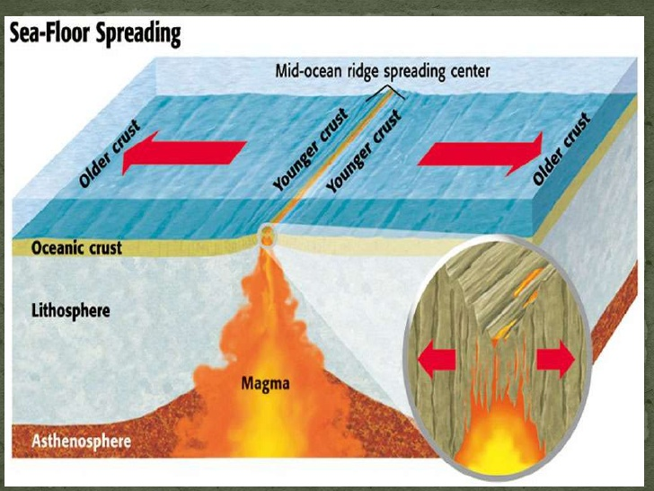

Slide 39
How the continents were formed
Plate Tectonics: A Documentary
Continental Drift Song
Plate Tectonics

