Slide 1
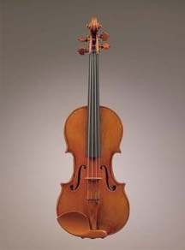
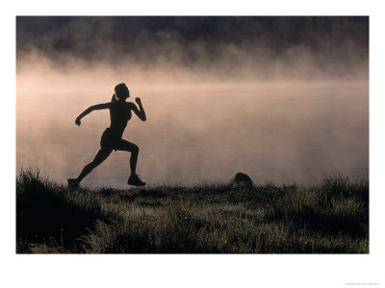
Which of these activities do not involve your nervous system?
*playing a musical instrument
*reading a book
*running
*sleeping

Slide 2
All of the activities involve your nervous system. Your nervous system involves almost everything you do.

Slide 3
Start-up Activity pg. 79
1. Sit in a chair with one arm in a “handshake” position. Your partner should stand facing you, holding a meterstick vertically. The stick should be positioned between your thumb and fingers.
2. Tell your partner to let go of the meterstick without warning you. Catch the stick between your thumb and fingers.
3. How many centimeters did the stick drop before you were able to catch it? This distance represents your reaction time?
4. Repeat for a total of 3 turns for each person. Calculate your average.

Slide 4
http://www.ama-assn.org/ama/pub/physician-resources/patient-education-materials/atlas-of-human-body/nervous-system-basic.shtml

Slide 5
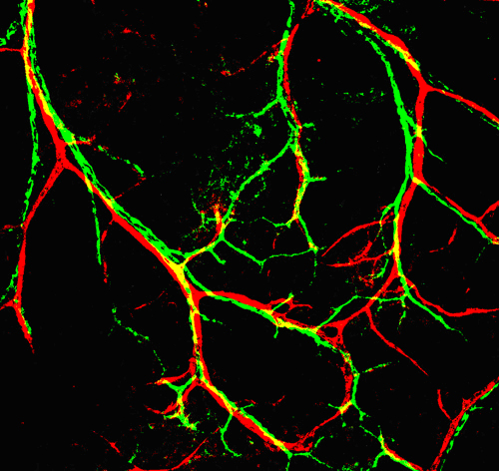
Section 1: Nervous System
2 Parts of the Nervous System
central nervous system (CNS)-it is your brain and spinal cord.
What does it do?
CNS processes and responds to all messages coming from the peripheral nervous system.

Slide 6
peripheral nervous system (PNS)-all the parts of the nervous system except for the brain and the spinal cord.
What does it do?
It connects all parts of the body to the CNS. PNS uses specialized structures called nerves to carry information between your body and your CNS.

Slide 7
Look at figure 1 on page 80
The CNS (orange) acts as the control center for your body. The PNS (in purple) carries information to and from the CNS.

Slide 8
The Peripheral Nervous System
neuron-a nerve cell that is specialized to transfer messages in the form of fast-moving electrical energy. (electrical messages are called impulses)

Slide 9
Neuron Structure
Cell body-large region in the center (has a nucleus and cell organelles)
Dendrites-branched extensions of the cell. Neurons receive information from other cells through their dendrites.
A neuron can have many dendrites. This allows it to receive impulses from thousands of other cells.

Slide 10
axons-carry impulses away from the cell. They can extend from your lower back to your toes. They vary in length.
axon terminal- the tip of each branch

Slide 11
Neuron

Slide 12
Group Activity
Form a circle
Your left hand is the dendrite
Your body is the cell body.
Your right arm is the axon.
Your right hand is the axon terminal.
Call out parts as it passes you: axon terminal, dendrite, cell body, axon. . .
Making a neuron

Slide 13
Neuron Activity
Left hand=dendrite
Body=cell body
Right arm=axon
Right hand=axon terminal

Slide 14
Building a Neuron
http://faculty.washington.edu/chudler/chmodel.html

Slide 15
Sensory neurons
Receptors
Some neurons are sensory neurons. They gather information about what is happening in and around your body.
Sensory neurons have specialized nerve endings called receptors.

Slide 16
Motor Neurons
Neurons that send impulses from the brain and the spinal cord to other systems
Response from muscles=contraction
For example, squinting when you are in bright light.
Motor neurons also send messages to your
glands(like sweat) to tell sweat glands to start or
stop making sweat.

Slide 17
Worm: Nervous System
http://www.iit.edu/~smile/cb0298.htm

Slide 18
Nerves
It is a collection of axons bundled together with blood vessels and connective tissue.
CNS is connected to the rest of your body by nerves.
Look at figure 3 on page 82
It shows the structure of a nerve.

Slide 19
Peripheral Nervous System
It connects your CNS to the rest of your body.
It has 2 main parts:
Sensory (collect information from your senses and send it back to the CNS)
Motor (carry out the CNS responses to the sensory information)

Slide 20
Motor
2 Parts
Somatic Nervous System
These neurons are under your conscious control.
They control voluntary movements like writing, talking, smiling, or jumping (skeletal movements).
Autonomic Nervous System
It controls body functions that you do not think about like heart rate and digestion.
It’s main job is to keep all the body’s functions in balance.

Slide 21
PNS: Motor neurons
2 kinds of nerves:
Sympathetic Nervous System & Parasympathetic
Nervous System
These 2 work together to keep your internal environment stable. This stability or balance is called homeostasis.

Slide 22
Nerve Block
Sometimes it is not possible to inject anesthetic into a part of the body that needs to be anesthetized. In these cases, a nerve block is performed. In this procedure, anesthetic is injected into or around a nerve that serves the body part that needs to be anesthetized.
Group Activity ? Page 83

Slide 23
Central Nervous System
It receives information from sensory neurons.
It responds by sending messages to the body through motor neurons.

Slide 24
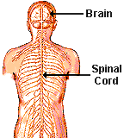
The CNS
The Control Center
The largest organ in the nervous system is the
brain.
brain-is the main control center of the nervous
system.
involuntary-processes that happen
automatically without your control.
voluntary-processes that are controlled by your
brain

Slide 25
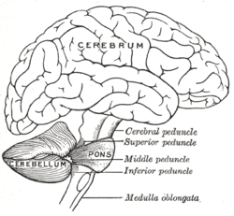
Cerebrum
It is the largest part of your brain.
It is where you think and where memories are stored.
It controls your voluntary movements and your sense of touch.
It has two ½’s called hemispheres.
They are:
Left side controls the right side of the body
It controls activities like speaking, reading, writing, and solving
problems.
Right side controls the left side of the body
It controls activities like spatial thinking, processing music, and interpreting emotions.

Slide 26
Cerebellum
It is the second largest part of your brain.
It is under the back part of the cerebrum.
It sends impulses to skeletal muscles and joints to help keep your body balanced.

Slide 27
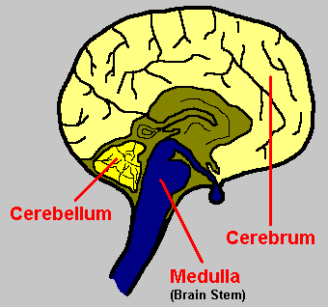
Medulla
It is the part of the brain that connects to your spinal cord.
You cannot live without it.
It is about 3 cm long.
It controls involuntary processes like:
blood pressure
body temperature
heart rate
involuntary breathing
Look at page 85 Figure 6

Slide 28
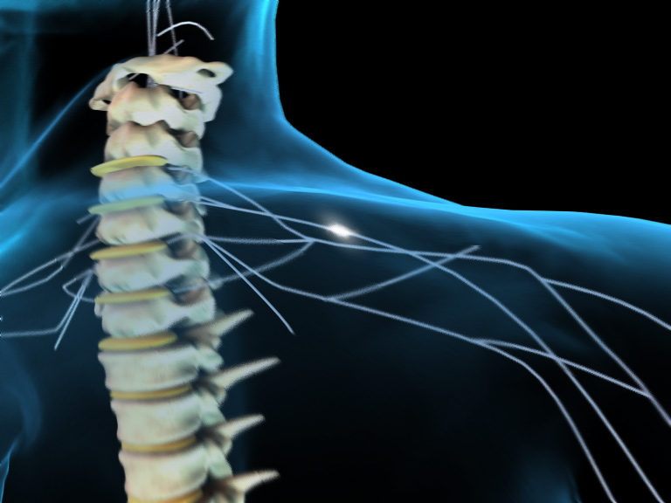
Spinal Cord
It is about as big around as your thumb.
It is made of neurons and bundles of axons that pass impulses to and from the brain.
Theses nerve fibers allow your brain to communicate with your peripheral nervous system.
The spinal cord is surrounded by protective bones called vertebrae.

Slide 29
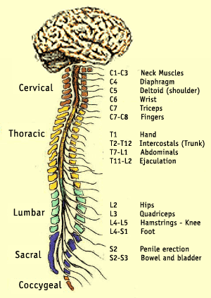
Spinal Cord Injury
It can block all information to and from the brain.
Sensory information coming from below the injury may not be able to get to the brain.
Motor commands may not be able to reach the injured area making this person paralyzed.

Slide 30
http://www.nlm.nih.gov/medlineplus/tutorials/spinalcordinjury/htm/_no_50_no_0.htm

Slide 31
Section 2: Responding to the Environment
sensation-impulses that travel to the brain and create an awareness
Skin has different kinds of receptors that respond to one kind of stimulus. For example,
thermoreceptors-respond to temperature change

Slide 32
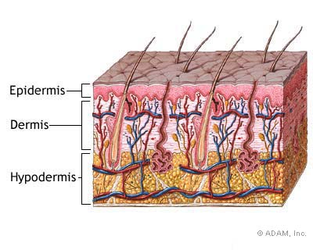
Integumentary System
It protects the body from damage and includes:
hair, skin, and nails

Slide 33
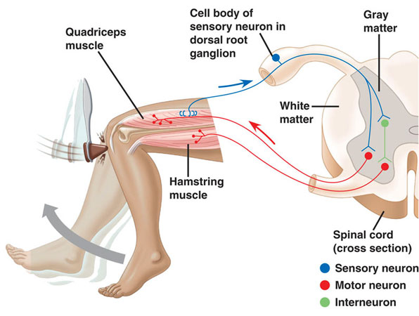
Reflex
An immediate, involuntary action
Pain receptors send impulses to your spinal cord . Your brain doesn’t tell your leg to move that would take longer.

Slide 34
Feedback Mechanism
It is a cycle of events in which information from one step controls or affects a previous step.
For example,
Heat receptors on a hot day detect an increase in body temperature. The receptors send impulses to the brain. Your brain responds by sending messages to your sweat glands to make sweat. As sweat evaporates it cools your body. Then your brain tells the blood vessels in your skin to dilate (open wider). Blood flow increases cooling the body. The brain sends a message to your sweat glands and blood vessels to reduce their activity.

Slide 35
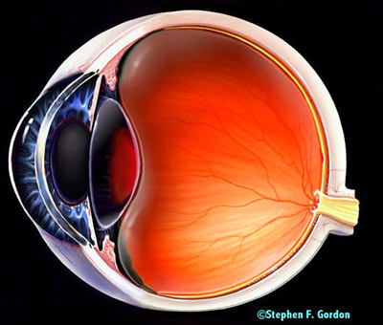
Sense of Light
Cornea-a clear membrane that covers the front of the eye. It protects the eye, but allows light to enter.
Pupil-An opening that light from an object enters at the front of your eye. The light then travels through the lens to the back of the eye.
It looks like a black dot in the center of your eye, but it is the opening that lets light enter the eye.
Retina-at the back of the eye, the light strikes this layer of light-sensitive cells. It is packed with photoreceptors.

Slide 36
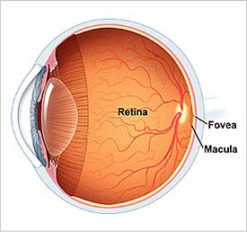
Photoreceptors
They are a special neuron that changes light into electrical impulses. The retina has 2 kinds of photoreceptor:
Rods-are very sensitive to dim light. They are important for night vision.
Their impulses are interpreted as black and white images.
Cones-are very sensitive to bright light. Impulses from cones allow you to see fine details and colors.
Impulses from rods and cones travel along axons. The order:
1. The impulses leave the back of each eye through an optic nerve.
2. The optic nerve carries the impulses to your brain.
3. At the brain, the impulses are interpreted as the images that you see.

Slide 37
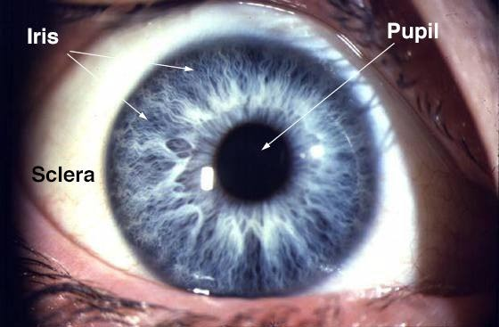
Iris
It surround the pupil.
It is a ring muscle.
It controls the amount of light that enters the eye and gives the eye its color.
In bright light, the iris contracts, making the iris smaller.
A smaller pupil reduces the amount of light entering the eye and passing to the retina.
In dim light, the iris opens the pupil and lets in more light.

Slide 38
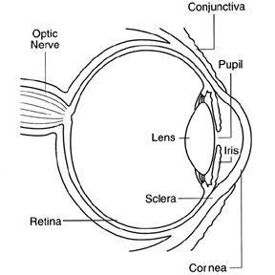
Lens
It is an oval-shaped piece of clear, curved material behind the iris.
Light travels in straight lines until it passes through the cornea and the lens.
Muscles in the eye change the shape of the lens in order to focus light onto the retina.
When you:
Look at object close to the eye, the lens becomes more curved.
Look at object farther away from the eye, the lens gets flatter.

Slide 39
Diagram of the Eye
http://www.nei.nih.gov/health/eyediagram/

Slide 40
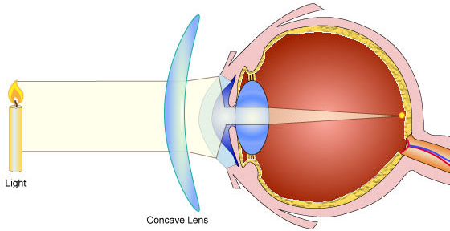
Common Vision Problems
The focal point has to be at the retina.
If focal point is before, then you will be nearsighted.
If focal point is behind the retina, then it will result in farsightedness.
Quick Lab (page 91)

Slide 41
http://library.thinkquest.org/J002330/visionsim.htm
http://library.thinkquest.org/J002330/stereograms.htm
http://library.thinkquest.org/J002330/opill.htm

Slide 42
http://www.exploratorium.edu/learning_studio/cow_eye/coweye.pdf
http://faculty.washington.edu/chudler/chvision.html

Slide 43
http://www.exploratorium.edu/learning_studio/cow_eye/step01.html
http://www.exploratorium.edu/science_explorer/pictures_from_light.html

Slide 44
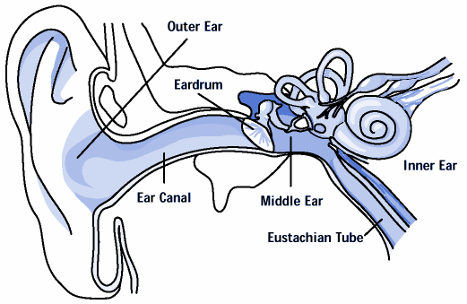
Each ear has an outer, middle, and inner portion.

Slide 45
Sense of Hearing
How hearing works:
1. Sound waves reaching the outer ear are funneled into the
middle ear.
2. The waves make the eardrum vibrate (middle ear).
eardrum is a thin membrane separating the
outer ear from the middle ear.
3. The vibrating eardrum makes tiny bones in the middle ear
vibrate.

Slide 46
4. One of these bones vibrates against the cochlea.
cochlea-a fluid-filled organ of the inner ear
5. Inside the cochlea, vibrations make waves.
6. Neurons in the cochlea, change the waves into
electrical impulses.
7. These impulses travel along the auditory nerve to the
area of the brain that interprets sound.

Slide 47
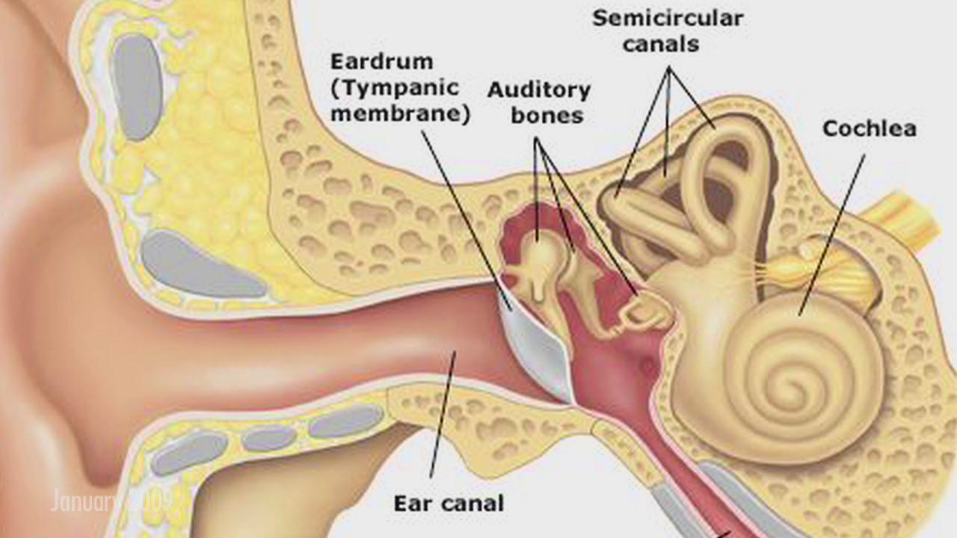

Slide 48
http://www.childrensuniversity.manchester.ac.uk/interactives/interactive_fs.asp?swfpath=science/brainandsenses/ear.swf
The human ear

Slide 49
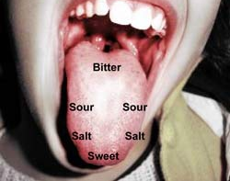
Taste
It is the sense that allows you to detect chemicals and distinguish flavors.
Papillae-tiny bumps that cover your tongue
Most papillae contain taste buds (detect dissolved molecules).
Taste buds contain clusters of taste cells.
Taste cells react to 4 basic tastes: sweetness
sourness
saltiness
bitterness

Slide 50
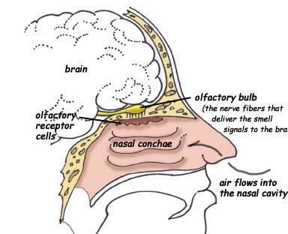
Sense of Smell
olfactory cells-receptors for smell are located here in the upper part of the nasal cavity
These are nerve cells that respond to chemical molecules in the air.
Molecules dissolved in the moist lining of the nasal cavity. This triggers an impulse(odor) to the brain.

Slide 51
The Endocrine System
It controls body functions by using chemicals that are made by the endocrine glands.
epinephrine-one of the body’s chemicals messenger made by the endocrine system.
gland-is a group of cells that make special chemicals for your body.
hormone-is a chemical messenger (made by the endocrine glands) made in one cell or tissue that causes a change in another cell or tissue in another part of the body.

Slide 52
Hormones flow through the bloodstream to all parts of the body. For example, an endocrine gland near your brain can control an organ somewhere else in your body.
Look at figure 1 on page 94

Slide 53
Flight or Fight Response
Adrenal glands release the hormone epinephrine
(also called adrenaline)
Epinephrine increases your heartbeat and breathing rate.
This response prepares you to fight the danger or run from it.

Slide 54
Types of endocrine glands
1. Pituitary gland-
stimulates skeletal growth and helps the thyroid gland work correctly
Regulates the amount of water in the blood
It also activates the birthing process
Thyroid hormones-
It is important during infancy.
It controls the secretion of growth hormones for normal body growth.
Controls the development of the CNS.
Controls your metabolism

Slide 55
metabolism-a sum of all the chemical processes that take place in your body.
Thymus gland-
Regulates the immune system to help fight disease.
Pancreas-
Regulates blood glucose levels

Slide 56
Pancreas (a feedback mechanism)
The pancreas lies beneath the stomach and is connected to the small intestine at the duodenum. It has specialized cells that make two different hormones:
insulin and glucagon
They control the level of the glucose in the blood.
Insulin lowers blood-glucose levels by telling the liver to convert glucose into glycogen and to store it for future use.
Glucagon has the opposite effect. It tells the liver to convert glycogen into glucose and to release glucose into the blood.

Slide 57
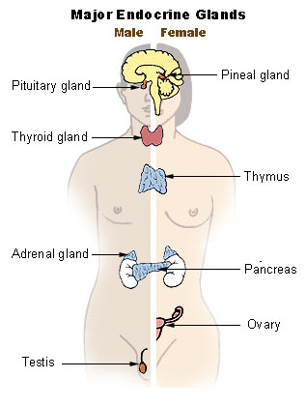

Slide 58
What happens if it does not work properly?
Glucagon slowly increases the blood sugar level. If the insulin secreting cells do not work properly, diabetes occurs.
Look at figure 3 on page 96

Slide 59
A person whose body does not use insulin properly or whose pancreas does not make enough insulin has a condition called diabetes mellitus.
They may need daily injections of insulin to keep his or her blood glucose levels within safe limits.

Slide 60
http://www.nlm.nih.gov/medlineplus/tutorials/diabetesintroduction/htm/_no_50_no_0.htm
http://web.diabetes.org/link/link_for_life/main.html

Slide 61
Hormone Imbalances
When a child’s pituitary gland does not make enough growth hormone,
the child’s growth is stunted
If detected early, a doctor can prescribe growth hormone and monitor the child’s growth.
If pituitary gland makes too much hormone, the child may grow taller than expected.

