Slide 1
Genes & DNA
We learned last chapter that genes are part of chromosomes (structures in the nucleus).
Chromosomes are made of protein and DNA.
DNA (deoxyribonucleic acid)- the genetic material that determines inherited characteristics.

Slide 2
What did Scientists Know about the Material in Genes?
It must be able to give instructions for building
and maintaining cells.
It must be able to be copied each time a cell divides
so that each cell has identical genes.

Slide 3
What is DNA made of?
It is made of subunits called nucleotides.
nucleotide-consists of a sugar, a phosphate, and a base.
The nucleotides are identical except for the base.
There are 4 bases (each one has a different shape):
Adenine (A)
Thymine (T)
Guanine (G)
Cytosine (C)
Look at figure 1 on page 86

Slide 4
http://learn.genetics.utah.edu/content/begin/dna/

Slide 5
1950 Chargaff’s Rules
Erwin Chargaff found that in DNA the amount:
adenine equals the amount of thymine
guanine equals the amount of cytosine
This is known as Chargaff’s Rules.

Slide 6
Rosalind Franklin
She made images of DNA molecules using a process called x-ray diffraction.
How did it work? X-rays are aimed at the DNA molecule. The x-ray hits part of the molecule and bounces off. She captured it on film, and suggested it had a spiral shape.

Slide 7
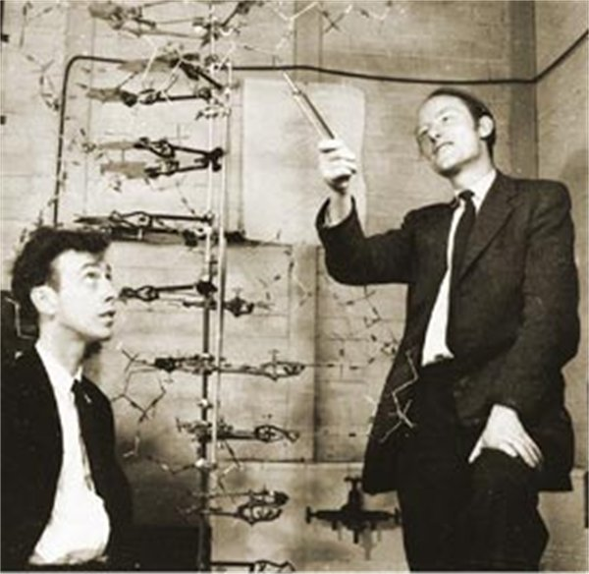
Watson and Crick’s Model
After seeing Franklin’s images, they concluded that DNA looked like a long twisted ladder.
They built a model of DNA, which helped explain how DNA is copied and how it functions in the cell.

Slide 8
Timeline
http://www.learner.org/interactives/dna/history.html

Slide 9
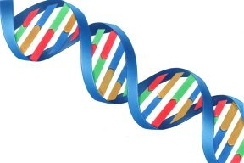
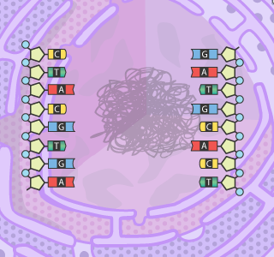
What DNA Looks Like
Double Helix-it looks like a twisted ladder. The two sides to the ladder
are made of alternating sugar and phosphate parts. The rungs of the
ladder are made of a pair of bases.

Slide 10
Structure of DNA

Slide 11
Making Copies of DNA
The pairing of bases allows the cell to replicate.
Each base allows bonds with only one other base.
Pairs of bases are complimentary to each other, for example:
The sequence CGAC will bond with the sequence GTCG.

Slide 12
Building DNA

Slide 13
How Copies are Made
During replication, a DNA molecule is split down the middle (where the bases meet).
The bases on each side of the molecules are used as a pattern for a new strand.
Complimentary nucleotides are added to each side.
Half of each of the DNA molecule is old, and the other ½ is new.

Slide 14
When Copies are Made
DNA is copied every time a cell divides.
Each new cell gets a complete copy of all the DNA.
The job of unwinding, copying, and re-winding the DNA is done by proteins within the cell.

Slide 15
Using Base Pair Rules Write the complimentary base sequence of:
AACTACCGT

Slide 16
AACTACGGT
TTGATGCCA

Slide 17
Section 2: How DNA Works
It is found is all organisms. Most cells in your body contain 1.5 m of DNA.
If a cell lacks a nucleus, the DNA forms a loose loop within the cell.
In a cell that has a nucleus, the DNA and proteins are bundled into chromosomes.
The order of the bases on one side of the molecule is a code that carries information.
Gene-consists of a string of nucleotides that give the cell information about how to make a specific trait.

Slide 18
There is so much DNA, so there are a variety of genes.
Humans have at least 30,000 genes.
Look at page 90-91 figure 1

Slide 19
DNA Game

Slide 20
Genes and Proteins
Groups of three bases are the codes for specific amino acids.
For example, CCA is the code for the amino acid
proline,
and AGC is the code for the amino acid
serine.
A long string of amino acids form a protein.
Each gene is usually a set of instructions that makes a protein.

Slide 21
Proteins
They are found throughout cells and cause most of the differences that you can see among organisms.
For example, how tall you grow and whether your hair is curly or straight.
A single organism has thousands of genes that code for thousands of proteins.

Slide 22
RNA (ribonucleic acid)
It is a type of molecule that helps make proteins.
It is so similar to DNA that it can serve as a temporary copy of DNA.
It helps in the process of changing the DNA code into proteins.
Look at age 92 figure 2

Slide 23
DNA Virtual Lab

Slide 24
DNA/RNA
Cheek Cell DNA Extraction

Slide 25
http://www.gov.mb.ca/conservation/sustain/dnadone.pdf
http://library.thinkquest.org/19037/making_a_candy_model.html
http://www.explorelearning.com/

Slide 26
mRNA (messenger)-copy of DNA segment
Ribosome-a cell organelle composed of RNA and protein
tRNA (transfer)-picks up a specific amino acid from the cytoplasm, and match up with bases from the mRNA

Slide 27
Making of a Protein
Steps:
1. Copy one side of the segment of DNA containing a gene.
A mirrorlike copy of the DNA segment is made out of
mRNA(messenger RNA) It moves out of the nucleus and into the cytoplasm.
Each group of 3 bases on the mRNA segment codes for one amino acid.
The mRNA segment is fed through the ribosome.

Slide 28
5. The molecules of transfer RNA (tRNA) deliver
amino acids from the cytoplasm to the ribosome.
The amino acids are dropped off at the ribosome.
The amino acids are joined to make a protein. One protein is produced for each gene.

Slide 29
Making DNA and Protein Synthesis

Slide 30
Mutations-
Changes in the number, type, or order of bases on a
piece of DNA
deletion-when a base is left out
insertion-when an extra base is added
substitution-the wrong base is used

Slide 31
Do Mutations Matter?
Possible consequences:
Improved trait
No change
Harmful trait
When an error is found, it is usually fixed. If it is not,
Then the mistakes become part of the genetic message.
If it occurs in sex cells, the changed gene can be passed
on to the next generation.

Slide 32
How do mutations happen?
Random errors when DNA is copied
Damage to DNA
A physical or chemical agent
mutagen –a physical or chemical agent that can cause a mutation
Examples are x-rays, high radiation, ultraviolet radiation,
asbestos, and chemicals in cigarette smoke.

Slide 33
An Example of Substitution
It can be harmful because it may cause a gene to produce the wrong protein.
A simple change in an amino acid can cause the disease sickle cell anemia. It affects red blood cells.
Look at page 95 figure 4 to see the result in the substitution.

Slide 34
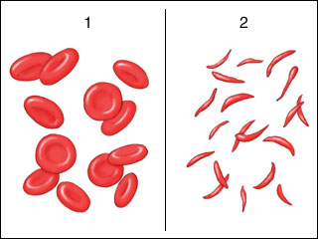
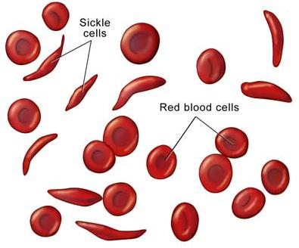
Sickle Cell Anemia
Normal Cells Sickle Cells

Slide 35
Genetic Knowledge
Can cause ethical and scientific debates
Genetic Engineering-scientists manipulate individual genes within organisms.
Look at figure 5
Can use it to create new products like drugs, foods, or fabrics.
Cows may be used to produce human proteins.

Slide 36
Can Genetic Engineering be Dangerous?
Some scientists worry about the dangers of creating genetically engineered organisms.

Slide 37
Genetic Identification
DNA fingerprinting-identifies the unique patterns in an individual’s DNA
It can be used as evidence in crimes.
It can be used to identify hereditary diseases and family relations.
Identical twins have identical DNA.
clone-a new organism that has an exact copy of another organism’s genes.

Slide 38
DNA Fingerprinting Lab
How cloning works

Slide 39
http://www.guardian.co.uk/gall/0,8542,627251,00.html
http://www.businesspundit.com/20-animals-that-have-been-cloned/

Slide 40
DNA video

