Slide 1
Excretion
It is the process of removing waste products from the body.
Three of your systems remove waste products from your body:
Integumentary system releases waste products and water when you sweat.
Respiratory system releases carbon dioxide and water when you exhale.
Urinary system contains organs that remove waste products from your blood.

Slide 2
Urinary System
It contains the organs that remove waste products from your blood.
Your body produces the waste products of carbon dioxide and ammonia. The urinary system removes these waste from your blood.

Slide 3
Kidneys
A pair of organs that constantly clean the blood.
Your kidneys filter about 2,000 L of blood each day.
nephrons-are microscopic filters in the kidney that remove wastes from the blood. Each kidney has more than 1 million nephrons.
urea, which contains nitrogen, is one of the most important waste it removes . Nitrogen forms when cells use proteins for energy.

Slide 4
How Kidneys Filter the Blood
Look at page 67 for the process

Slide 5
How does your Body keep the water levels in balance?
The balance of fluids is controlled by chemical messengers in the body called hormones.

Slide 6
Antidiuretic Hormone (ADH)
ADH signals the kidneys to take water from the nephrons .
The nephrons return the water to the bloodstream, so the kidneys make less urine.
If your blood has too much water, then smaller amounts of ADH are released, so more water stays in the nephrons to leave as urine.

Slide 7
Diuretic
These cause the kidneys to make more urine, which decreases the amount of water in the blood.
Caffeine is a diuretic. It increases fluid loss.
Your body uses less of the water from a caffeinated soda than from a glass of water.

Slide 8
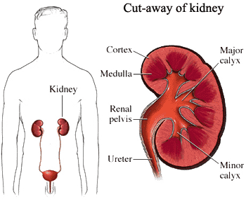

Slide 9
Urinary System Problems
Bacterial Infections: Bacteria gets in to the bladder and ureters through the urethra. Infections can cause permanent damage to the nephrons.
Kidney Stones: Salts and other wastes collect inside the kidneys and form kidney stones like the one on page 69. They can block urine flow, but most kidney stone pass naturally .
Kidney Disease: Damage to the nephrons can prevent normal kidney functioning. If this happens, a kidney machine can be used to filter waste from the blood.

Slide 10
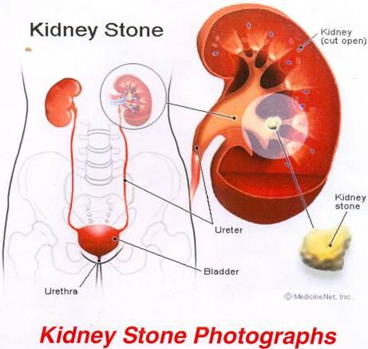
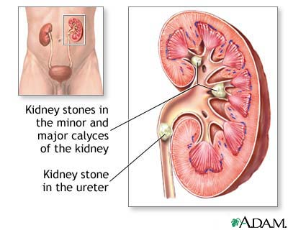
Kidney Stones

Slide 11
Kidney & Dialysis Sites
http://www.davita.com/kidney_animation/#intro
http://davita.feedroom.com/
http://davita.feedroom.com/?fr_chl=f10cf51f54d19d75ae4b8e83b48313d5f2519556&rf=bm

