Slide 1
Digestive System
A group of organs that work together to digest food so that it can be used by the body

Slide 2
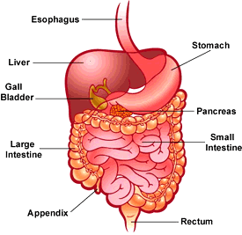
http://www.open2.net/everwonderedfood/interactives/digestive_system.swf

Slide 3
Digestive Tract
Includes your mouth, pharynx, esophagus, stomach, small intestines, large intestines, rectum, and anus.
It can be more than 9 meters long.
The liver, gallbladder, pancreas, and salivary glands are part of the digestive system, but food does not pass through these organs.

Slide 4
Two types of Digestion:
Mechanical Digestion-the breaking, crushing, and mashing of food
Chemical Digestion-large molecules are broken down into nutrients
Nutrients-substances in food that the body needs for normal growth, maintenance, and repair.

Slide 5
Major Types of Nutrients
1. Carbohydrates
2. Proteins-too large to be absorbed into the bloodstream, so enzymes cut up the chain of amino acids.
-amino acids-smaller chains of proteins that can pass
through the bloodstream
-enzymes-break the nutrients into smaller pieces so for the
body to use
3. Fats

Slide 6
Labeling the Digestive System
http://members.enchantedlearning.com/subjects/anatomy/digestive/labeleasy/index.shtml?p

Slide 7
Digestive System
http://www.medtropolis.com/VBody.asp

Slide 8
Digestion Begins with the Mouth
Teeth are important organs for mechanical
digestion.
enamel-the outermost layer of a tooth. It is the
hardest material in the body.
Chewing is important because:
It creates small, slippery pieces of food that are easier to swallow than big, dry pieces.
Small pieces of food are easier to digest

Slide 9
2. Saliva –food mixes with this as you chew. It contains an enzyme that begins the chemical digestion of carbohydrates.
Why is the enzyme important?
It changes complex carbohydrates into simple sugars.

Slide 10
esophagus-once the food is soft mush, the tongue pushes it into the throat, which leads to a long, straight tube, the esophagus.
The esophagus squeezes the mass of food with muscle contractions called peristalsis.
This forces the food into the stomach.

Slide 11
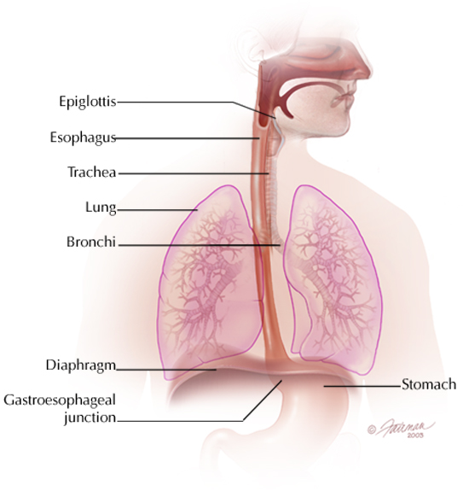

Slide 12
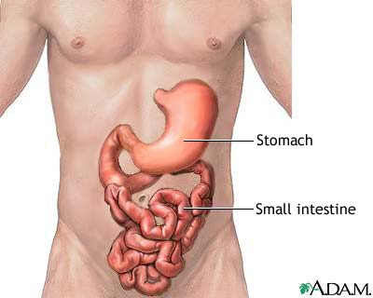
Stomach
It is a muscular, saclike, digestive organ attached to the lower end of the esophagus.
It squeezes the food with muscular contractions (mechanical digestion)
Enzymes and acids break food down into nutrients.
Chemical and mechanical digestion of the stomach produces chyme.

Slide 13
Leaving the Stomach
A ring of muscle that acts like a valve keeps food in the stomach until the food has been mixed thoroughly with digestive fluids.
The stomach slowly releases chyme into the small intestines through the valve.
The small intestines mixes fluid from liver and pancreas.

Slide 14
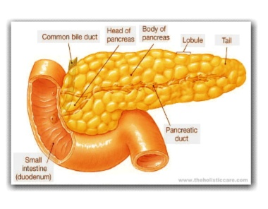
Pancreas
Pancreas-an oval organ located between the stomach and the small intestine.
When chyme leaves the stomach, it is very acidic. The pancreas makes fluid that protects the small intestines from the acid.
The fluid contains enzymes that chemically digest
chyme, neutralizing acid.
It also makes hormones that regulate blood sugar.
Most chemical digestion takes place after the food leaves the stomach.

Slide 16
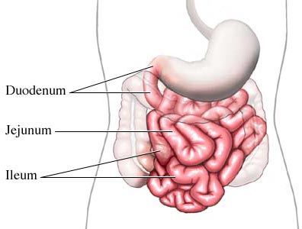
Small Intestines
It is a muscular tube that is about 2.5 cm in diameter and about 6 meters long.
The inside wall of the small intestine is covered with fingerlike projections called
villi.
Villi are covered with tiny nutrient absorbing cells. Once absorbed, the nutrients enter the bloodstream.

Slide 17
Liver
A large, reddish brown organ that helps with digestion.
Where is it located?
Your right side, slightly higher than your stomach
What does it do?
It makes bile to break up fat.
It stores nutrients.
It breaks down toxins.

Slide 18
Storing Nutrients
Nutrients that are not needed are stored in the liver.
The liver releases the nutrients into the body as needed.
The liver also captures and detoxifies many chemicals like alcohol and other drugs.

Slide 19
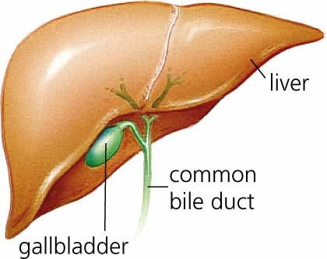
Gallbladder
This is where bile from
the liver is temporarily
stored.
It is a small saclike
organ.
Bile is squeezed from
the gallbladder into the
small intestines to break
down large fat droplets.

Slide 20
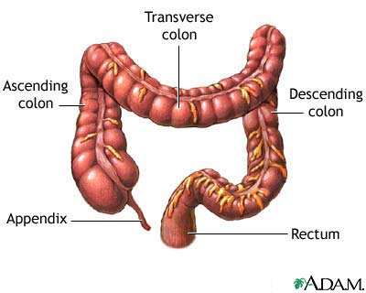
Large Intestines
It is the organ of the digestive system that stores, compacts, and eliminates indigestible material from the body.
Has a larger diameter than the small intestines, but is shorter in length.
It is about 1.5 meters long.

Slide 21
Moving through the Large Intestines
The large intestines absorbs most of the water in the mixture, and changes the liquid into a semi-solid waste material called feces or stool.
Whole grains, fruits, and vegetables contain a carbohydrate called cellulose. Humans cannot digest it.
This material is referred to as fiber and it keeps the stool soft and the material moving through the large intestines.

Slide 22
Leaving the Body
The rectum is the last part of the large intestine.
It stores feces until they can be expelled.
The feces pass to the outside of the body through an opening called the anus.

