Slide 1
Latitude
Chapter 13
Section 1 Climate and Climate Change
Latitude is the distance north or south from the equator and is expressed in degrees.
The equator is located at 0° latitude.The most northerly latitude is the North Pole, at 90° north, whereas the most southerly latitude is the South Pole, at 90° south.
Latitude strongly affects climate because the amount of solar energy an area of the Earth receives depends on its latitude.

Slide 2
Climate
Chapter 13
Section 1 Climate and Climate Change
Climate is the average weather conditions in an area over a long period of time.
Climate is determined by a variety of factors that include latitude, atmospheric circulation patterns, oceanic circulation patterns, the local geography of an area, solar activity, and volcanic activity.
The most important of these factors is distance from the equator.

Slide 3
Low Latitudes
Chapter 13
Section 1 Climate and Climate Change
More solar energy falls on areas near the equator than on areas closer to the poles.
The incoming solar energy is concentrated on a small surface at the equator.
In regions near the equator, night and day are both about 12 hours long throughout the year.
In addition, temperatures are high year-round, and there are no summers or winters.

Slide 4
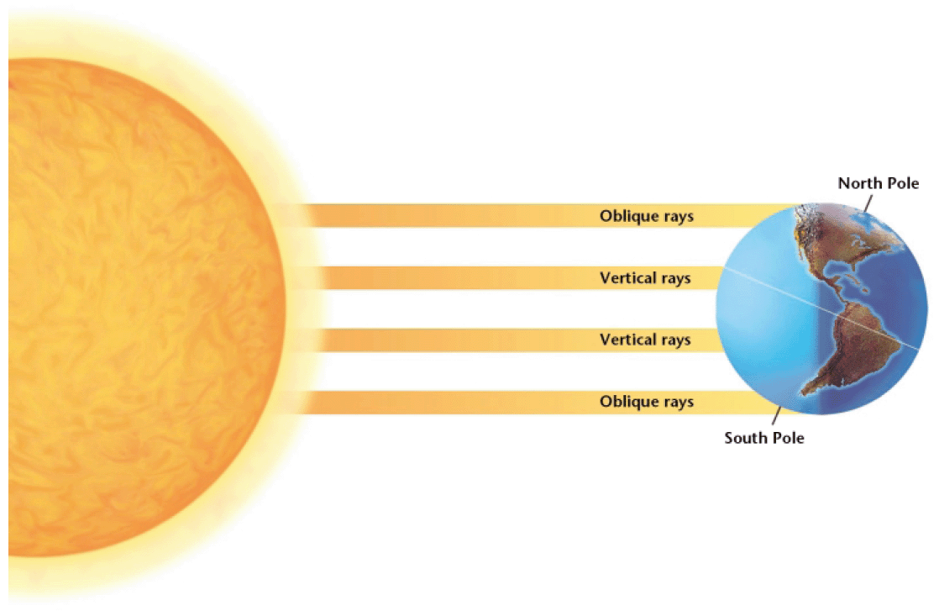
High Latitudes
Chapter 13
Section 1 Climate and Climate Change
In regions closer the poles, the sun is lower in the sky, reducing the amount of energy arriving at the surface, causing lower average temperatures.
At 45° north and south latitude, there is up to16 hours of daylight during the summer and as little as 8 hours of sunlight in the winter.
Near the poles, the sun sets for only a few hours during the summer and rises for only a few hours during the winter.

Slide 5
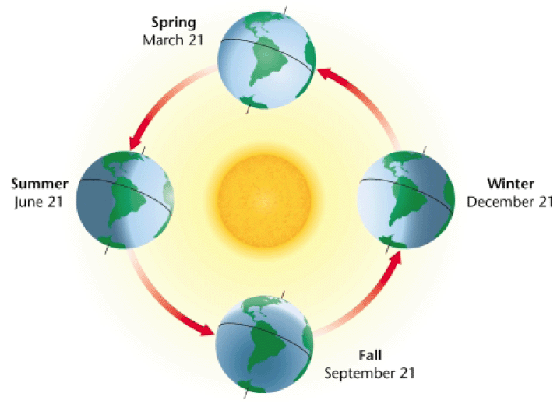
Seasonal Changes in Climate
Chapter 13
Section 1 Climate and Climate Change
The seasons result from the tilt of the Earth’s axis, which is about 23.5° relative to the plane of its orbit.
Because of this tilt the angle at which the sun’s rays strike the Earth changes as the Earth moves around the sun.

Slide 6
Atmospheric Circulation
Chapter 13
Section 1 Climate and Climate Change
Three important properties of air illustrate how air circulation affects climate.
Cold air sinks because it is denser than warm air. As the air sinks, it compresses and warms.
Warm air rises. It expands and cools as it rises.
Warm air can hold more water vapor than cold air can. Therefore, when warm air cools, the water vapor it contains may condense into liquid water to form rain, snow, or fog.

Slide 7
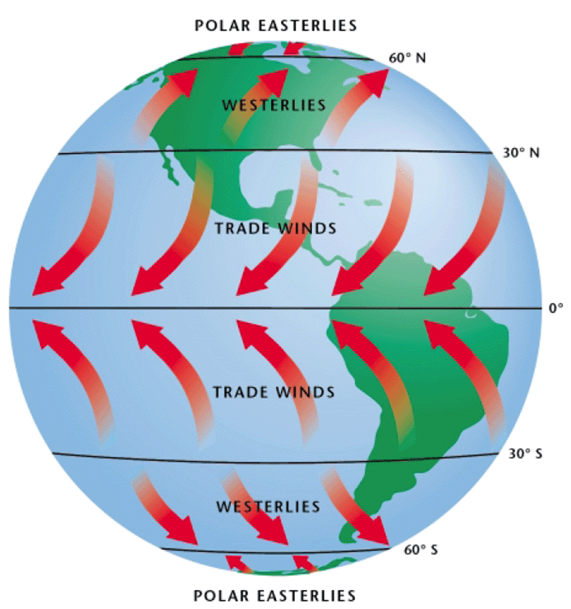
Atmospheric Circulation
Chapter 13
Section 1 Climate and Climate Change
“Prevailing Winds”
Solar energy heats the ground, which warms the air above it. This warm air rises, and cooler air moves in to replace it. This movement of air within the atmosphere is called wind.
Because the Earth rotates, and different latitudes receive different amounts of solar energy, a pattern of global atmospheric circulation results.
This pattern also determines Earth’s precipitation patterns.

Slide 8
Oceanic Circulation
Chapter 13
Section 1 Climate and Climate Change
Ocean currents have a great effect on climate because water holds large amounts of heat.
The movement of surface ocean currents is caused mostly by winds and the rotation of the Earth.
These surface currents redistribute warm and cool masses of water around the world and in doing so, they affect the climate in many parts of the world.

Slide 9
El Niño–Southern Oscillation
Chapter 13
Section 1 Climate and Climate Change
El Niño is the warm phase of the El Niño–Southern Oscillation. It is the periodic occurrence in the eastern Pacific Ocean in which the surface-water temperature becomes unusually warm.
During El Niño, winds in the western Pacific Ocean, which are usually weak, strengthen and push warm water eastward.
Rainfall follows this warm water eastward and produces increased rainfall in the southern half on the U.S., but drought in Australia.

Slide 10
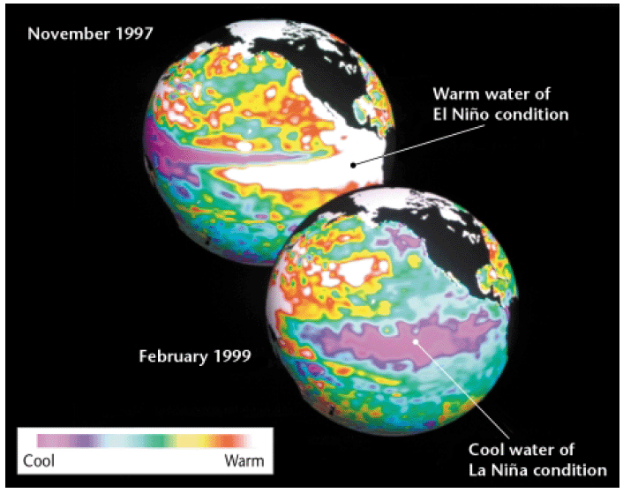
El Niño–Southern Oscillation
Chapter 13
Section 1 Climate and Climate Change
La Niña is the cool phase of the El Niño–Southern oscillation. It is the periodic occurrence in the eastern Pacific Ocean in which the surface water temperature becomes unusually cool.
El Niño and La Niña are opposite phases of the El Niño–Southern Oscillation (ENSO) cycle.

Slide 11
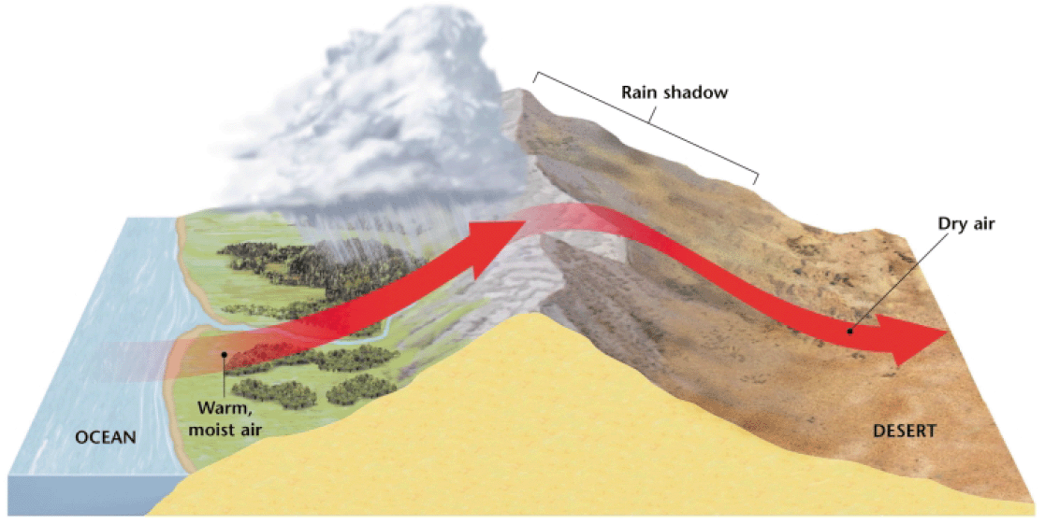
Topography
Chapter 13
Section 1 Climate and Climate Change
Height above sea level (elevation) has an important effect on climate. Temperatures fall by about 6°C (about 11°F) for every 1,000 m increase in elevation.
Mountain ranges also influence the distribution of precipitation. For example, warm air from the ocean blows east, hits the mountains, and rises. As the air rises, it cools, causing it to rain on the western side of the mountain. When the air reaches the eastern side of the mountain it is dry. This effect is known as a rain shadow.

Slide 12
Other Influences on Earth’s Climate
Chapter 13
Section 1 Climate and Climate Change
In large-scale volcanic eruptions, sulfur dioxide gas can reach the upper atmosphere.
The sulfur dioxide, which can remain in the atmosphere for up to 3 years, reacts with smaller amounts of water vapor and dust in the stratosphere.
This reaction forms a bright layer of haze that reflects enough sunlight to cause the global temperature to decrease.

Slide 13
The Ozone Shield
Chapter 13
Section 2 The Ozone Shield
The ozone layer is the layer of the atmosphere at an altitude of 15 to 40 km in which ozone absorbs ultraviolet solar radiation. Ozone is a molecule made of three oxygen atoms.
UV light is harmful to organisms because it can damage the genetic material in living cells.
By shielding the Earth’s surface from most of the sun’s UV light, the ozone in the stratosphere acts like a sunscreen for the Earth’s inhabitants.

Slide 14
Chemicals That Cause Ozone Depletion
Chapter 13
Section 2 The Ozone Shield
Chlorofluorocarbons (CFCs) are hydrocarbons in which some or all of the hydrogen atoms are replaced by chlorine and fluorine.
They are used in coolants for refrigerators and air conditioners and in cleaning solvents. They were also used as a propellant in spray cans of everyday products such as deodorants, insecticides, and paint.
Their use is now restricted because they destroy ozone molecules in the stratosphere.

Slide 15
Chemicals That Cause Ozone Depletion
Chapter 13
Section 2 The Ozone Shield
At the Earth’s surface, CFCs are chemically stable. They do not combine with other chemicals or break down into other substances.
But, CFC molecules break apart high in the stratosphere, where UV radiation is absorbed.
Once CFC molecules break apart, parts of the CFC molecules destroy the protective ozone.

Slide 16
Chemicals That Cause Ozone Depletion
Chapter 13
Section 2 The Ozone Shield
Each CFC molecule contains from one to four chlorine atoms, and scientists have estimated that a single chlorine atom in the CFC structure can destroy 100,000 ozone molecule.

Slide 17
The Ozone Hole
Chapter 13
Section 2 The Ozone Shield
In 1985, studies by scientists working in Antarctica revealed that the ozone layer above the South Pole had thinned by 50 to 98 percent.
The ozone hole is a thinning of stratospheric ozone that occurs over the poles during the spring.

Slide 18
How Does the Ozone Hole Form?
Chapter 13
Section 2 The Ozone Shield
During the dark polar winter, strong circulating winds over Antarctica, called the polar vortex, isolate cold air from surrounding warmer air. The air within the vortex grows extremely cold.
On the surfaces of polar stratospheric clouds, the products of CFCs are converted to molecular chlorine.
When sunlight returns to the South Pole in the spring, molecular chlorine is split into two chlorine atoms by UV radiation. The chlorine atoms rapidly destroy ozone.

Slide 19
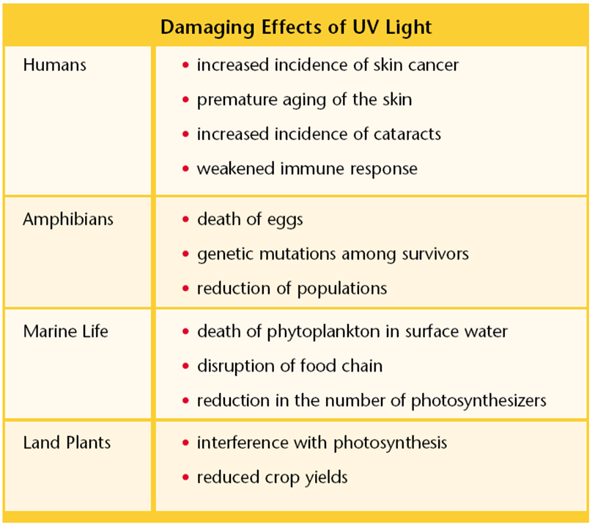
Protecting the Ozone Layer
Chapter 13
Section 2 The Ozone Shield
In 1987, a group of nations made an agreement, called the Montreal Protocol, to sharply limit their production of CFCs.
At a second conference in Copenhagen, Denmark in 1992, developed countries agreed to eliminate most CFCs by 1995.
The United States pledged to ban all substances that pose a significant danger to the ozone layer by the year 2000.

Slide 20
Protecting the Ozone
Chapter 13
Section 2 The Ozone Shield
After developed countries banned most uses of CFCs, chemical companies developed CFC replacements.
Aerosol cans no longer uses CFCs as propellants, and air conditioners are becoming CFC free.

Slide 21
Protecting the Ozone Layer
Chapter 13
Section 2 The Ozone Shield
However, the battle to protect the ozone layer is not over.
CFC molecules remain active in the stratosphere for 60 to 120 years.
CFCs released 30 years ago are still destroying ozone today, so it will be many years before the ozone layer completely recovers.

Slide 22
The Greenhouse Effect
Chapter 13
Section 3 Global Warming
The Earth is similar to a greenhouse. The Earth’s atmosphere acts like the glass in a greenhouse.
Sunlight streams through the atmosphere and heats the Earth. As this heat radiates up from Earth’s surface, some of it escapes into space. The rest of the heat is absorbed by gases in the troposphere and warms the air.

Slide 23
The Greenhouse Effect
Chapter 13
Section 3 Global Warming
Not every gas in our atmosphere absorbs heat in this way.
A greenhouse gas is a gas composed of molecules that absorb and radiate infrared radiation from the sun.
The major greenhouse gases are water vapor, carbon dioxide, CFCs, methane, and nitrous oxide. Of these, water vapor and carbon dioxide account for most of the absorption of that occurs in the atmosphere.

Slide 24
Measuring Carbon Dioxide in the Atmosphere
Chapter 13
Section 3 Global Warming
In 1985, a geochemist named Charles Keeling installed an instrument at the top of a tall tower on the volcano Mauna Loa in Hawaii. He wanted to precisely measure the amount of carbon dioxide in the air, far away from forests and cities.
In a forest, carbon dioxide levels rise and fall with the daily rhythms of photosynthesis. Near cities, carbon dioxide from traffic and industrial pollution raises the local concentration of gas.

Slide 25
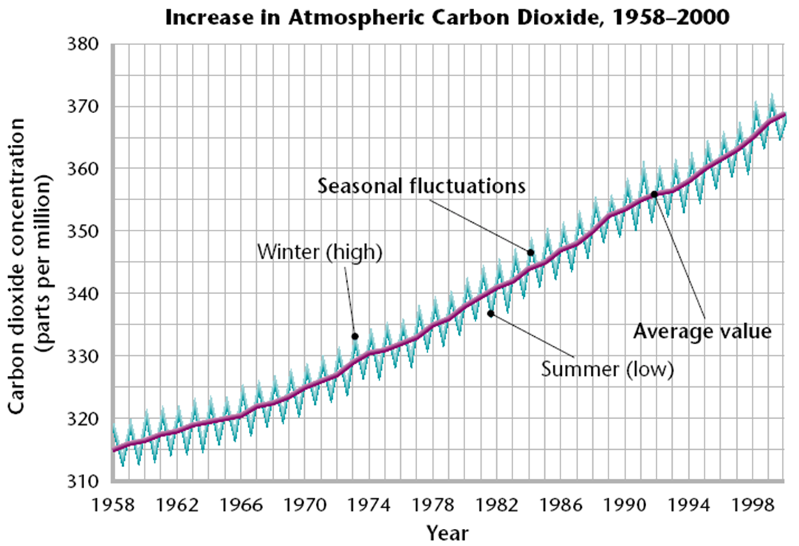
Measuring Carbon Dioxide in the Atmosphere
Chapter 13
Section 3 Global Warming
Keeling’s first measurement, in March of 1958, was 0.0314 percent, and the levels rose slightly the next month. By summer the levels were falling, but in the winter, they rose again.
During the summer, growing plants use more carbon dioxide for photosynthesis than they release in respiration, causing the levels to drop.
In the winter, dying grasses and fallen leaves decay and release the carbon that was stored in them, causing levels to rise.

Slide 26
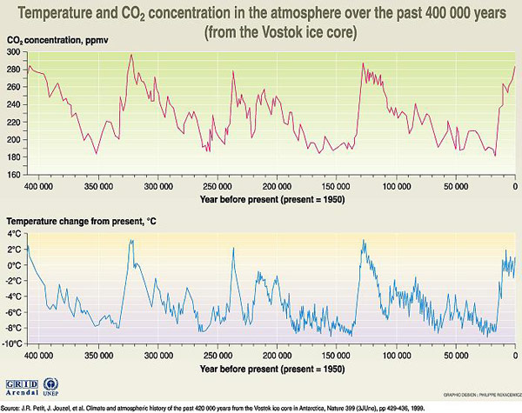
Greenhouse Gases and the Earth’s Temperature
Chapter 13
Section 3 Global Warming
Many scientists think that because greenhouse gases trap heat near the Earth’s surface, more greenhouse gases in the atmosphere will result in an increase in global temperature.

Slide 27
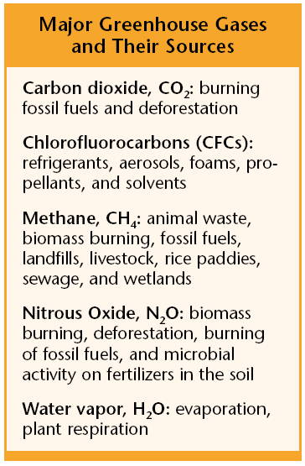
Greenhouse Gases and the Earth’s Temperature
Chapter 13
Section 3 Global Warming
Today, we are releasing more carbon dioxide than any other greenhouse gas into the atmosphere.
Millions of tons of carbon dioxide are released into the atmosphere each year from power plants that burn coal or oil, and cars that burn gasoline. Millions of trees are burned in tropical rainforest to clear the land for farming.
We also release other greenhouse gases, such as CFCs, methane, and nitrous oxide, in significant amounts.

Slide 28
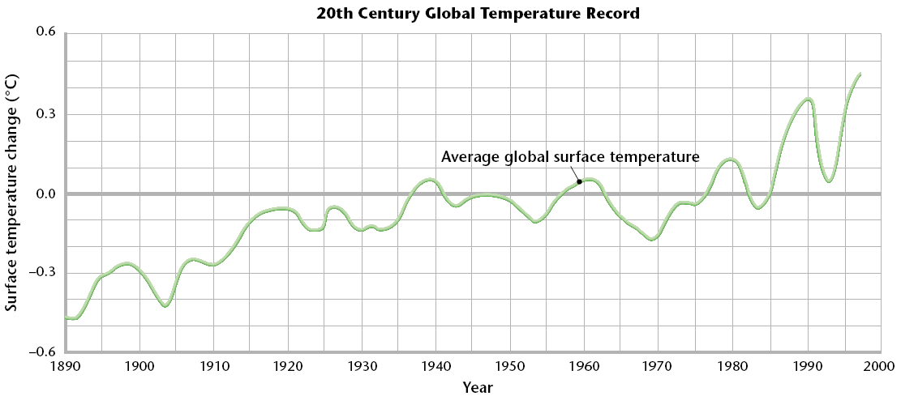
How Certain is Global Warming?
Chapter 13
Section 3 Global Warming
Global warming is a gradual increase in the average global temperature that is due to a higher concentration of gases such as carbon dioxide in the atmosphere.
Earth’s average global temperature increased during the 20th century and many scientists predict that this warming trend will continue throughout the 21st century.

Slide 29
Melting Ice and Rising Sea Levels
Chapter 13
Section 3 Global Warming
If the global temperature increased, the amount of ice and snow at the poles would decrease, causing sea levels around the world to rise.
Coastal wetlands, and other low-lying areas could be flooded. People who live near coastlines could lose their homes and sources of income.
The salinity of bays and estuaries might increase, adversely affecting marine fisheries. Also, freshwater aquifers could become too salty to be used as sources of fresh water.

Slide 30
Global Weather Patterns
Chapter 13
Section 3 Global Warming
If the Earth warms up significantly, the surface of the oceans will absorb more heat, which may make hurricanes and typhoons more common.
Some scientists are concerned that global warming will also cause a change in ocean current patterns, shutting off the Gulf Stream.
Such a change could significantly affect the world’s weather. Severe flooding could occur in some regions at the same time droughts devastate other regions.

Slide 31
Human Health Problems
Chapter 13
Section 3 Global Warming
Greater numbers of heat related deaths could occur. Very young and very old people would have the greatest risk of heat exhaustion.
Concentrations of ground level ozone could increase as air temperatures rise, causing respiratory illnesses, especially in urban areas, to increase.
Warmer temperatures might enable mosquitoes, which carry diseases such as malaria and encephalitis, to greatly increase in number.

Slide 32
Agriculture
Chapter 13
Section 3 Global Warming
Agriculture would be most severely impacted by global warming if extreme weather events, such as drought, became more frequent.
Higher temperatures could result in decreased crop yields.
As a result, the demand for irrigation could increase, which would further deplete aquifers that have already been overused.

Slide 33
Effects on Plants
Chapter 13
Section 3 Global Warming
Climate change could alter the range of plant species and could change the composition of plant communities.
A warmer climate could cause trees to colonize northward into cooler areas.
Forests could shrink in areas in the southern part of their range and lose diversity.

Slide 34
Effects on Animals
Chapter 13
Section 3 Global Warming
Global warming could cause a shift in the geographical range of some animals. For example, Northern birds may not migrate as far south during the winter.
Warming of surface waters of the ocean might cause a reduction of zooplankton, tiny shrimp-like animals, that many marine animals depend on for food.
Warming tropical waters may kill algae that nourish corals, thus destroying coral reefs.

Slide 35
Reducing the Risk
Chapter 13
Section 3 Global Warming
The Kyoto Protocol is an international treaty according to which developed countries that signed the treaty agree to reduce their emissions of carbon dioxide and other gases that may contribute to global warming by the year 2012.
In March of 2001, the United States decided not to ratify the Kyoto Protocol. However, most other developed nations are going ahead with the treaty.

Slide 36
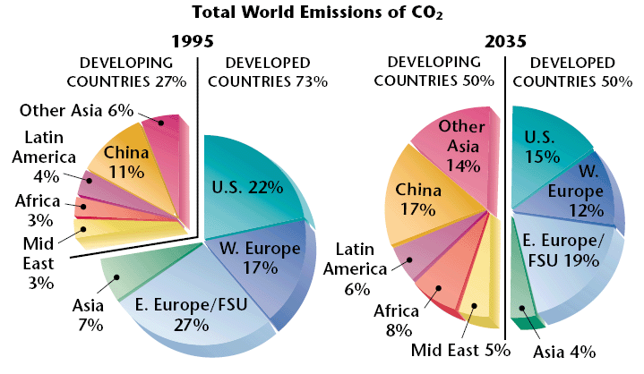
Reducing the Risk
Chapter 13
Section 3 Global Warming
Conflict has already arisen between developed and developing countries over future CO₂ emissions.
Developing countries are projected to make up half of all CO₂ emissions by 2035.

