Slide 1
Chapter 2
Understanding Weather
Table of Contents
Section 1 Water in the Air
Section 2 Air Masses and Fronts
Section 3 Severe Weather
Section 4 Forecasting the Weather

Slide 2
Chapter 2
Section 1 Water in the Air
Bellringer
Observe two glasses of water. One filled with ice water, and one filled with warm water. Why do water droplets form on the outside of the cold container? Where do the water beads come from? Why don’t the water beads form on the warm container?
Write your answers in your science journal.

Slide 3
Objectives
Explain how water moves through the water cycle.
Describe how relative humidity is affected by temperature and levels of water vapor.
Describe the relationship between dew point and condensation.
List three types of cloud forms.
Identify four kinds of precipitation.

Slide 4
What is weather?
The condition of the atmosphere at a given time and place.
Including temperature, humidity, precipitation, wind, and visibility.
What is Climate?
The average weather conditions in an area over a long period of time.

Slide 5
The 2 most important factors affecting the weather
Temperature
Water in the Air (humidity)

Slide 6
Temperature
driven by the sun.
Uneven heating causes temperature variations
Temperatures can change daily based on the amount of radiant energy received by the Earth

Slide 7
The Water Cycle
Section 1 Water in the Air
The condition of the atmosphere is affected by the amount of water in the air.
Water in liquid, solid, and gaseous states is constantly being recycled through the water cycle.
The water cycle is the continuous movement of water from sources on Earth’s surface into the air, onto and over land, into the ground, and back to the surface & air.

Slide 8
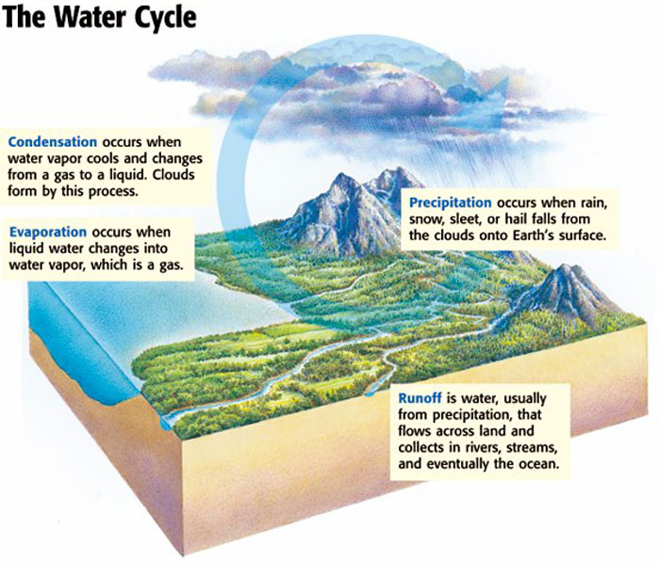
Section 1 Water in the Air

Slide 9
Humidity
Section 1 Water in the Air
Humidity is the amount of water vapor in the air.
The air’s ability to hold water vapor changes as the temperature of the air changes.

Slide 11
Relative Humidity is the amount of water vapor in the air compared to the maximum amount of water vapor that the air can hold at a certain temperature.
Calculate the relative humidity by using the formula:
actual water
vapor content (g/m³)
× 100
= relative humidity (%)
saturation water
vapor content (g/m³)

Slide 12
Measuring Relative Humidity
A psychrometer is an instrument that is used to measure relative humidity.
A psychrometer consists of two thermometers, one of which is a wet-bulb thermometer.
The difference in temperature readings between the thermometers indicates the amount of water vapor in the air.

Slide 13
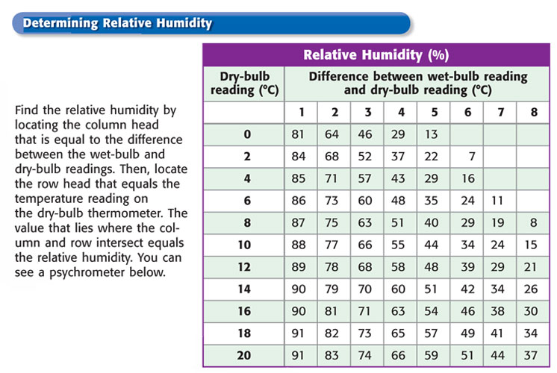
Section 1 Water in the Air
Humidity, continued

Slide 14
Chapter 2
Section 1 Water in the Air
Condensation is the process by which a gas, such as water vapor, becomes a liquid.
Dew Point The dew point is the temperature at which a gas condenses into a liquid.

Slide 15
Clouds
Section 1 Water in the Air
A cloud is a collection of small water droplets or ice crystals suspended in the air, which forms when the air is cooled and condensation occurs.
Clouds are classified by form, and by altitude.

Slide 16
Section 1 Water in the Air
Cumulus Clouds are puffy, white clouds that tend to have flat bottoms.
Stratus Clouds are clouds that form in layers.(FOG)
Cirrus Clouds are thin, feathery, white clouds found at high altitudes.

Slide 17
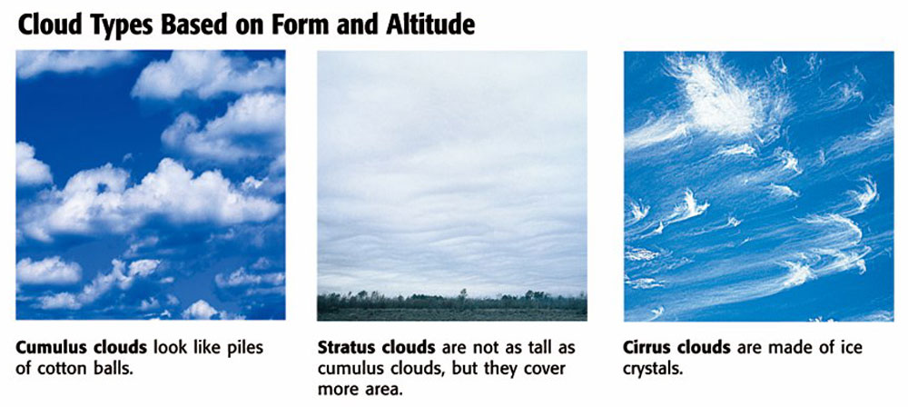
CLOUDS
Section 1 Water in the Air

Slide 18
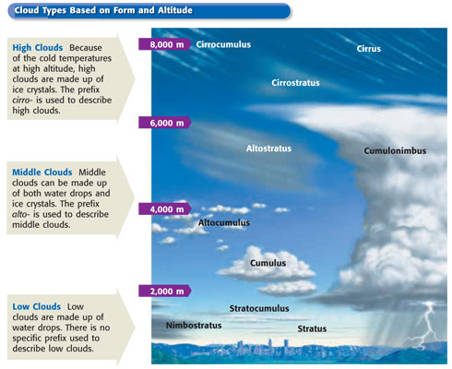
Section 1 Water in the Air
Clouds, continued

Slide 19
Precipitation
Section 1 Water in the Air
Rain is the most common form of precipitation.
Sleet and Snow Sleet forms when rain falls through a layer of freezing air. Snow forms when temperatures are so cold that water vapor changes directly to a solid.
Hail are balls or lumps of ice that fall from clouds.

Slide 20
http://www.weatherstock.com/hailcat3.html
Weather animation
Hail forming
Clouds

Slide 21
Chapter 2
Section 2 Air Masses and Fronts
Bellringer
Think of as many different qualities of air as possible.
Write your answers in your science journal.

Slide 22
Chapter 2
Section 2 Air Masses and Fronts
Objectives
Identify the four kinds of air masses that influence weather in the United States.
Describe the four major types of fronts.
Explain how fronts cause weather changes.
Explain how cyclones and anticyclones affect the weather.

Slide 23
Air Masses
Changes in weather are caused by the movement and interaction of air masses.
An air mass is a large body of air where temperature and moisture content are constant throughout.

Slide 24
Air masses are characterized by their moisture and temperature
These are determined by the source areas
Source areas- area where the air mass forms and moves from.
There are 4 types of air masses that affect the United States.

Slide 25
Section 2 Air Masses and Fronts
Cold Air Masses Most of the cold winter weather in the United States is influenced by three polar air masses.
Warm Air Masses Four warm air masses influence the weather in the United States.

Slide 27
Fronts
Section 2 Air Masses and Fronts
Front- area in which two types of air masses meet is called
Named during WWII when the clashing air masses reminded people of war.
Air masses clash when they meet. Creates variations in weather.

Slide 28
Cold Fronts A cold front forms where cold air moves under warm air,which is less dense, and pushes the warm air up.

Slide 29
COLD Fronts
Bring violent storms
Heavy Rain
Can move quickly
Can bring abrupt temperature changes
Weather maps =

Slide 30
Warm Fronts A warm front forms where warm air moves over cold, denser air.

Slide 31
WARM Fronts
Gradually replaces, not as violent
Steady drizzle and rain
Generally followed by clear warm weather
Weather maps =

Slide 32
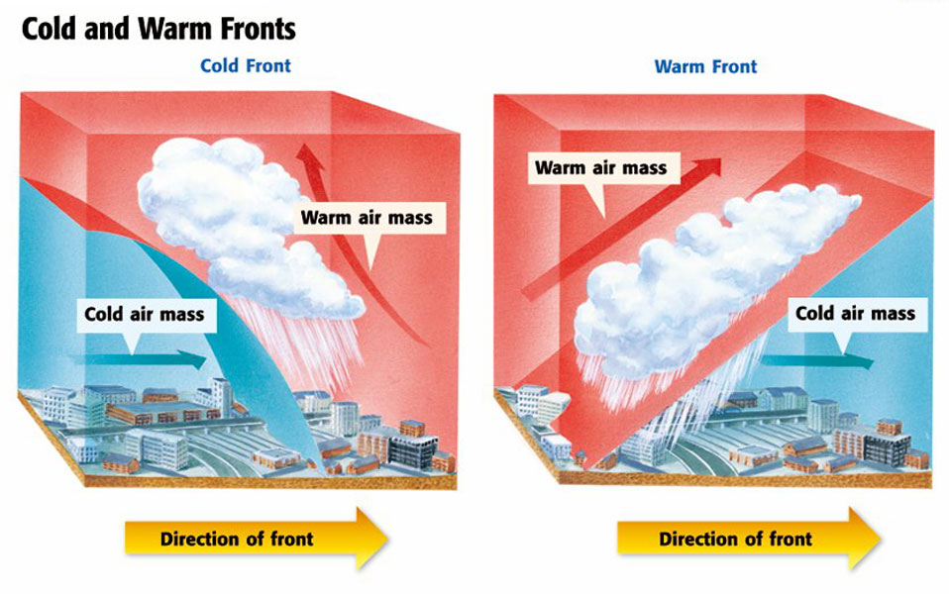
Chapter 2
Section 2 Air Masses and Fronts

Slide 33
Occluded Front- forms when a warm air mass is caught between two cold air masses.

Slide 34
Occluded Front
An occluded front has cool temperatures and large amounts of rain and snow.
Keeps pushing until the cold air masses mix or one pushes other out of way.
Weather maps=

Slide 35
Stationary Front- forms when a cold air mass meets a warm air mass.

Slide 36
Stationary front
A stationary front often brings many days of cloudy, wet weather.
Weather maps=

Slide 37
Chapter 2
Section 2 Air Masses and Fronts

Slide 38
Air Pressure and Weather
Cyclones are areas that have lower pressure than the surrounding areas do.
Anticyclones are areas that have high pressure.

Slide 40
Chapter 2
Section 3 Severe Weather
Bellringer
Write a one-paragraph description of a thunderstorm. Describe the weather conditions immediately before, during, and after the storm. How does the storm affect each of your senses?
Record your response in your science journal.

Slide 41
Chapter 2
Section 3 Severe Weather
Objectives
Describe how lightning forms.
Describe the formation of thunderstorms, tornadoes, and hurricanes.
Describe the characteristics of thunderstorms, tornadoes, and hurricanes.
Explain how to stay safe during severe weather.

Slide 42
Thunderstorms
Rising warm air reaches dew point and forms cumulus clouds.
Rapid winds cause the air to keep rising and become a dark cumulonimbus cloud.
Heavy with moisture, static causes variations in charges from the top and bottom of clouds.

Slide 43
Can create heavy rain, hail, flash floods, and tornadoes.
Flash flooding- too much rain for the water shed to handle.
Causes millions of dollars in damage each year

Slide 44
Hail
Damage crops
Dent metal roofs on cars and buildings
Breaks windows

Slide 45
Thunderstorms
Section 3 Severe Weather
Lightning
an electric discharge that occurs between a positively charged area and a negatively charged area.
Thunderstorms are very active electrically.

Slide 46
Responsible for starting forest fires
Injures or kills about 100 people a year

Slide 47
Thunder
is the sound that results from the rapid expansion of air along the lightning strike.
Lightning super heats the air to over 33,000°C
The rapid expansion and contraction of air creates a soundwave we call thunder

Slide 48
Section 3 Severe Weather
Tornadoes
A tornado
a small, spinning column of air that has high wind speeds and low central pressure and that touches the ground.
Created in supercell thunderstorms
Storm with powerful updrafts.
It takes cold, dry air colliding with rapidly moving warm,moist air

Slide 49
A tornado starts out as a funnel cloud that pokes through the bottom of a cumulonimbus cloud and hangs in the air. The funnel cloud becomes a tornado when it makes contact with Earth’s surface.
Most often occur in spring.
Tornado Alley- area of U.S. plains

Slide 50
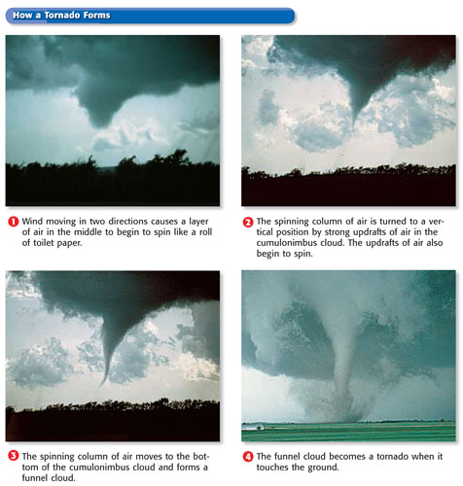
Section 3 Severe Weather
Tornadoes, continued

Slide 51
Writing-on loose leaf paper
Why are there more hurricanes in recent years than in the past?
Do you think the number of hurricanes will continue to increase why or why not?
Support your thoughts with facts about how a hurricane develops.

Slide 52
Hurricanes
Section 3 Severe Weather
Hurricane Formation
begins as a group of thunderstorms moving over tropical ocean waters.
Winds traveling in two different directions meet and cause the storm to spin.
Area of Low pressure pulls water and air up
Winds pickup as moisture increases
Called typhoons in Pacific.

Slide 53
SIDE NOTES
Hurricanes rotate counter clockwise in Northern hemisphere and clockwise in southern hemisphere.
Coriolis Effect causes rotational differences.
Fueled by warm ocean water
Must stay over water to keep up strength
Weaken over the land

Slide 54
Damage Caused by Hurricanes
Hurricanes can cause a lot of damage when they move near or onto land.
Wind speeds of most hurricanes range from 120 to 150 km/h.
Watch=
Warning=

Slide 55
SIDE NOTES
Hurricane Katrina
Listed as worst disaster in U.S.
Flooding of cities- levee breach
Got strong fast- Water was warmer than normal
Land fall as a category 4

Slide 56
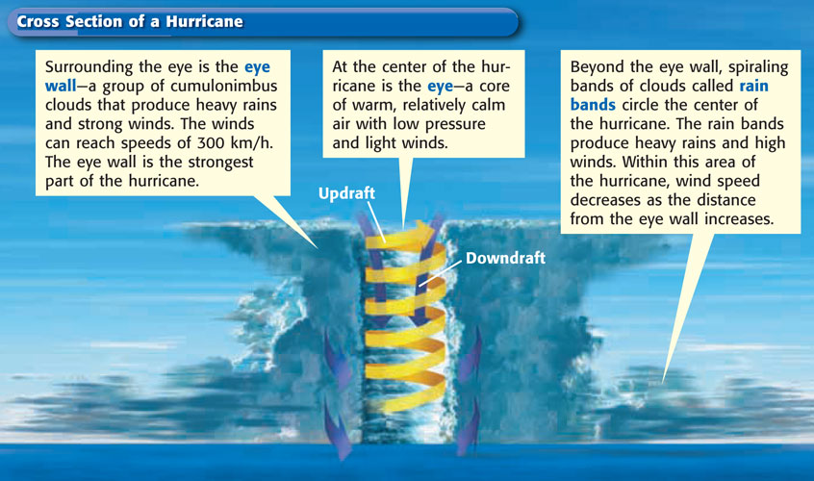
Section 3 Severe Weather
Hurricanes, continued

Slide 57
Side notes
Eye- center, calm winds, clear skies, can be miles wide
Eye Wall- high cumulonimbus clouds, highest wind speeds, most destructive part of hurricane
Rain Bands- arms of hurricane, decreased wind speed as you move out from eye, heavy precipitation.

Slide 58
Chapter 2
Section 3 Severe Weather
Severe Weather Safety
Thunderstorm Safety Lightning is one of the most dangerous parts of a thunderstorm. If you are outside, stay away from trees, which can get struck down. If you are in the open, crouch down.
Tornado Safety If there is a tornado warning for your area, find shelter quickly. The best place to go is a basement or cellar.

Slide 59
Chapter 2
Section 3 Severe Weather
Flood Safety The best thing to do during a flood is to find a high place to wait out the flood.
Hurricane Safety If you live in an area where hurricanes strike, your family should have a disaster supply kit that includes enough water and food to last several days.

Slide 60
Chapter 2
Section 4 Forecasting the Weather
Bellringer
If you did not have the benefit of the weather forecast on the news, radio, or television, how would you forecast the weather?
Record your answer in your science journal.

Slide 61
Bellwork
With your partner take a look at your weather maps for the last week.
Write a paragraph to explain the movements of fronts, rain storm and pressure centers over the last week.
Predict what tomorrows map will look like.

Slide 62
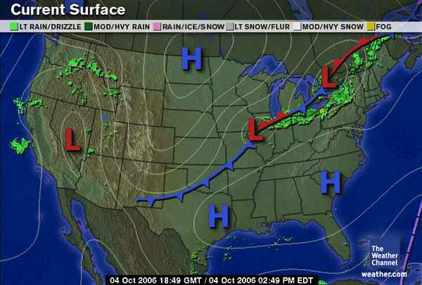

Slide 65
Chapter 2
Section 4 Forecasting the Weather
Objectives
Describe the different types of instruments used to take weather measurements.
Explain how radar and weather satellites help meteorologists forecast the weather.
Explain how to interpret a weather map.

Slide 66
Weather-Forecasting Technology
High in the Sky Weather balloons carry electronic equipment that can measure weather conditions as high as 30 km above Earth’s surface.
Measuring Air Temperature and Pressure
Thermometer- A tool used to measure air temperature
Barometer- instrument used to measure air pressure is a

Slide 67
Measuring Wind Direction
Wind direction can be measured by using a windsock or a wind vane.
Measuring Wind Speed
anemometer-An instrument used to measure wind speed
Radar and Satellites
Radar is used to find the location, movement, and amount of precipitation.
Weather satellites that orbit Earth provide images of weather systems.

Slide 68
Side Notes
Doppler Radar- Radar system that uses sound frequencies.
Sounds are emitted and bounce back off of moisture in the air.
The change in frequency tells meteorologists the direction and speed of system.

Slide 69
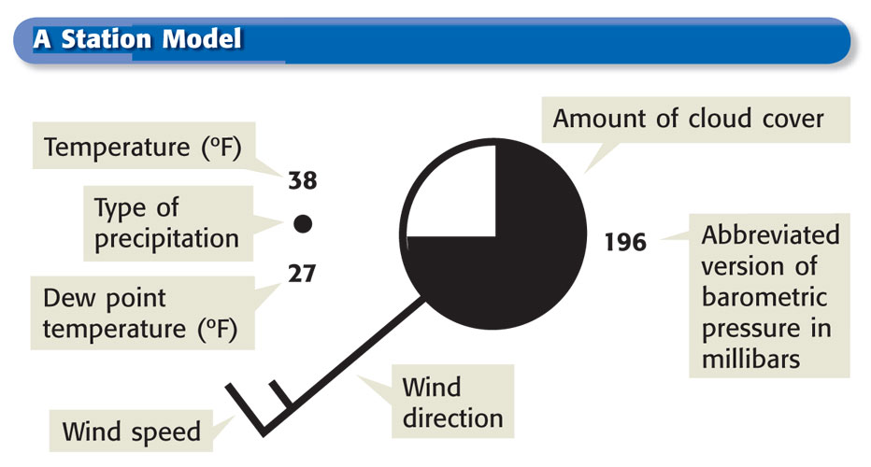
Section 4 Forecasting the Weather
Who Makes the Weather Maps- The National Weather Service produces weather maps based on information gathered from about 1,000 weather stations across the United States.

Slide 70
SIDE NOTES
Weather stations collect data on
Precipitation
Humidity
Wind direction and speed
Dew point
Cloud Cover
Temperature
Air pressure

Slide 71
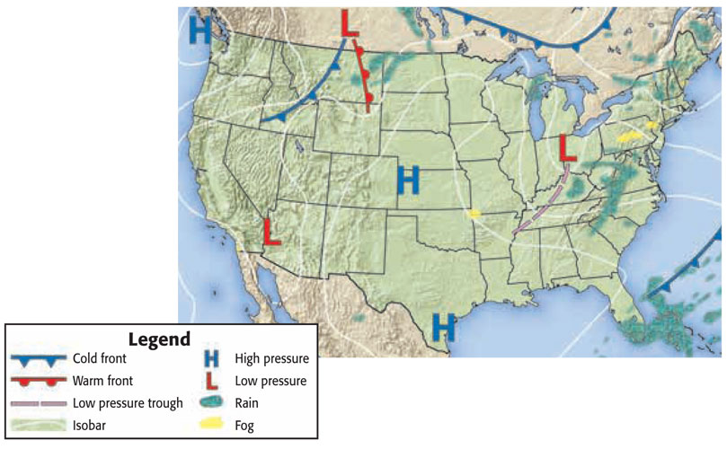

Slide 72
Side Notes
Frontal Systems move according to the winds
Frontal systems can spin slightly around the pressure center
Isobars- lines on weather maps that connect areas of equal air pressure

Slide 73
Chapter 2
Understanding Weather
Concept Map
Use the terms below to complete the concept map on the next slide.
water hail cumulus humidity weather | air masses cirrus clouds fronts

Slide 74
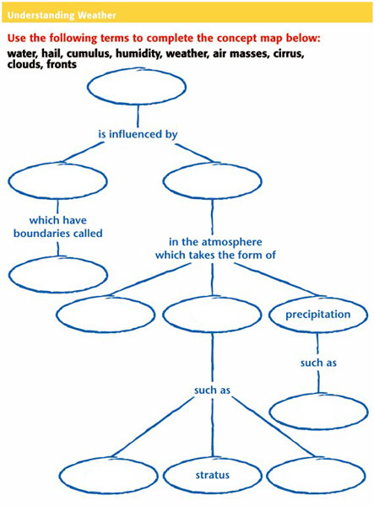

Slide 75
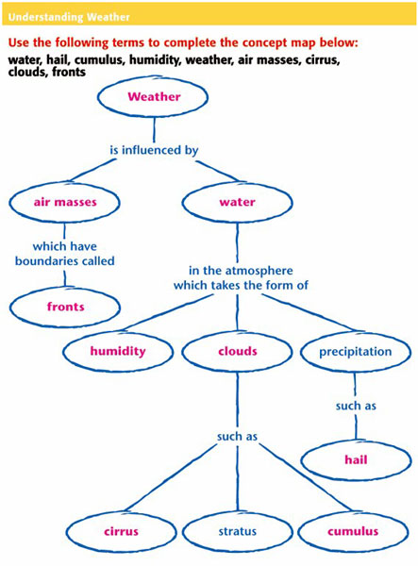

Slide 76
Chapter 2
Standardized Test Preparation
Reading
Read each of the passages. Then, answer the questions that follow each passage.

Slide 77
Chapter 2
Standardized Test Preparation
Passage 1 In May 1997, a springtime tornado wreaked havoc on Jarrell, Texas. The Jarrell tornado was a powerful tornado, whose wind speeds were estimated at more than 410 km/h. The winds of the twister were so strong that they peeled the asphalt from paved roads, stripped fields of corn bare, and destroyed an entire neighborhood.
Continued on the next slide

Slide 78
Chapter 2
Standardized Test Preparation
Passage 1, continued Some tornadoes, such as the one that struck the town of Jarrell, are classified as violent tornadoes. Only 2% of the tornadoes that occur in the United States are categorized as violent tornadoes. Despite the fact that these types of tornadoes do not occur often, 70% of all tornado-related deaths are a result of violent tornadoes.

Slide 79
Chapter 2
Standardized Test Preparation
1. In the passage, what does the word wreaked mean?
A smelled
B caused
C prevented
D removed

Slide 80
Chapter 2
Standardized Test Preparation
1. In the passage, what does the word wreaked mean?
A smelled
B caused
C prevented
D removed

Slide 81
Chapter 2
Standardized Test Preparation
2. Which of the following can be concluded from the passage?
F Tornadoes often hit Jarrell, Texas.
G Most tornadoes fall into the violent category.
H The tornado that hit Jarrell was a rare type of tornado.
I Tornadoes always happen during the spring.

Slide 82
Chapter 2
Standardized Test Preparation
2. Which of the following can be concluded from the passage?
F Tornadoes often hit Jarrell, Texas.
G Most tornadoes fall into the violent category.
H The tornado that hit Jarrell was a rare type of tornado.
I Tornadoes always happen during the spring.

Slide 83
Chapter 2
Standardized Test Preparation
3. Which of the following best describes a characteristic of violent tornadoes?
A Violent tornadoes destroy paved roads.
B Violent tornadoes damage crops.
C Violent tornadoes damage homes.
D Violent tornadoes have extremely strong winds.

Slide 84
Chapter 2
Standardized Test Preparation
3. Which of the following best describes a characteristic of violent tornadoes?
A Violent tornadoes destroy paved roads.
B Violent tornadoes damage crops.
C Violent tornadoes damage homes.
D Violent tornadoes have extremely strong winds.

Slide 85
Chapter 2
Standardized Test Preparation
Passage 2 Water evaporates into the air from Earth’s surface. This water returns to Earth’s surface as precipitation. Precipitation is water, in solid or liquid form, that falls from the air to Earth. The four major types of precipitation are rain, snow, sleet, and hail. The most common form of precipitation is rain.
Continued on the next slide

Slide 86
Chapter 2
Standardized Test Preparation
Passage 2, continued
A cloud produces rain when the cloud’s water drops become a certain size. A raindrop begins as a water droplet that is smaller than the period at the end of this sentence. Before a water drop falls as rain, it must become about 100 times its original size. Water drops get larger by joining with other water drops. When the water drops become too heavy, they fall as precipitation.

Slide 87
Chapter 2
Standardized Test Preparation
1. In this passage, what does precipitation mean?
A acceleration
B haste
C water that falls from the atmosphere to Earth
D separating a substance from a solution as a solid

Slide 88
Chapter 2
Standardized Test Preparation
1. In this passage, what does precipitation mean?
A acceleration
B haste
C water that falls from the atmosphere to Earth
D separating a substance from a solution as a solid

Slide 89
Chapter 2
Standardized Test Preparation
2. What is the main idea of the second paragraph?
F Rain occurs when the water droplets in clouds become large enough to fall.
G Raindrops are very small at first.
H Water droplets join with other water droplets to become larger.
I Rain is a form of precipitation.

Slide 90
Chapter 2
Standardized Test Preparation
2. What is the main idea of the second paragraph?
F Rain occurs when the water droplets in clouds become large enough to fall.
G Raindrops are very small at first.
H Water droplets join with other water droplets to become larger.
I Rain is a form of precipitation.

Slide 91
Chapter 2
Standardized Test Preparation
3. According to the passage, which step happens last in the formation of precipitation?
A Water droplets join.
B Water droplets fall to the ground.
C Water droplets become heavy.
D Water evaporates into the air.

Slide 92
Chapter 2
Standardized Test Preparation
3. According to the passage, which step happens last in the formation of precipitation?
A Water droplets join.
B Water droplets fall to the ground.
C Water droplets become heavy.
D Water evaporates into the air.

Slide 93
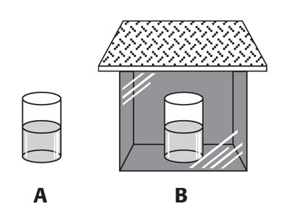
Chapter 2
Standardized Test Preparation
Interpreting Graphics
Use the diagram below to answer the question on the next slide.

Slide 94
Chapter 2
Standardized Test Preparation
1. During an experiment, the setup shown in the diagram above is maintained for 72 h. Which of the following is the most likely outcome?
A Beaker A will hold less water than beaker B will.
B The amount of water in beaker A and beaker B will stay the same.
C The amount of water in beaker A and beaker B will change by about the same amount.
D Beaker B will hold less water than beaker A will.

Slide 95
Chapter 2
Standardized Test Preparation
1. During an experiment, the setup shown in the diagram above is maintained for 72 h. Which of the following is the most likely outcome?
A Beaker A will hold less water than beaker B will.
B The amount of water in beaker A and beaker B will stay the same.
C The amount of water in beaker A and beaker B will change by about the same amount.
D Beaker B will hold less water than beaker A will.

Slide 96
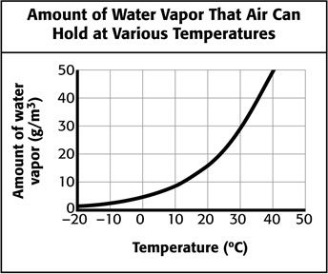
Chapter 2
Standardized Test Preparation
Interpreting Graphics
Use the diagram below to answer the question on the next slide.

Slide 97
Chapter 2
Standardized Test Preparation
2. Look at the line graph. Which statement is consistent with the line graph?
F The ability of air to hold moisture increases as temperature increases.
G The ability of air to hold moisture decreases as temperature increases.
H The ability of air to hold moisture decreases and then increases as temperature increases.
I The ability of air to hold moisture stays the same regardless of temperature.

Slide 98
Chapter 2
Standardized Test Preparation
2. Look at the line graph. Which statement is consistent with the line graph?
F The ability of air to hold moisture increases as temperature increases.
G The ability of air to hold moisture decreases as temperature increases.
H The ability of air to hold moisture decreases and then increases as temperature increases.
I The ability of air to hold moisture stays the same regardless of temperature.

Slide 99
Chapter 2
Standardized Test Preparation
Math
Read each question and choose the best answer.

Slide 100
Chapter 2
Standardized Test Preparation
1. The speed of light is 3.00 × 10⁸ m/s. What is another way to express this measure?
A 3,000,000,000 m/s
B 300,000,000 m/s
C 3,000,000 m/s
D 300,000 m/s

Slide 101
Chapter 2
Standardized Test Preparation
1. The speed of light is 3.00 × 10⁸ m/s. What is another way to express this measure?
A 3,000,000,000 m/s
B 300,000,000 m/s
C 3,000,000 m/s
D 300,000 m/s

Slide 102
Chapter 2
Standardized Test Preparation
2. A hurricane is moving 122 km/h. How long will it take to hit the coast, which is 549 km away?
F 4.2 h
G 4.5 h
H 4.8 h
I 5.2 h

Slide 103
Chapter 2
Standardized Test Preparation
2. A hurricane is moving 122 km/h. How long will it take to hit the coast, which is 549 km away?
F 4.2 h
G 4.5 h
H 4.8 h
I 5.2 h

Slide 104
Chapter 2
Standardized Test Preparation
3. A front is moving 15 km/h in an easterly direction. At that rate, how far will the front travel in 12 h?
A 0.8 km
B 1.25 km
C 27 km
D 180 km

Slide 105
Chapter 2
Standardized Test Preparation
3. A front is moving 15 km/h in an easterly direction. At that rate, how far will the front travel in 12 h?
A 0.8 km
B 1.25 km
C 27 km
D 180 km

Slide 106
Chapter 2
Standardized Test Preparation
4. On average, 2 out of every 100 tornadoes are classified as violent tornadoes. If there are 400 tornadoes in one year, which is the best prediction of the number of tornadoes that will be classified as violent tornadoes during that year?
F 2
G 4
H 8
I 16

Slide 107
Chapter 2
Standardized Test Preparation
4. On average, 2 out of every 100 tornadoes are classified as violent tornadoes. If there are 400 tornadoes in one year, which is the best prediction of the number of tornadoes that will be classified as violent tornadoes during that year?
F 2
G 4
H 8
I 16

Slide 108
Chapter 2
Standardized Test Preparation
5. The air temperature in the morning was 27°C. During the day, a front moved into the region and caused the temperature to drop to 18°C. By how many degrees did the temperature drop?
A 1°C
B 9°C
C 11°C
D 19°C

Slide 109
Chapter 2
Standardized Test Preparation
5. The air temperature in the morning was 27°C. During the day, a front moved into the region and caused the temperature to drop to 18°C. By how many degrees did the temperature drop?
A 1°C
B 9°C
C 11°C
D 19°C

Slide 110
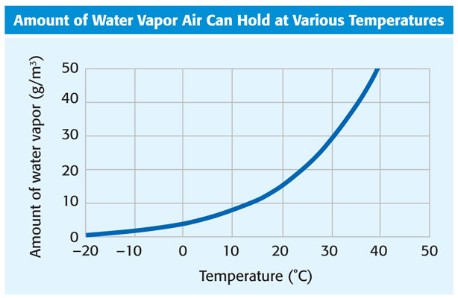
Chapter 2
Section 1 Water in the Air

Slide 111
Chapter 2
Section 1 Water in the Air

Slide 112
Chapter 2
Section 1 Water in the Air

Slide 113
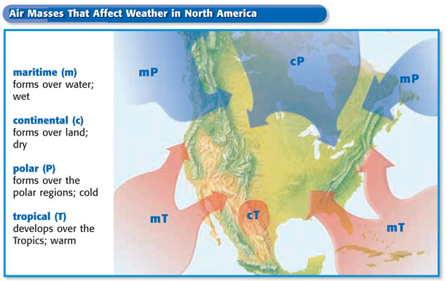
Chapter 2
Section 2 Air Masses and Fronts

Slide 114
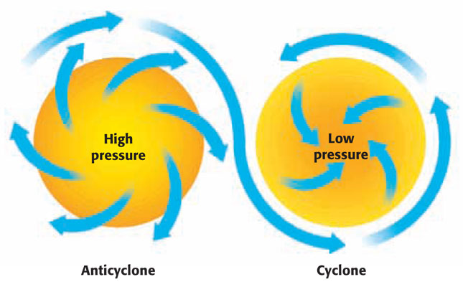
Chapter 2
Section 2 Air Masses and Fronts

Slide 115
Chapter 2
Section 3 Severe Weather

Slide 116
Chapter 2
Section 3 Severe Weather

Slide 117
Chapter 2
Section 4 Forecasting the Weather

Slide 118
Chapter 2
Section 4 Forecasting the Weather

Slide 119
Chapter 2
Standardized Test Preparation

Slide 120
Chapter 2
Standardized Test Preparation

