Slide 1
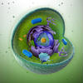
The Cell in Action
An organism is like a factory.
It has to be able to get energy, materials, and get rid of wastes.
Why is this important? It keeps the cells healthy so they can divide.

Slide 2
Cell Membrane
It is the place where the exchange of materials between a cell and its environment occur.

Slide 3
Diffusion
The movement from areas of high concentration (crowded) to areas of low concentration (less crowded).
This can also be said from regions of higher density to regions of lower density.
This happens within and between cells.
Look at figure 1 on page 34

Slide 4
http://www.youtube.com/watch?v=sdiJtDRJQEc
Osmosis

Slide 5
http://www.explorelearning.com/index.cfm?method=cResource.dspView&ResourceID=417

Slide 6
Osmosis
It is the diffusion of water through a semipermeable membrane.
Water is made up of molecules. Pure water has the highest concentration of water molecules. When it is mixed with something, you lower it’s concentration.
Semipermeable means that only certain substances can pass through.

Slide 7
More Osmosis
The concentration of particles in around the cell is kept in balance by osmosis.
Red blood cells are surrounded by plasma. If they were in pure water, they would burst.
When RBC’s are placed in a salty solution, the concentration of water inside the cell is higher than the concentration of water outside.
This difference is what makes the water move out of the cells.

Slide 8
Osmosis
Diffusion
Diffusion & Osmosis

Slide 9
Moving Particles
channels-small particles like water and sugars cross the cell membrane through these passageways
The channels are made of proteins in the cell membrane.

Slide 10
2 Types of Transport for Small Particles
passive transport-the movement of particles across a cell membrane without the use of energy by the cell
Particles move from areas of higher concentration to areas of lower concentration.
ie. diffusion and osmosis
active transport-a process of transporting particles that require the cells to use energy.
Usually involves the movement of particles from an area of low concentration to an area of high concentration.

Slide 11
Moving Large Particles
Large particles move into and out of the cell by:
endocytosis-an active transport process
where a cell surrounds a large particle and encloses the particle in a vesicle to bring the particle into the cell.
vesicle-sacs formed from pieces of cell membrane
Exocytosis-when a large particle leaves the cell, the
cell uses this active-transport
A vesicle forms around a large particle within the cell, and
carries the particle to the cell membrane where the vesicle fuses with
the cell membrane and releases the particle to the
outside of the cell.

Slide 12
Cell Rap
Active and Passive Transport
Exocytosis and Enocytosis

Slide 13
Cell Energy
Photosynthesis-plants capture energy from the sun and change it into food through this process.
The food that plants make supplies the energy to the plant.
The food is also a source of energy for the organisms that eat the plant.

Slide 14
Photosynthesis
pigments-plant cells have these molecules that absorb light energy.
Chlorophyll is the main pigment used in photosynthesis. It gives plants their green color. It is found in chloroplasts.
Plants use the energy captured by chlorophyll to change carbon dioxide and water into food.
Glucose-a food that is in the form of carbohydrate that can be stored and used by the plant’s cells.
The by product of photosythesis is oxygen.

Slide 15
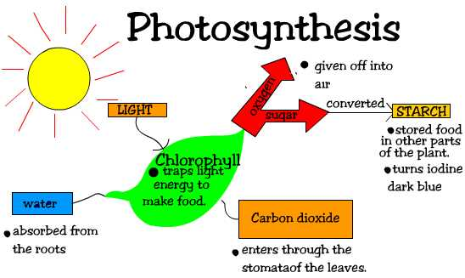

Slide 16
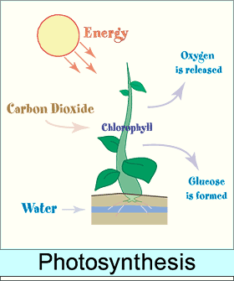

Slide 17
Photosynthesis Formula
6CO₂ + 6H₂O + Light Energy C₆H₁₂O₆ + 6O₂
Carbon Water Glucose Oxygen
Dioxide
Energy is transformed from the sun into glucose. Cells take in carbon dioxide and
release oxygen.

Slide 18
Photosynthesis in Overview
Process by which plants store the energy of sunlight into sugars(glucose).
Requires sunlight, water, and carbon dioxide.
Overall equation:
6 CO₂ + 6 H₂0 → C₆H₁₂O₆ + 6 O₂
Occurs in the leaves of plants in organelles called chloroplasts.

Slide 19
Photosynthesis Song
Photosynthesis: Bill Nye
Photosynthesis

Slide 20
Photosythesis Animation

Slide 21
Getting Energy from Food
Cellular respiration-a way of getting energy from food by using oxygen to break down food. It is a chemical process that occurs within cells.
Breathing supplies the oxygen needed for cellular respiration.
Breathing removes carbon dioxide.

Slide 22
How does Cellular Respiration Work?
Food like glucose is broken down into carbon dioxide and water.
The energy released from this conversion is used to maintain body temperature.
Some of the energy used is in the form of ATP. This supplies the cells with energy.
Cellular respiration in eukaryotes takes place in the mitochondria.
In prokaryotes, it takes place in the cell membrane.

Slide 23
Cellular Respiration Formula
C₆H₁₂O₆ + 6O₂ 6CO₂ + 6H₂O + Energy (ATP)
Glucose Oxygen Carbon Water
Dioxide
Cells use oxygen to break down glucose and release energy and carbon dioxide.
Compare the two equations. What do you notice about the two?

Slide 24
Photosynthesis Formula
6CO₂ + 6H₂O + Light Energy C₆H₁₂O₆ + 6O₂
Carbon Water Glucose Oxygen
Dioxide
Energy is transformed from the sun into glucose. Cells take in carbon dioxide and
release oxygen.

Slide 25
Look at figure 3 on page 40
Each of the processes makes by products that are needed by something else.

Slide 26
Fermentation
When muscles cannot get the oxygen they need for cellular respiration, they use this to get energy.
One type of fermentation produces a build up of lactic acid in the muscle. This causes a burning sensation and muscle soreness.

Slide 27
The Cell Cycle
Cell cycle-the life cycle of a cell
The cell cycle begins when the cell is formed and ends when it divides.
Before a cell divides, it makes copies of its deoxyribonucleic acid (DNA).
DNA-the hereditary material that controls the activities of the cell and cell division.

Slide 28
Chromosomes
The DNA of a cell is organized into these structures.
How does a cell make more cells?
It depend on whether it is prokaryotic (no nucleus) or eukaryotic (nucleus).

Slide 29
Prokaryotic Cells
They are not as complex as eukaryotic cells.
For example, bacteria has ribosomes and a single strand of DNA, but no membrane enclosed organelles.
Binary fission- “splitting into two parts”
It results in two cells that each contain one copy of the circle of DNA.
Look at figure 1 on page 42

Slide 30
Eukaryotic Cells
More complex than prokaryotic cells
Contain more DNA than prokaryotic cells
Different eukaryotic cells have different numbers of chromosomes
The number of chromosomes is not related to the complexity of the organism:
Potato 48
Fruit flies 8
Humans 46

Slide 31
Look at figure 2 on page 43
These pairs are made up of similar
chromosomes called
homologous chromosomes.

Slide 32
3 Stages of the Eukaryotic Cell
1st Stage: Interphase
Cell grows and copies its organelles and chromosomes
chromatids-the two copies are called this
The chromatids are held together at the centromere.
The chromatids twist and coil, then condense into an x shape.

Slide 33
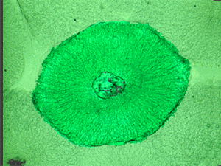
Interphase
Chromosomes are copies, so each chromosome is then 2 chomatids.

Slide 34
2nd Stage
mitosis-process of chromosome separation
It is divided into 4 phases.
It makes sure that each new cell gets a copy of each chromosome.

Slide 35
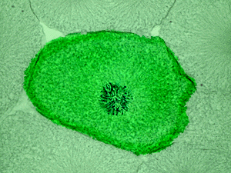
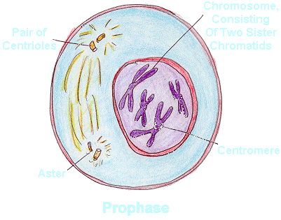
Prophase: Mitosis Phase 1
Mitosis begins. The nuclear membrane dissolves. Chromosomes condense into rodlike structures.

Slide 36
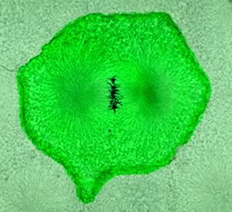
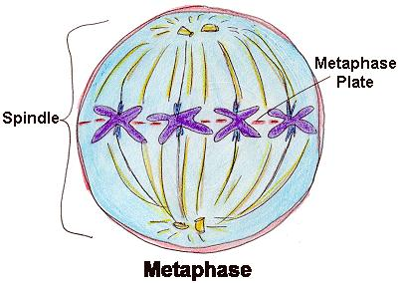
Metaphase: Mitosis Phase 2
The chromosomes line up along the equator of the cell. Homologous chromosomes (similar) pair up.

Slide 37
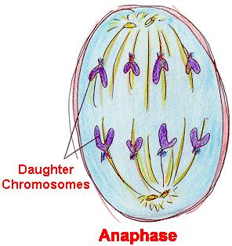
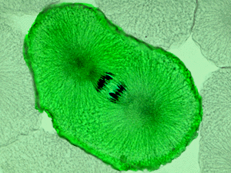
Anaphase: Mitosis Phase 3
The chromatids separate and move to opposite sides of the cell.

Slide 38
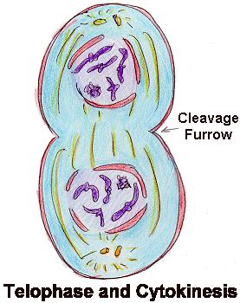
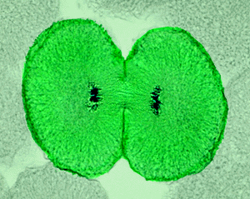
Telophase: Mitosis Phase 4
A nuclear membrane forms around each set of chromosomes, and the chromosomes unwind.
Mitosis is complete.

Slide 39
3rd Stage: Cytokinesis
The division of cytoplasm
For animal cells and other eukaryotes that do not have cell walls:
this occurs at the cell membrane.
The cell membrane pinches inward to form a groove that eventually divides.
Eukaryotic cells that have a cell wall (plants, algae, and fungi):
form a cell plate in the middle of the cell.
After the cell splits into 2, a new cell wall forms where the cell plate was.

Slide 40
http://www.cellsalive.com/mitosis.htm

Slide 41
http://highered.mcgraw-hill.com/olcweb/cgi/pluginpop.cgi?it=swf::535::535::/sites/dl/free/0072437316/120073/bio14.swf::Mitosis%20and%20Cytokinesis

