Slide 1
How to Use This Presentation
To View the presentation as a slideshow with effects
select “View” on the menu bar and click on “Slide Show.”
To advance through the presentation, click the right-arrow key or the space bar.
From the resources slide, click on any resource to see a presentation for that resource.
From the Chapter menu screen click on any lesson to go directly to that lesson’s presentation.
You may exit the slide show at any time by pressing the Esc key.

Slide 2
Resources
Chapter Presentation
Bellringers
Transparencies
Standardized Test Prep
Image and Math Focus Bank
CNN Videos
Visual Concepts
Notes:
Header – dark yellow 24 points Arial Bold
Body text – white 20 points Arial Bold, dark yellow highlights
Bullets – dark yellow
Copyright – white 12 points Arial
Size:
Height: 7.52"
Width: 10.02"
Scale: 70%
Position on slide:
Horizontal - 0"
Vertical - 0"

Slide 3
Chapter 21
A Family of Planets
Table of Contents
Section 1 The Nine Planets
Section 2 The Inner Planets
Section 3 The Outer Planets
Section 4 Moons
Section 5 Small Bodies in the Solar System
Notes:
Header – dark yellow 24 points Arial Bold
Body text – white 20 points Arial Bold, dark yellow highlights
Bullets – dark yellow
Copyright – white 12 points Arial
Size:
Height: 7.52"
Width: 10.02"
Scale: 70%
Position on slide:
Horizontal - 0"
Vertical - 0"

Slide 4
Chapter 21
Section 1 The Nine Planets
Bellringer
Create a mnemonic device to help you remember the order of the planets:
Mercury, Venus, Earth, Mars, Jupiter, Saturn, Uranus, Neptune, Pluto
Example: My very eccentric mother just sent us nine pigs.
Notes:
Header – dark yellow 24 points Arial Bold
Body text – white 20 points Arial Bold, dark yellow highlights
Bullets – dark yellow
Copyright – white 12 points Arial
Size:
Height: 7.52"
Width: 10.02"
Scale: 70%
Position on slide:
Horizontal - 0"
Vertical - 0"

Slide 5
Chapter 21
Section 1 The Nine Planets
Objectives
List the planets in the order in which they orbit the sun.
Explain how scientists measure distances in space.
Describe how the planets in our solar system were discovered.
Describe three ways in which the inner planets and outer planets differ.
Notes:
Header – dark yellow 24 points Arial Bold
Body text – white 20 points Arial Bold, dark yellow highlights
Bullets – dark yellow
Copyright – white 12 points Arial
Size:
Height: 7.52"
Width: 10.02"
Scale: 70%
Position on slide:
Horizontal - 0"
Vertical - 0"

Slide 6
Chapter 21
Section 1 The Nine Planets
Our Solar System
Our solar system includes the sun, the planets, and many smaller objects.
Notes:
Header – dark yellow 24 points Arial Bold
Body text – white 20 points Arial Bold, dark yellow highlights
Bullets – dark yellow
Copyright – white 12 points Arial
Size:
Height: 7.52"
Width: 10.02"
Scale: 70%
Position on slide:
Horizontal - 0"
Vertical - 0"

Slide 7
Chapter 21
Section 1 The Nine Planets
The Inner and Outer Solar Systems
The Inner Planets The planets closest to the sun include Mercury, Venus, Earth, and Mars.
Terrestrial planets
The Outer Planets The outer planets include Jupiter, Saturn, Uranus, Neptune, and Pluto.
Gas Giants
Notes:
Header – dark yellow 24 points Arial Bold
Body text – white 20 points Arial Bold, dark yellow highlights
Bullets – dark yellow
Copyright – white 12 points Arial
Size:
Height: 7.52"
Width: 10.02"
Scale: 70%
Position on slide:
Horizontal - 0"
Vertical - 0"

Slide 8
Chapter 21
Section 1 The Nine Planets
The Discovery of the Solar System
Early Knowledge Up until the 17th century, the universe was thought to only contain Earth, Venus, Mercury, Venus, Mars, Jupiter, Saturn, the sun, and Earth’s moon.
Using a Telescope After the invention of the telescope by the end of the 17th century, the moons of Jupiter and Saturn were discovered.
By the end of the 18th century, Uranus & 2 of its moons
By the end of the 19th century, Neptune and moons of other planets
Modern Times By the 20th century, Pluto and many other bodies had been discovered.
Notes:
Header – dark yellow 24 points Arial Bold
Body text – white 20 points Arial Bold, dark yellow highlights
Bullets – dark yellow
Copyright – white 12 points Arial
Size:
Height: 7.52"
Width: 10.02"
Scale: 70%
Position on slide:
Horizontal - 0"
Vertical - 0"

Slide 9
Chapter 21
Section 1 The Nine Planets
Measuring and Interplanetary Distances
Scientists use the astronomical unit to measure distances in space. One astronomical unit is the average distance between the sun and Earth, or approximately 150,000,000 km.
Notes:
Header – dark yellow 24 points Arial Bold
Body text – white 20 points Arial Bold, dark yellow highlights
Bullets – dark yellow
Copyright – white 12 points Arial
Size:
Height: 7.52"
Width: 10.02"
Scale: 70%
Position on slide:
Horizontal - 0"
Vertical - 0"

Slide 10
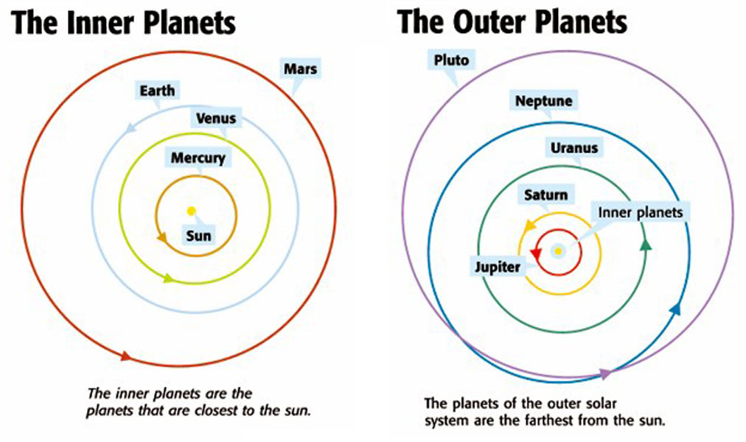
Chapter 21
Section 1 The Nine Planets
Notes:
Header – dark yellow 24 points Arial Bold
Body text – white 20 points Arial Bold, dark yellow highlights
Bullets – dark yellow
Copyright – white 12 points Arial
Size:
Height: 7.52"
Width: 10.02"
Scale: 70%
Position on slide:
Horizontal - 0"
Vertical - 0"

Slide 11
Chapter 21
Section 2 The Inner Planets
Objectives
Explain the difference between a planet’s period of rotation and period of revolution.
Describe the difference between prograde and retrograde rotation.
Describe the individual characteristics of Mercury, Venus, Earth, and Mars.
Identify the characteristics that make Earth suitable for life.
Notes:
Header – dark yellow 24 points Arial Bold
Body text – white 20 points Arial Bold, dark yellow highlights
Bullets – dark yellow
Copyright – white 12 points Arial
Size:
Height: 7.52"
Width: 10.02"
Scale: 70%
Position on slide:
Horizontal - 0"
Vertical - 0"

Slide 12
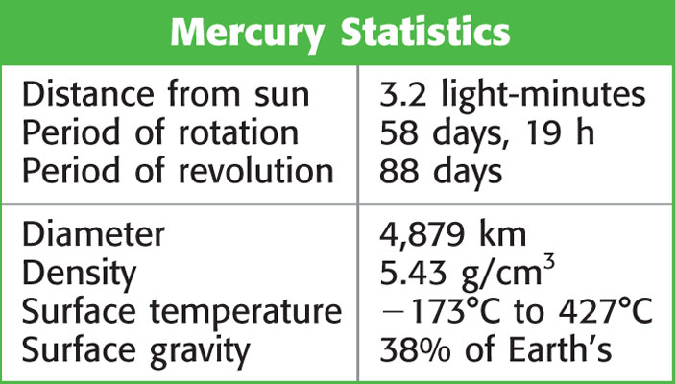
Chapter 21
Section 2 The Inner Planets
Mercury: Closest to the Sun
Mercury is a very hot, small planet. It only takes Mercury 88 days to revolve around the sun.
Notes:
Header – dark yellow 24 points Arial Bold
Body text – white 20 points Arial Bold, dark yellow highlights
Bullets – dark yellow
Copyright – white 12 points Arial
Size:
Height: 7.52"
Width: 10.02"
Scale: 70%
Position on slide:
Horizontal - 0"
Vertical - 0"

Slide 13
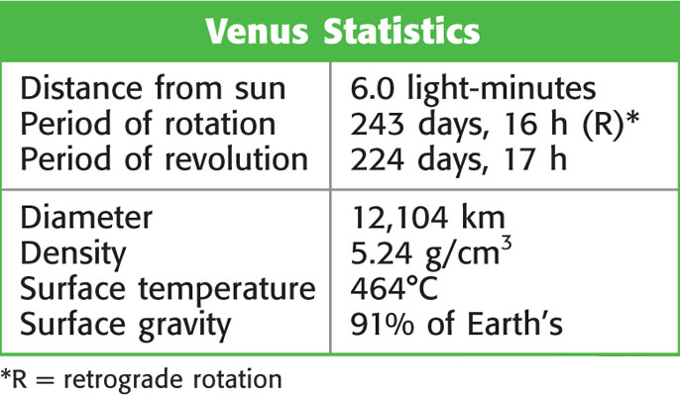
Chapter 21
Section 2 The Inner Planets
Venus: Earth’s Twin?
The Atmosphere of Venus Of all the inner planets, Venus has the densest atmosphere.
Mapping Venus’s Surface The Magellan spacecraft mapped the surface of Venus by using radar waves.
Notes:
Header – dark yellow 24 points Arial Bold
Body text – white 20 points Arial Bold, dark yellow highlights
Bullets – dark yellow
Copyright – white 12 points Arial
Size:
Height: 7.52"
Width: 10.02"
Scale: 70%
Position on slide:
Horizontal - 0"
Vertical - 0"

Slide 14
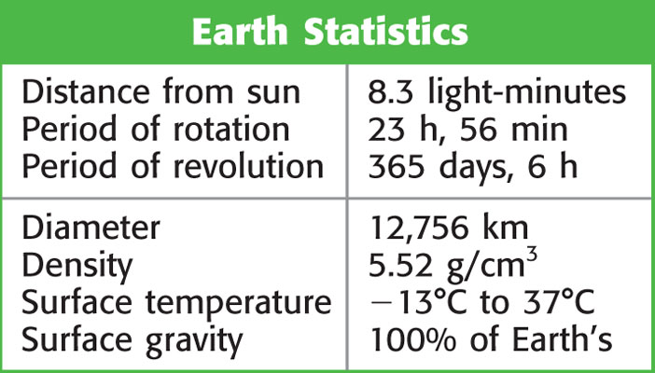
Chapter 21
Section 2 The Inner Planets
Earth: An Oasis in Space
Water on Earth Earth is warm enough to keep most of its water from freezing and cool enough to keep its water from boiling away. Liquid water is important to life on Earth.
The Earth from Space Satellites are used to study the Earth from space in order to better understand global systems.
Notes:
Header – dark yellow 24 points Arial Bold
Body text – white 20 points Arial Bold, dark yellow highlights
Bullets – dark yellow
Copyright – white 12 points Arial
Size:
Height: 7.52"
Width: 10.02"
Scale: 70%
Position on slide:
Horizontal - 0"
Vertical - 0"

Slide 15
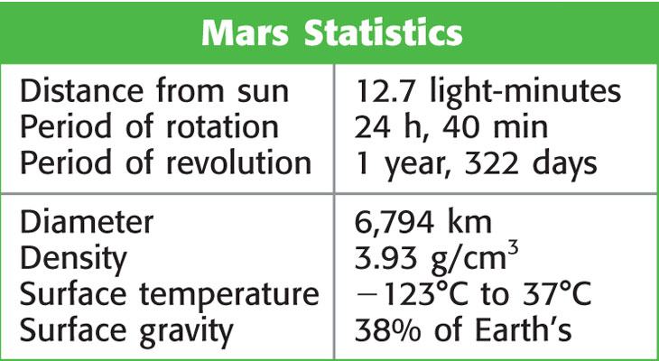
Chapter 21
Section 2 The Inner Planets
Mars: Our Intriguing Neighbor
The Atmosphere of Mars Mars has a thin atmosphere with low air pressure.
Water on Mars Liquid water cannot exist on Mars’s surface today, but most likely it was there in the past.
Notes:
Header – dark yellow 24 points Arial Bold
Body text – white 20 points Arial Bold, dark yellow highlights
Bullets – dark yellow
Copyright – white 12 points Arial
Size:
Height: 7.52"
Width: 10.02"
Scale: 70%
Position on slide:
Horizontal - 0"
Vertical - 0"

Slide 16
Chapter 21
Section 2 The Inner Planets
Mars: Our Intriguing Neighbor, continued
Where Is the Water Now? Mars has two polar icecaps made of frozen water and carbon dioxide. Many scientists think that there is more frozen water beneath the Martian soil
Martian Volcanoes Mars has two large volcanic systems, one of which includes the largest mountain in the solar system.
Notes:
Header – dark yellow 24 points Arial Bold
Body text – white 20 points Arial Bold, dark yellow highlights
Bullets – dark yellow
Copyright – white 12 points Arial
Size:
Height: 7.52"
Width: 10.02"
Scale: 70%
Position on slide:
Horizontal - 0"
Vertical - 0"

Slide 17
Chapter 21
Section 2 The Inner Planets
Mars: Our Intriguing Neighbor, continued
Missions to Mars Several recent missions to Mars were launched to gain a better understanding of the planet.
Notes:
Header – dark yellow 24 points Arial Bold
Body text – white 20 points Arial Bold, dark yellow highlights
Bullets – dark yellow
Copyright – white 12 points Arial
Size:
Height: 7.52"
Width: 10.02"
Scale: 70%
Position on slide:
Horizontal - 0"
Vertical - 0"

Slide 18
Chapter 21
Section 3 The Outer Planets
Bellringer
All planets with atmospheres have weather. Jupiter’s Great Red Spot appears to be very similar to a hurricane system on Earth, but it has lasted for centuries, driven by the planet’s internal thermal energy. Write or tape-record a humorous but accurate weather forecast for one of the planets with an atmosphere.
Notes:
Header – dark yellow 24 points Arial Bold
Body text – white 20 points Arial Bold, dark yellow highlights
Bullets – dark yellow
Copyright – white 12 points Arial
Size:
Height: 7.52"
Width: 10.02"
Scale: 70%
Position on slide:
Horizontal - 0"
Vertical - 0"

Slide 19
Chapter 21
Section 3 The Outer Planets
Objectives
Explain how gas giants are different from terrestrial planets.
Describe the individual characteristics of Jupiter, Saturn, Uranus, Neptune, and Pluto.
Notes:
Header – dark yellow 24 points Arial Bold
Body text – white 20 points Arial Bold, dark yellow highlights
Bullets – dark yellow
Copyright – white 12 points Arial
Size:
Height: 7.52"
Width: 10.02"
Scale: 70%
Position on slide:
Horizontal - 0"
Vertical - 0"

Slide 20
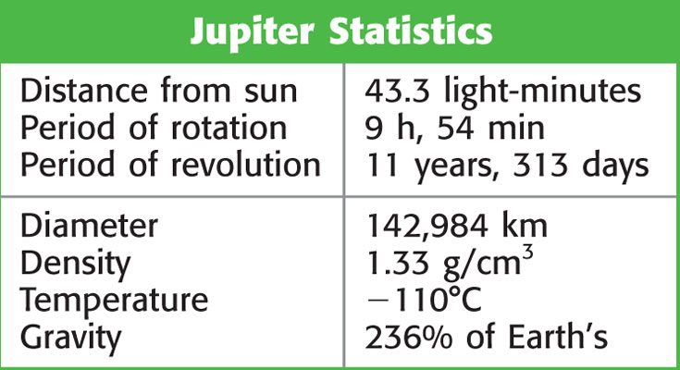
Chapter 21
Section 3 The Outer Planets
Jupiter: A Giant Among Giants
Jumbo Sized Jupiter is the largest planet in our solar system.
NASA Missions to Jupiter NASA has sent five missions to Jupiter to study Jupiter’s atmosphere and moons.
Notes:
Header – dark yellow 24 points Arial Bold
Body text – white 20 points Arial Bold, dark yellow highlights
Bullets – dark yellow
Copyright – white 12 points Arial
Size:
Height: 7.52"
Width: 10.02"
Scale: 70%
Position on slide:
Horizontal - 0"
Vertical - 0"

Slide 21
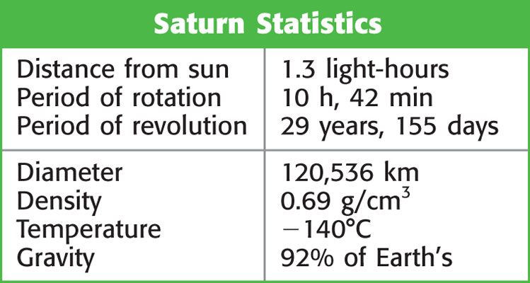
Chapter 21
Section 3 The Outer Planets
Saturn: Still Forming
The Rings of Jupiter Saturn’s rings are the largest of all of the gas giants’ rings.
NASA Exploration of Saturn Launched in 1997, the Cassini spacecraft is designed to study Saturn’s rings, moon, and atmosphere.
Notes:
Header – dark yellow 24 points Arial Bold
Body text – white 20 points Arial Bold, dark yellow highlights
Bullets – dark yellow
Copyright – white 12 points Arial
Size:
Height: 7.52"
Width: 10.02"
Scale: 70%
Position on slide:
Horizontal - 0"
Vertical - 0"

Slide 22
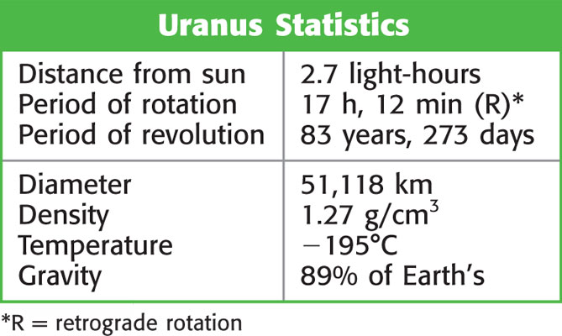
Chapter 21
Section 3 The Outer Planets
Uranus: A Small Giant
Uranus’s Atmosphere The atmosphere of Uranus is mainly hydrogen and methane, which makes the planet appear to be blue-green in color.
Notes:
Header – dark yellow 24 points Arial Bold
Body text – white 20 points Arial Bold, dark yellow highlights
Bullets – dark yellow
Copyright – white 12 points Arial
Size:
Height: 7.52"
Width: 10.02"
Scale: 70%
Position on slide:
Horizontal - 0"
Vertical - 0"

Slide 23
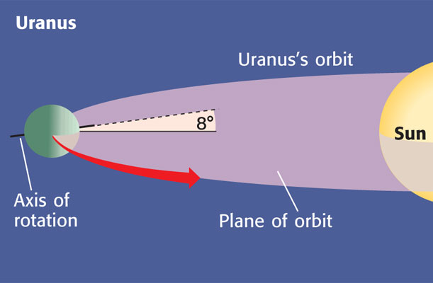
Chapter 21
Section 3 The Outer Planets
Uranus: A Small Giant, continued
A Tilted Planet Unlike most other planets, Uranus is tipped over on its axis. So its axis of rotation is tilted by almost 90° and lies almost in the plane of its orbit.
Notes:
Header – dark yellow 24 points Arial Bold
Body text – white 20 points Arial Bold, dark yellow highlights
Bullets – dark yellow
Copyright – white 12 points Arial
Size:
Height: 7.52"
Width: 10.02"
Scale: 70%
Position on slide:
Horizontal - 0"
Vertical - 0"

Slide 24
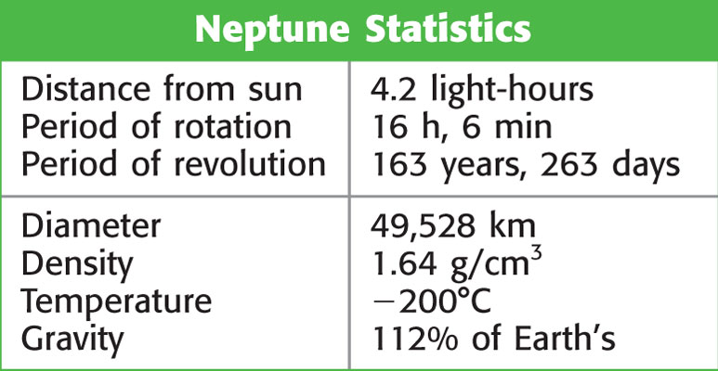
Chapter 21
Section 3 The Outer Planets
Neptune: The Blue World
Discovery of Neptune Neptune was not discovered until 1846.
The Atmosphere of Neptune The composition of Neptune’s atmosphere is similar to that of Uranus’s atmosphere, but Neptune has belts of clouds that are much more visible.
Notes:
Header – dark yellow 24 points Arial Bold
Body text – white 20 points Arial Bold, dark yellow highlights
Bullets – dark yellow
Copyright – white 12 points Arial
Size:
Height: 7.52"
Width: 10.02"
Scale: 70%
Position on slide:
Horizontal - 0"
Vertical - 0"

Slide 25
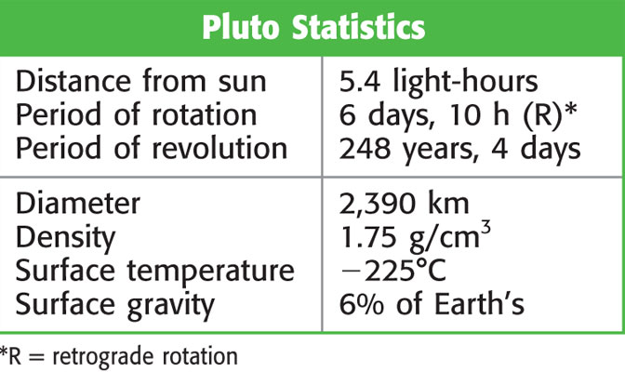
Chapter 21
Section 3 The Outer Planets
Pluto: The Mystery Planet
A Small World Less than half the size of Mercury, Pluto is the smallest planet in the solar system.
A True Planet? Because Pluto is so small and unusual, some scientists think that is should not be classified as a planet. Some scientists classify Pluto as a large asteroid or comet.
Notes:
Header – dark yellow 24 points Arial Bold
Body text – white 20 points Arial Bold, dark yellow highlights
Bullets – dark yellow
Copyright – white 12 points Arial
Size:
Height: 7.52"
Width: 10.02"
Scale: 70%
Position on slide:
Horizontal - 0"
Vertical - 0"

Slide 26
Chapter 21
Section 4 Moons
Bellringer
The first astronauts to land on the moon were quarantined after their mission. NASA wanted to make sure that the astronauts didn’t bring back any disease-causing organisms from the moon. Discuss whether or not they think this would be possible.
Notes:
Header – dark yellow 24 points Arial Bold
Body text – white 20 points Arial Bold, dark yellow highlights
Bullets – dark yellow
Copyright – white 12 points Arial
Size:
Height: 7.52"
Width: 10.02"
Scale: 70%
Position on slide:
Horizontal - 0"
Vertical - 0"

Slide 27
Chapter 21
Section 4 Moons
Objectives
Describe the current theory of the origin of Earth’s moon.
Explain what causes the phases of Earth’s moon.
Describe the difference between a solar eclipse and a lunar eclipse.
Describe the individual characteristics of the moons and other planets.
Notes:
Header – dark yellow 24 points Arial Bold
Body text – white 20 points Arial Bold, dark yellow highlights
Bullets – dark yellow
Copyright – white 12 points Arial
Size:
Height: 7.52"
Width: 10.02"
Scale: 70%
Position on slide:
Horizontal - 0"
Vertical - 0"

Slide 28
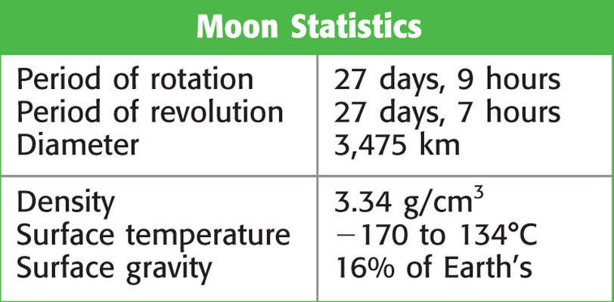
Chapter 21
Section 4 Moons
Luna: The Moon of Earth
The Surface of the Moon The surfaces of bodies that have no atmospheres, such as the moon, preserve a record of almost all of the impacts that the bodies have had.
Notes:
Header – dark yellow 24 points Arial Bold
Body text – white 20 points Arial Bold, dark yellow highlights
Bullets – dark yellow
Copyright – white 12 points Arial
Size:
Height: 7.52"
Width: 10.02"
Scale: 70%
Position on slide:
Horizontal - 0"
Vertical - 0"

Slide 29
Chapter 21
Section 4 Moons
Luna: The Moon of Earth, continued
Lunar Origins The next slide shows how scientists think the moon probably formed.
Current Theory : The moon formed from a piece of Earth’s mantle which broke off during a collision between Earth and a large object
Supported by the fact that the moon has a composition similar to the Earth’s mantle
Notes:
Header – dark yellow 24 points Arial Bold
Body text – white 20 points Arial Bold, dark yellow highlights
Bullets – dark yellow
Copyright – white 12 points Arial
Size:
Height: 7.52"
Width: 10.02"
Scale: 70%
Position on slide:
Horizontal - 0"
Vertical - 0"

Slide 30
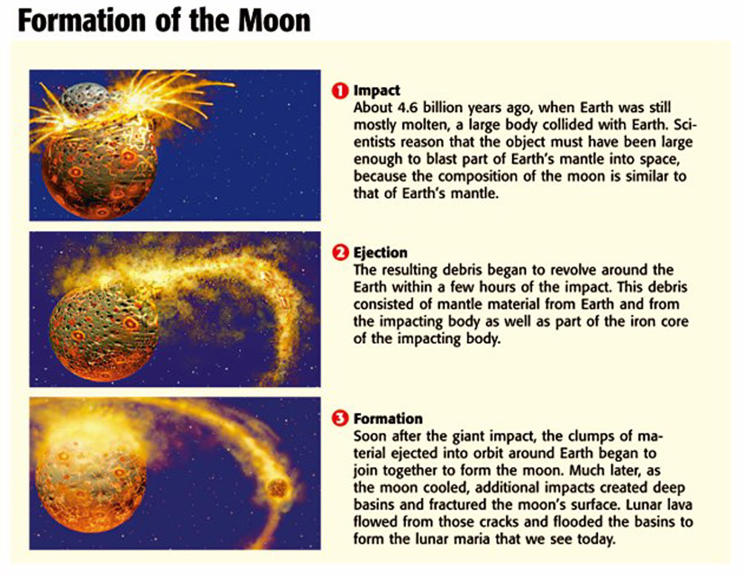
Chapter 21
Section 4 Moons
Notes:
Header – dark yellow 24 points Arial Bold
Body text – white 20 points Arial Bold, dark yellow highlights
Bullets – dark yellow
Copyright – white 12 points Arial
Size:
Height: 7.52"
Width: 10.02"
Scale: 70%
Position on slide:
Horizontal - 0"
Vertical - 0"

Slide 31
Chapter 21
Section 4 Moons
Luna: The Moon of Earth, continued
Phases of the Moon The different appearances of the moon due to its changing position are called phases. The moon takes 29.5 days to get through all of it’s phases.
Waxing and Waning When the moon is waxing, the sunlit fraction that we can see from Earth is getting larger. When the moon is waning, the sunlit fraction is getting smaller.
Notes:
Header – dark yellow 24 points Arial Bold
Body text – white 20 points Arial Bold, dark yellow highlights
Bullets – dark yellow
Copyright – white 12 points Arial
Size:
Height: 7.52"
Width: 10.02"
Scale: 70%
Position on slide:
Horizontal - 0"
Vertical - 0"

Slide 32
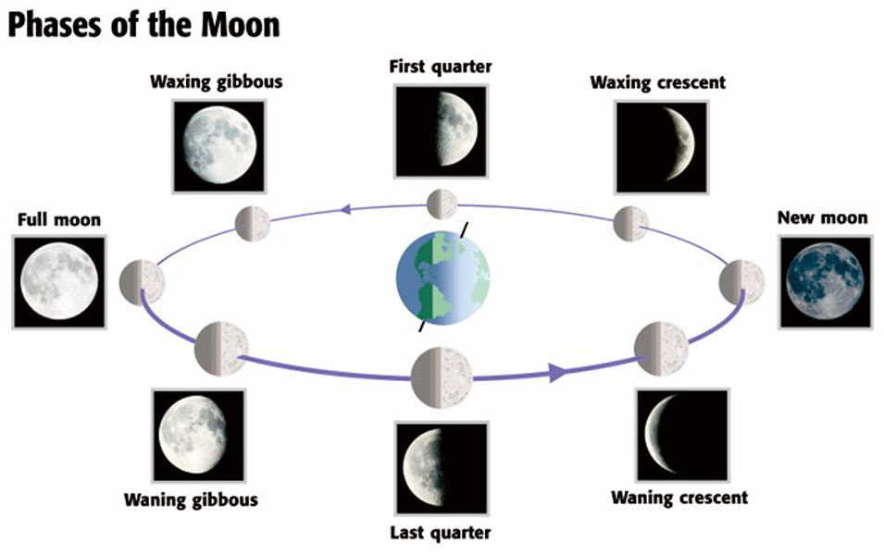
Chapter 21
Section 4 Moons
Notes:
Header – dark yellow 24 points Arial Bold
Body text – white 20 points Arial Bold, dark yellow highlights
Bullets – dark yellow
Copyright – white 12 points Arial
Size:
Height: 7.52"
Width: 10.02"
Scale: 70%
Position on slide:
Horizontal - 0"
Vertical - 0"

Slide 33
Chapter 21
Section 4 Moons
Solar Eclipse
Occurs when the new moon comes between the Earth and the sun
Shadow of moon falls on part of the Earth
Notes:
Header – dark yellow 24 points Arial Bold
Body text – white 20 points Arial Bold, dark yellow highlights
Bullets – dark yellow
Copyright – white 12 points Arial
Size:
Height: 7.52"
Width: 10.02"
Scale: 70%
Position on slide:
Horizontal - 0"
Vertical - 0"

Slide 34
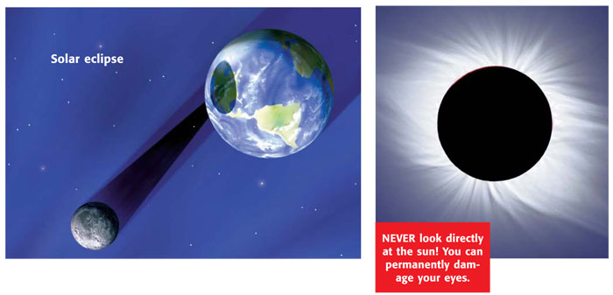
Chapter 21
Section 4 Moons
Luna: The Moon of Earth, continued
Eclipses When the shadow of one celestial body falls on another, an eclipse occurs.
Solar Eclipses During a total solar eclipse, the disk of the moon completely covers the disk of the sun, as shown below.
Notes:
Header – dark yellow 24 points Arial Bold
Body text – white 20 points Arial Bold, dark yellow highlights
Bullets – dark yellow
Copyright – white 12 points Arial
Size:
Height: 7.52"
Width: 10.02"
Scale: 70%
Position on slide:
Horizontal - 0"
Vertical - 0"

Slide 35
Chapter 21
Section 4 Moons
Lunar Eclipse
Occurs when the Earth comes between the sun and moon
Shadow of Earth falls on the moon
The moon is red because when sunlight passes through Earth’s atmosphere, blue light is filtered out
Notes:
Header – dark yellow 24 points Arial Bold
Body text – white 20 points Arial Bold, dark yellow highlights
Bullets – dark yellow
Copyright – white 12 points Arial
Size:
Height: 7.52"
Width: 10.02"
Scale: 70%
Position on slide:
Horizontal - 0"
Vertical - 0"

Slide 36
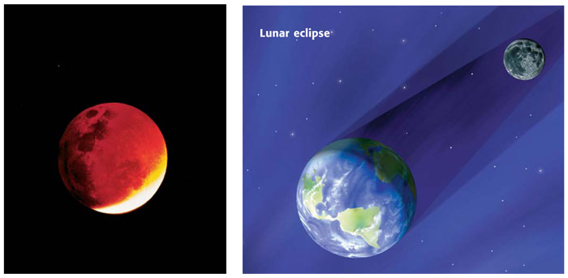
Chapter 21
Section 4 Moons
Luna: The Moon of Earth, continued
Lunar Eclipses During a lunar eclipse, the moon passes through the Earth’s shadow.
The Tilted Orbit of the Moon You don’t see a solar and lunar eclipse every month because the moon’s orbit around the Earth is tilted.
Notes:
Header – dark yellow 24 points Arial Bold
Body text – white 20 points Arial Bold, dark yellow highlights
Bullets – dark yellow
Copyright – white 12 points Arial
Size:
Height: 7.52"
Width: 10.02"
Scale: 70%
Position on slide:
Horizontal - 0"
Vertical - 0"

Slide 37
Chapter 21
Section 4 Moons
The Moons of Other Planets
The Moons of Mars Mars’s two moons, Phobos and Deimos, are small, oddly shaped satellites.
Large & rocky, asteroids caught by Mars’s gravity
The Moons of Jupiter Jupiter has dozens of moons. Liquid water may be beneath the surface of the moon Europa.
Largest 4 : Ganymede, Callisto, Io, and Europa
Known as Galilean satellites
Io is the closest and the most volcanically active
Europa may have liquid water
Notes:
Header – dark yellow 24 points Arial Bold
Body text – white 20 points Arial Bold, dark yellow highlights
Bullets – dark yellow
Copyright – white 12 points Arial
Size:
Height: 7.52"
Width: 10.02"
Scale: 70%
Position on slide:
Horizontal - 0"
Vertical - 0"

Slide 38
Chapter 21
Section 4 Moons
The Moons of Other Planets, continued
The Moons of Saturn Like Jupiter, Saturn has dozens of moons. Most of these moons are small bodies of mostly frozen water but some contain rocky material.
Largest : Titan, believe that Earth may have looked this way before life evolved
The Moons of Uranus Uranus has several moons. Uranus’s largest moons are made of ice and rock and are heavily cratered.
Most unusual: Miranda
Notes:
Header – dark yellow 24 points Arial Bold
Body text – white 20 points Arial Bold, dark yellow highlights
Bullets – dark yellow
Copyright – white 12 points Arial
Size:
Height: 7.52"
Width: 10.02"
Scale: 70%
Position on slide:
Horizontal - 0"
Vertical - 0"

Slide 39
Chapter 21
Section 4 Moons
The Moons of Other Planets, continued
The Moons of Neptune
Several moons which are small and rocky.
Largest is Triton
Triton has a retrograde orbit and a thin nitrogen atmosphere
Triton’s surface is frozen nitrogen and methane, volcanoes eject nitrogen into the air
Notes:
Header – dark yellow 24 points Arial Bold
Body text – white 20 points Arial Bold, dark yellow highlights
Bullets – dark yellow
Copyright – white 12 points Arial
Size:
Height: 7.52"
Width: 10.02"
Scale: 70%
Position on slide:
Horizontal - 0"
Vertical - 0"

Slide 40
Chapter 21
Section 5 Small Bodies in the Solar System
Bellringer
Have scientists ever brought extraterrestrial material to Earth?
Scientists have studied rocks from Mars and other parts of the solar system. How did scientists obtain these rocks?
Record your response in your science journal.
Notes:
Header – dark yellow 24 points Arial Bold
Body text – white 20 points Arial Bold, dark yellow highlights
Bullets – dark yellow
Copyright – white 12 points Arial
Size:
Height: 7.52"
Width: 10.02"
Scale: 70%
Position on slide:
Horizontal - 0"
Vertical - 0"

Slide 41
Chapter 21
Section 5 Small Bodies in the Solar System
Objectives
Explain why comets, asteroids, and meteoroids are important to the study of the formation of the solar system.
Describe the similarities of and differences between asteroids and meteoroids.
Explain how cosmic impacts may affect life on Earth.
Notes:
Header – dark yellow 24 points Arial Bold
Body text – white 20 points Arial Bold, dark yellow highlights
Bullets – dark yellow
Copyright – white 12 points Arial
Size:
Height: 7.52"
Width: 10.02"
Scale: 70%
Position on slide:
Horizontal - 0"
Vertical - 0"

Slide 42
Chapter 21
Section 5 Small Bodies in the Solar System
Comets
What Is a Comet? A small body of ice, rock, and cosmic dust loosely packed together is called a comet.
Formed in the cold, outer solar system back when the planets were formed, thus each is a sample of the early solar system
Has a solid center called a nucleus
No tail until it nears the sun
Notes:
Header – dark yellow 24 points Arial Bold
Body text – white 20 points Arial Bold, dark yellow highlights
Bullets – dark yellow
Copyright – white 12 points Arial
Size:
Height: 7.52"
Width: 10.02"
Scale: 70%
Position on slide:
Horizontal - 0"
Vertical - 0"

Slide 43
Chapter 21
Section 5 Small Bodies in the Solar System
Comets
Comet Tails When a comet passes close enough to the sun, solar radiation heats the ice so that the comet gives off gas and dust in the form of a long tail.
Sometimes there are 2 tails – one made of dust, and one made of ions, which are made of electrically charged particles, the ion tail points away from the sun when blown by solar wind
Notes:
Header – dark yellow 24 points Arial Bold
Body text – white 20 points Arial Bold, dark yellow highlights
Bullets – dark yellow
Copyright – white 12 points Arial
Size:
Height: 7.52"
Width: 10.02"
Scale: 70%
Position on slide:
Horizontal - 0"
Vertical - 0"

Slide 44
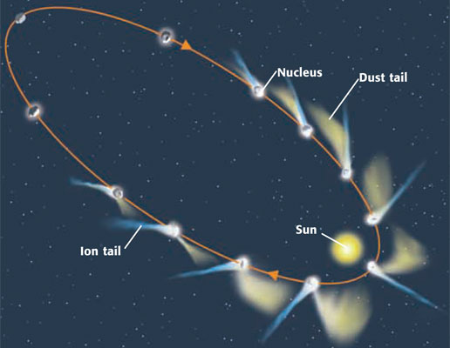
Chapter 21
Section 5 Small Bodies in the Solar System
Comets, continued
Comet Orbits The orbits of all bodies that move around the sun are ellipses. A comet’s ion tail always points away from the sun.
Comet Origins Many scientists think that comets come from the Oort Cloud, a spherical region that surrounds the solar system, or from the Kuiper Belt
Notes:
Header – dark yellow 24 points Arial Bold
Body text – white 20 points Arial Bold, dark yellow highlights
Bullets – dark yellow
Copyright – white 12 points Arial
Size:
Height: 7.52"
Width: 10.02"
Scale: 70%
Position on slide:
Horizontal - 0"
Vertical - 0"

Slide 45
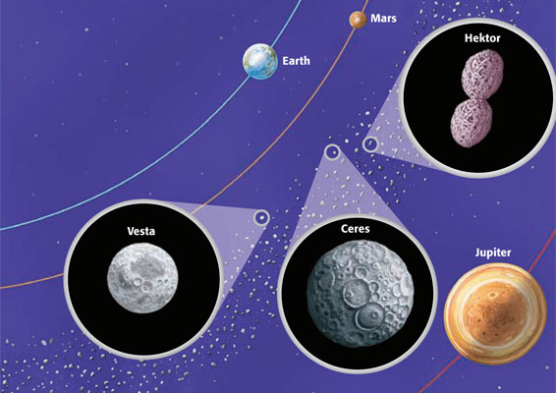
Chapter 21
Section 5 Small Bodies in the Solar System
Asteroids
What Are Asteroids? Small, rocky bodies that revolve around the sun are called asteroids.
Types of Asteroids Asteroids mostly have irregular shapes, larger ones are spherical
Located in the asteroid belt, between Mars and Jupiter
Notes:
Header – dark yellow 24 points Arial Bold
Body text – white 20 points Arial Bold, dark yellow highlights
Bullets – dark yellow
Copyright – white 12 points Arial
Size:
Height: 7.52"
Width: 10.02"
Scale: 70%
Position on slide:
Horizontal - 0"
Vertical - 0"

Slide 46
Chapter 21
Section 5 Small Bodies in the Solar System
Meteoroids
What Are Meteoroids? A meteoroid is a small, rocky body that revolves around the sun.
Similar, but smaller than asteroids
Most burn up in the atmosphere, giving off light and heat energy
.
Notes:
Header – dark yellow 24 points Arial Bold
Body text – white 20 points Arial Bold, dark yellow highlights
Bullets – dark yellow
Copyright – white 12 points Arial
Size:
Height: 7.52"
Width: 10.02"
Scale: 70%
Position on slide:
Horizontal - 0"
Vertical - 0"

Slide 47
Chapter 21
Section 5 Small Bodies in the Solar System
Meteorites
Meteor Showers You can see a large number of meteors during a meteor shower as Earth passes through the dusty debris of comets.
Types of Meteorites Meteorites have different compositions. The three major types of meteorites are stony, metallic, and stony-iron meteorites.
Stony - contain organic materials and water
Metallic - made of iron and nickel
Stony-iron – made of iron and nickel
Notes:
Header – dark yellow 24 points Arial Bold
Body text – white 20 points Arial Bold, dark yellow highlights
Bullets – dark yellow
Copyright – white 12 points Arial
Size:
Height: 7.52"
Width: 10.02"
Scale: 70%
Position on slide:
Horizontal - 0"
Vertical - 0"

Slide 48
Chapter 21
Section 5 Small Bodies in the Solar System
The Role of Impacts in the Solar System
Future Impacts on Earth? Scientists estimate that impacts that are powerful enough to cause a natural disaster might happen once every few thousand years.
Often result in craters
Planets with no atmosphere have more impacts
Large impacts occur every few hundred years
Notes:
Header – dark yellow 24 points Arial Bold
Body text – white 20 points Arial Bold, dark yellow highlights
Bullets – dark yellow
Copyright – white 12 points Arial
Size:
Height: 7.52"
Width: 10.02"
Scale: 70%
Position on slide:
Horizontal - 0"
Vertical - 0"

Slide 49
Chapter 21
Section 5 Small Bodies in the Solar System
The Role of Impacts in the Solar System
The Torino Scale The Torino scale is a system that allows scientists to rate the hazard level of an object moving toward Earth.
0 = small chance of striking Earth
5,6,7 = highly likely to hit Earth
8,9,10 = collision is certain (capable of causing a global catastophe
Notes:
Header – dark yellow 24 points Arial Bold
Body text – white 20 points Arial Bold, dark yellow highlights
Bullets – dark yellow
Copyright – white 12 points Arial
Size:
Height: 7.52"
Width: 10.02"
Scale: 70%
Position on slide:
Horizontal - 0"
Vertical - 0"

Slide 50
Chapter 21
A Family of Planets
Concept Map
Use the terms below to complete the concept map on the next slide.
planets prograde Earth sun | clockwise astronomical units (AU) counterclockwise North Pole
Notes:
Header – dark yellow 24 points Arial Bold
Body text – white 20 points Arial Bold, dark yellow highlights
Bullets – dark yellow
Copyright – white 12 points Arial
Size:
Height: 7.52"
Width: 10.02"
Scale: 70%
Position on slide:
Horizontal - 0"
Vertical - 0"

Slide 51
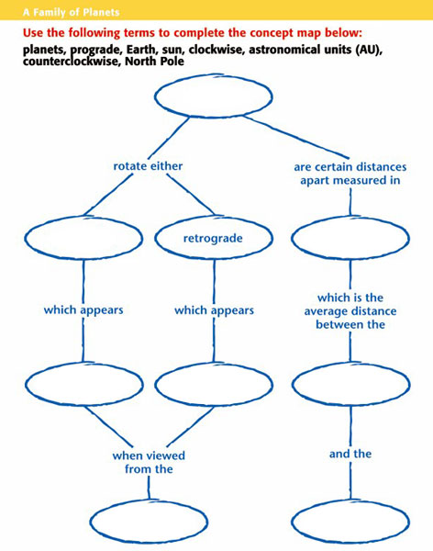
Chapter 21
A Family of Planets
Notes:
Header – dark yellow 24 points Arial Bold
Body text – white 20 points Arial Bold, dark yellow highlights
Bullets – dark yellow
Copyright – white 12 points Arial
Size:
Height: 7.52"
Width: 10.02"
Scale: 70%
Position on slide:
Horizontal - 0"
Vertical - 0"

Slide 52
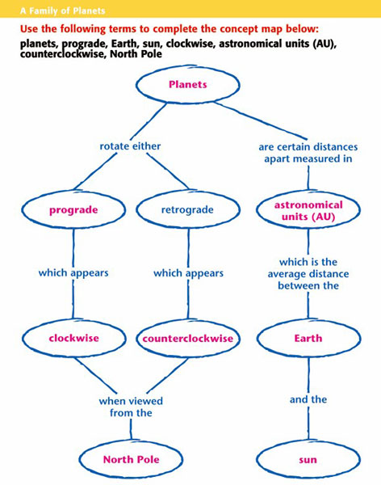
Chapter 21
A Family of Planets
Notes:
Header – dark yellow 24 points Arial Bold
Body text – white 20 points Arial Bold, dark yellow highlights
Bullets – dark yellow
Copyright – white 12 points Arial
Size:
Height: 7.52"
Width: 10.02"
Scale: 70%
Position on slide:
Horizontal - 0"
Vertical - 0"

Slide 53
End of Chapter 21 Show
Notes:
Header – dark yellow 24 points Arial Bold
Body text – white 20 points Arial Bold, dark yellow highlights
Bullets – dark yellow
Copyright – white 12 points Arial
Size:
Height: 7.52"
Width: 10.02"
Scale: 70%
Position on slide:
Horizontal - 0"
Vertical - 0"

Slide 54
Chapter 21
Standardized Test Preparation
Reading
Read each of the passages. Then, answer the questions that follow each passage.

Slide 55
Chapter 21
Standardized Test Preparation
Passage 1 Imagine that it is 200 BCE and you are an apprentice to a Greek astronomer. After years of observing the sky, the astronomer knows all of the constellations as well as the back of his hand. He shows you how the stars all move together—the whole sky spins slowly as the night goes on. He also shows you that among the thousands of stars in the sky, some of the brighter ones slowly change their position relative to the other stars. He names these stars planetai, the Greek word for “wanderers.” Building on the observations of the ancient Greeks, we now know that the planetai are actually planets, not wandering stars.

Slide 56
Chapter 21
Standardized Test Preparation
1. Which of the following did the ancient Greeks know to be true?
A All planets have at least one moon.
B The planets revolve around the sun.
C The planets are much smaller than the stars.
D The planets appear to move relative to the stars.

Slide 57
Chapter 21
Standardized Test Preparation
1. Which of the following did the ancient Greeks know to be true?
A All planets have at least one moon.
B The planets revolve around the sun.
C The planets are much smaller than the stars.
D The planets appear to move relative to the stars.

Slide 58
Chapter 21
Standardized Test Preparation
2. What can you infer from the passage about the ancient Greek astronomers?
F They were patient and observant.
G They knew much more about astronomy than we do.
H They spent all their time counting stars.
I They invented astrology.

Slide 59
Chapter 21
Standardized Test Preparation
2. What can you infer from the passage about the ancient Greek astronomers?
F They were patient and observant.
G They knew much more about astronomy than we do.
H They spent all their time counting stars.
I They invented astrology.

Slide 60
Chapter 21
Standardized Test Preparation
3. What does the word planetai mean in Greek?
A planets
B wanderers
C stars
D moons

Slide 61
Chapter 21
Standardized Test Preparation
3. What does the word planetai mean in Greek?
A planets
B wanderers
C stars
D moons

Slide 62
Chapter 21
Standardized Test Preparation
Passage 2 To explain the source of short-period comets (comets that have a relatively short orbit), the Dutch-American astronomer Gerard Kuiper proposed in 1949 that a belt of icy bodies must lie beyond the orbits of Pluto and Neptune. Kuiper argued that comets were icy planetesimals that formed from the condensation
that happened during the formation of our galaxy. Because the icy bodies are so far from any large planet’s gravitational field (30 to 100 AU), they can remain on the fringe of the solar system.
Continued on the next slide

Slide 63
Chapter 21
Standardized Test Preparation
Passage 2, continued Some theorists speculate that the large moons Triton and Charon were once members of the Kuiper belt before they were captured by Neptune and Pluto. These moons and short-period comets have similar physical and chemical properties.

Slide 64
Chapter 21
Standardized Test Preparation
1. According to the passage, why can icy bodies remain at the edge of the solar system?
A The icy bodies are so small that they naturally float to the edge of the solar system.
B The icy bodies have weak gravitational fields and therefore do not orbit individual planets.
C The icy bodies are short-period comets, which can reside only at the edge of the solar system.
D The icy bodies are so far away from any large planet’s gravitational field that they can remain at the edge of the solar system.

Slide 65
Chapter 21
Standardized Test Preparation
1. According to the passage, why can icy bodies remain at the edge of the solar system?
A The icy bodies are so small that they naturally float to the edge of the solar system.
B The icy bodies have weak gravitational fields and therefore do not orbit individual planets.
C The icy bodies are short-period comets, which can reside only at the edge of the solar system.
D The icy bodies are so far away from any large planet’s gravitational field that they can remain at the edge of the solar system.

Slide 66
Chapter 21
Standardized Test Preparation
2. According to the passage, which of the following best describes the meaning of the word planetesimal?
F a small object that existed during the early development of the solar system
G an extremely tiny object in space
H a particle that was once part of a planet
I an extremely large satellite that was the result of a collision of two objects

Slide 67
Chapter 21
Standardized Test Preparation
2. According to the passage, which of the following best describes the meaning of the word planetesimal?
F a small object that existed during the early development of the solar system
G an extremely tiny object in space
H a particle that was once part of a planet
I an extremely large satellite that was the result of a collision of two objects

Slide 68
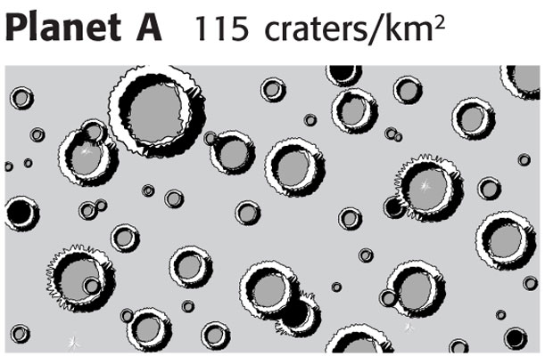
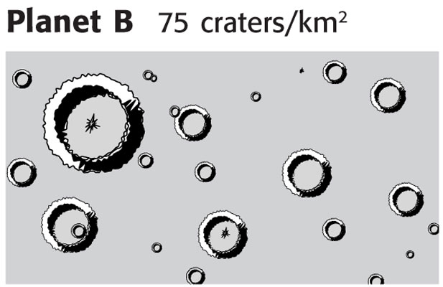
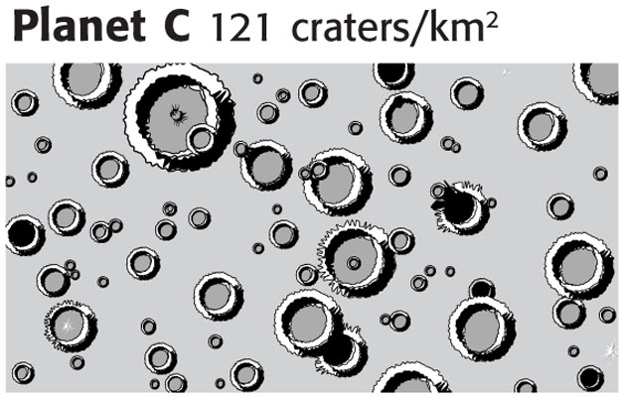
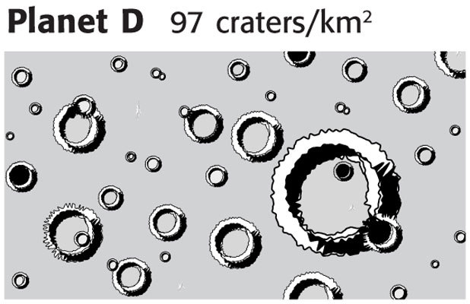
Chapter 21
Standardized Test Preparation
Interpreting Graphics
Use the diagrams below to answer the questions that follow.

Slide 69
Chapter 21
Standardized Test Preparation
1. According to the information above, which planet has the oldest surface?
A planet A
B planet B
C planet C
D planet D

Slide 70
Chapter 21
Standardized Test Preparation
1. According to the information above, which planet has the oldest surface?
A planet A
B planet B
C planet C
D planet D

Slide 71
Chapter 21
Standardized Test Preparation
2. How many more craters per square kilometer are there on planet C than on planet B?
F 46 craters per square kilometer
G 24 craters per square kilometer
H 22 craters per square kilometer
I 6 craters per square kilometer

Slide 72
Chapter 21
Standardized Test Preparation
2. How many more craters per square kilometer are there on planet C than on planet B?
F 46 craters per square kilometer
G 24 craters per square kilometer
H 22 craters per square kilometer
I 6 craters per square kilometer

Slide 73
Chapter 21
Standardized Test Preparation
Math
Read each question, and choose the best answer.

Slide 74
Chapter 3
Standardized Test Preparation
1. Venus’s surface gravity is 91% of Earth’s. If an object weighs 12 N on Earth, how much would it weigh on Venus?
A 53 N
B 13 N
C 11 N
D 8 N

Slide 75
Chapter 3
Standardized Test Preparation
1. Venus’s surface gravity is 91% of Earth’s. If an object weighs 12 N on Earth, how much would it weigh on Venus?
A 53 N
B 13 N
C 11 N
D 8 N

Slide 76
Chapter 21
Standardized Test Preparation
2. Earth’s overall density is 5.52 g/cm3, while Saturn’s density is 0.69 g/cm3. How many times denser is Earth than Saturn?
F 8 times
G 9 times
H 11 times
I 12 times

Slide 77
Chapter 21
Standardized Test Preparation
2. Earth’s overall density is 5.52 g/cm3, while Saturn’s density is 0.69 g/cm3. How many times denser is Earth than Saturn?
F 8 times
G 9 times
H 11 times
I 12 times

Slide 78
Chapter 21
Standardized Test Preparation
3. If Earth’s history spans 4.6 billion years and the Phanerozoic eon was 543 million years, what percentage of Earth’s history does the Phanerozoic eon represent?
A about 6%
B about 12%
C about 18%
D about 24%

Slide 79
Chapter 21
Standardized Test Preparation
3. If Earth’s history spans 4.6 billion years and the Phanerozoic eon was 543 million years, what percentage of Earth’s history does the Phanerozoic eon represent?
A about 6%
B about 12%
C about 18%
D about 24%

Slide 80
Chapter 21
Standardized Test Preparation
4. The diameter of Venus is 12,104 km. The diameter of Mars is 6,794 km. What is the difference between the diameter of Venus and the diameter of Mars?
F 5,400 km
G 5,310 km
H 4,890 km
I 890 km

Slide 81
Chapter 21
Standardized Test Preparation
4. The diameter of Venus is 12,104 km. The diameter of Mars is 6,794 km. What is the difference between the diameter of Venus and the diameter of Mars?
F 5,400 km
G 5,310 km
H 4,890 km
I 890 km

Slide 82
Chapter 21
Section 1 The Nine Planets
Notes:
Header – dark yellow 24 points Arial Bold
Body text – white 20 points Arial Bold, dark yellow highlights
Bullets – dark yellow
Copyright – white 12 points Arial
Size:
Height: 7.52"
Width: 10.02"
Scale: 70%
Position on slide:
Horizontal - 0"
Vertical - 0"

Slide 83
Chapter 21
Section 1 The Nine Planets
Notes:
Header – dark yellow 24 points Arial Bold
Body text – white 20 points Arial Bold, dark yellow highlights
Bullets – dark yellow
Copyright – white 12 points Arial
Size:
Height: 7.52"
Width: 10.02"
Scale: 70%
Position on slide:
Horizontal - 0"
Vertical - 0"

Slide 84
Chapter 21
Section 1 The Nine Planets
Notes:
Header – dark yellow 24 points Arial Bold
Body text – white 20 points Arial Bold, dark yellow highlights
Bullets – dark yellow
Copyright – white 12 points Arial
Size:
Height: 7.52"
Width: 10.02"
Scale: 70%
Position on slide:
Horizontal - 0"
Vertical - 0"

Slide 85
Chapter 21
Section 2 The Inner Planets
Notes:
Header – dark yellow 24 points Arial Bold
Body text – white 20 points Arial Bold, dark yellow highlights
Bullets – dark yellow
Copyright – white 12 points Arial
Size:
Height: 7.52"
Width: 10.02"
Scale: 70%
Position on slide:
Horizontal - 0"
Vertical - 0"

Slide 86
Chapter 21
Section 2 The Inner Planets
Notes:
Header – dark yellow 24 points Arial Bold
Body text – white 20 points Arial Bold, dark yellow highlights
Bullets – dark yellow
Copyright – white 12 points Arial
Size:
Height: 7.52"
Width: 10.02"
Scale: 70%
Position on slide:
Horizontal - 0"
Vertical - 0"

Slide 87
Chapter 21
Section 2 The Inner Planets
Notes:
Header – dark yellow 24 points Arial Bold
Body text – white 20 points Arial Bold, dark yellow highlights
Bullets – dark yellow
Copyright – white 12 points Arial
Size:
Height: 7.52"
Width: 10.02"
Scale: 70%
Position on slide:
Horizontal - 0"
Vertical - 0"

Slide 88
Chapter 21
Section 2 The Inner Planets
Notes:
Header – dark yellow 24 points Arial Bold
Body text – white 20 points Arial Bold, dark yellow highlights
Bullets – dark yellow
Copyright – white 12 points Arial
Size:
Height: 7.52"
Width: 10.02"
Scale: 70%
Position on slide:
Horizontal - 0"
Vertical - 0"

Slide 89
Chapter 21
Section 3 The Outer Planets
Notes:
Header – dark yellow 24 points Arial Bold
Body text – white 20 points Arial Bold, dark yellow highlights
Bullets – dark yellow
Copyright – white 12 points Arial
Size:
Height: 7.52"
Width: 10.02"
Scale: 70%
Position on slide:
Horizontal - 0"
Vertical - 0"

Slide 90
Chapter 21
Section 3 The Outer Planets
Notes:
Header – dark yellow 24 points Arial Bold
Body text – white 20 points Arial Bold, dark yellow highlights
Bullets – dark yellow
Copyright – white 12 points Arial
Size:
Height: 7.52"
Width: 10.02"
Scale: 70%
Position on slide:
Horizontal - 0"
Vertical - 0"

Slide 91
Chapter 21
Section 3 The Outer Planets
Notes:
Header – dark yellow 24 points Arial Bold
Body text – white 20 points Arial Bold, dark yellow highlights
Bullets – dark yellow
Copyright – white 12 points Arial
Size:
Height: 7.52"
Width: 10.02"
Scale: 70%
Position on slide:
Horizontal - 0"
Vertical - 0"

Slide 92
Chapter 21
Section 3 The Outer Planets
Notes:
Header – dark yellow 24 points Arial Bold
Body text – white 20 points Arial Bold, dark yellow highlights
Bullets – dark yellow
Copyright – white 12 points Arial
Size:
Height: 7.52"
Width: 10.02"
Scale: 70%
Position on slide:
Horizontal - 0"
Vertical - 0"

Slide 93
Chapter 21
Section 3 The Outer Planets
Notes:
Header – dark yellow 24 points Arial Bold
Body text – white 20 points Arial Bold, dark yellow highlights
Bullets – dark yellow
Copyright – white 12 points Arial
Size:
Height: 7.52"
Width: 10.02"
Scale: 70%
Position on slide:
Horizontal - 0"
Vertical - 0"

Slide 94
Chapter 21
Section 3 The Outer Planets
Notes:
Header – dark yellow 24 points Arial Bold
Body text – white 20 points Arial Bold, dark yellow highlights
Bullets – dark yellow
Copyright – white 12 points Arial
Size:
Height: 7.52"
Width: 10.02"
Scale: 70%
Position on slide:
Horizontal - 0"
Vertical - 0"

Slide 95
Chapter 21
Section 4 Moons
Notes:
Header – dark yellow 24 points Arial Bold
Body text – white 20 points Arial Bold, dark yellow highlights
Bullets – dark yellow
Copyright – white 12 points Arial
Size:
Height: 7.52"
Width: 10.02"
Scale: 70%
Position on slide:
Horizontal - 0"
Vertical - 0"

Slide 96
Chapter 21
Section 4 Moons
Notes:
Header – dark yellow 24 points Arial Bold
Body text – white 20 points Arial Bold, dark yellow highlights
Bullets – dark yellow
Copyright – white 12 points Arial
Size:
Height: 7.52"
Width: 10.02"
Scale: 70%
Position on slide:
Horizontal - 0"
Vertical - 0"

Slide 97
Chapter 21
Section 4 Moons
Notes:
Header – dark yellow 24 points Arial Bold
Body text – white 20 points Arial Bold, dark yellow highlights
Bullets – dark yellow
Copyright – white 12 points Arial
Size:
Height: 7.52"
Width: 10.02"
Scale: 70%
Position on slide:
Horizontal - 0"
Vertical - 0"

Slide 98
Chapter 21
Section 4 Moons
Notes:
Header – dark yellow 24 points Arial Bold
Body text – white 20 points Arial Bold, dark yellow highlights
Bullets – dark yellow
Copyright – white 12 points Arial
Size:
Height: 7.52"
Width: 10.02"
Scale: 70%
Position on slide:
Horizontal - 0"
Vertical - 0"

Slide 99
Chapter 21
Section 4 Moons
Notes:
Header – dark yellow 24 points Arial Bold
Body text – white 20 points Arial Bold, dark yellow highlights
Bullets – dark yellow
Copyright – white 12 points Arial
Size:
Height: 7.52"
Width: 10.02"
Scale: 70%
Position on slide:
Horizontal - 0"
Vertical - 0"

