Slide 1
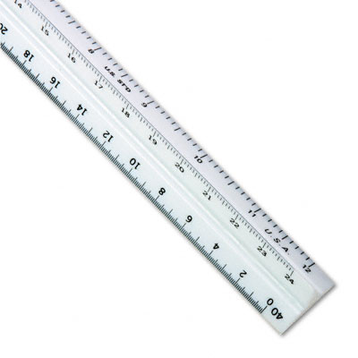
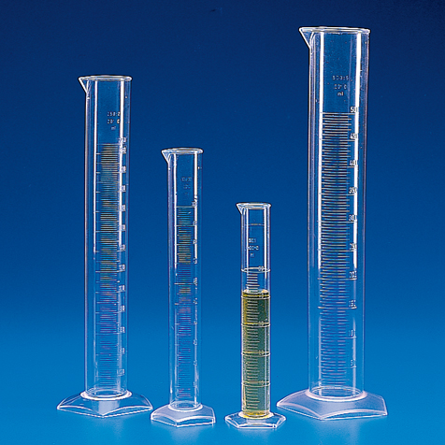
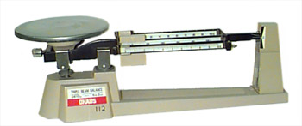
International System of Units (SI units)
This is the standard system of measurement used by many scientists.
Look at page 149

Slide 2
Introduction The Properties of Matter matter-is anything that has mass and takes up________.

Slide 3
Matter is not just something you can see and touch. Invisible gases are also forms of matter that have physical and chemical properties.
Matter is anything that has mass & volume . Even though we cannot usually see gases in the atmosphere, we are able to feel wind and see its effects.
The Properties of Matter

Slide 4
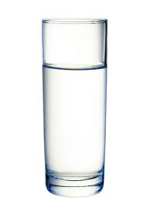
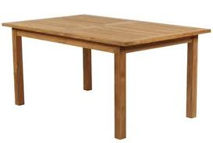
What do you have in common with
a table, a glass of water, and a neon sign?

Slide 5
Matter cannot share the same space at the same time with something else. Look at figure 1 on page 4

Slide 6
Volume-
The amount of space taken up by an object.

Slide 7
Demonstration (pg. 4)
Rock
Paper Clip
Book
Pencil
Cardboard Box
How are these objects alike?

Slide 8
They all take up space. This is volume.

Slide 9
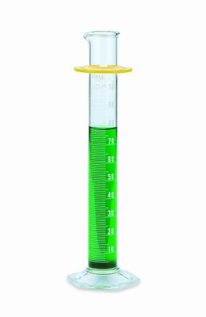
Measuring the Volume of Liquids
You will use a graduated cylinder to measure the volume of liquids.

Slide 10
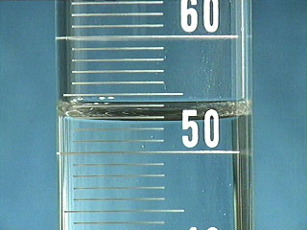
Meniscus
meniscus-the curve at a liquid’s surface by which one measures the volume of the liquid
To measure the volume of most liquids, look at the bottom of the meniscus (look at pg. 5)

Slide 11
Liquid Volume
Liters (L) and milliliters (mL) are the units used most often to express the volume of liquids.

Slide 12
Group Volume Activity
Page 5
Quick Lab

Slide 13
Volume of a Regularly Shaped Object
The volume of any solid object is expressed in cubic units.
cubic- “having three dimensions”
m³ (cubic meters) and cm³ (cubic centimeters)
are the most often used to express the volume of a solid.

Slide 14
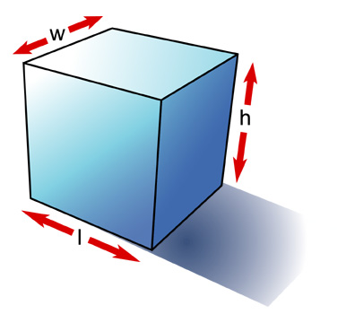
Formula to find the volume of regularly shaped objects
To find the volume of a cube or a rectangular object:
volume =length x width x height
Look at page 6

Slide 15
Review of triple beam balance, reading the meniscus, and measuring volume of a regular shaped object,

Slide 16
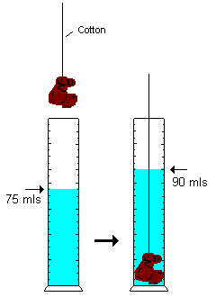
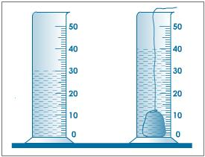
Volume of an Irregularly Shaped Solid Object
You have to find the volume of the water that the object displaces.
The volume of the water displaced by the object is equal to its volume.

Slide 17
Steps to measure the volume:
Fill the graduated cylinder with a designated amount of water and record
Add the object, then record the water level again.
Subtract this from the original water level.
This is your volume.

Slide 18
Mass-is the amount of matter in an object
The only way to change the mass of an object is to change the amount of matter that makes up the object.
You and a peanut are both matter, but you are made of more matter than a peanut, so you have more mass.

Slide 19
What is the difference between mass and weight?
weight-is a measure of the gravitational force exerted on an object
The more mass an object has, the greater the gravitational force on the object.
An objects weight can change depending on its location in the universe.
An object would weigh less on the moon and more on the earth because the moon has less gravitational force.

Slide 20
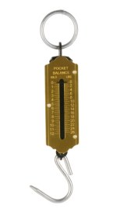
What is the difference between weight and mass?
Mass
Weight
It is a measure of the amount of matter in an object
It is always constant no matter where you are in the universe.
Mass is measured by using a balance.
Mass is expressed in grams (kg, mg, or g)
It is a measure of the gravitational force on an object.
Weight varies depending on where the object is in relation to the earth.
Weight is measured by using a spring scale.
Weight is expressed in newtons (N)

Slide 21
Ohaus Triple-Beam Balance Tutorial
Ohaus Triple-beam balance Tutorial

Slide 22
Look at page 8
There are 2 blocks: one sponge and one
brick
The brick has more mass, so a greater gravitational force is exerted on it. Therefore, it weighs more.
Weight is a good estimate of the mass of an object on Earth because gravity does not change on Earth.

Slide 23
Using this information see if you can Calculate the Math Focus Problems
1 Newton is = 100 grams on Earth

Slide 24
Math Focus (page 8)
A student has a mass of 45,000 g. How much does this student weigh in newtons?
45,000g
100g = 450 g

Slide 25
What is the weight of a car that has a mass of 1,362,000g?
1,362,000g
100g =

Slide 26
=13,620g

Slide 27
Your pair of boots has a mass of 850g. If each boot has exactly the same mass, what is the weight of each boot?

Slide 28
850g
2g = 425g
425g
100g = 4.25g

Slide 29
Inertia-It is the tendency of an object to resist a change in motion.
An object will remain at rest until something causes the object to move.
An object will keep moving at the same speed and in the same direction unless something acts on the object to change its speed or direction.

Slide 30
The heavier something is, the more resistance there will be to move it.
For example, playing kick ball with a bowling ball would be very difficult to get the ball moving (and painful).

Slide 31
Mass is a measure of inertia.
An object that has a large mass is harder to get moving and harder to stop than an object with less mass.
For example, pushing a grocery cart with a potato in it is easy (small mass), but pushing a cart filled with potatoes is more difficult to start and stop.

Slide 32
Section 2: Physical Properties
physical property-can be observed or measured without changing the matter’s identity.
Physical properties:
Magnetism
Thermal conductivity
Color
Volume
Strength
State
Density
Malleability
Ductility
Solubility
Flexibility

Slide 33
20 questions

Slide 34
Density
Is the amount of matter in a given
space(volume).
A golf ball and a table tennis ball(ping pong ball) have similar volumes, but one has more mass. So, the greater mass has more density.

Slide 35
Liquid Layers
The order of the layers shows the order of increasing density.
The densest layer is on the bottom.

Slide 36
Density of Solids
Which would you rather carry around all day:
a kilogram of lead of a kilogram of feathers?

Slide 37
Both have the same mass, but the feathers would take up much more volume(space).
Knowing the density of a substance can tell you if it will float or sink in water.
If the density of an object is less than the density of water, the object will float.
If it is more than the density of water, it will sink.

Slide 38
Solving for Density
To find density:
1. Measure an object’s mass
2. Measure the object’s volume
D = m
v
Units are: g/cm³, g/mL³, kg/m³, and kg/L

Slide 39
Using Density to Identify Substances
It is a useful physical property for identifying substances.
Each substance has a density that differs from the densities of other substances.
The density of a substance is always the same at a given temperature and pressure.
Look at Table 1 on page 13

Slide 40
Math Focus on Page 13
What is the density of an object whose mass is 25g and whose volume is 10cm³?

Slide 41
1. Find the density of a substance that has a
mass of 45 kg and a volume of 43 m³.
Be sure to use the correct units for
density.

Slide 42
2. Suppose you have a lead ball whose mass is 454g. What is the ball’s volume?
Use table 1 on page 13.

Slide 43
What is the mass of a 15 mL sample of mercury?

Slide 44
Physical Changes do not form new substances
physical change-a change that affects one or more physical properties of a substance.
Examples of physical changes:
Pounding a piece of silver into a heart
A popsicle melting(all changes of state are physical)
Smashing an aluminum can
Freezing water
Sanding a piece of wood
Dissolving sugar in water
Melt butter

Slide 45
Matter and Physical Changes
A physical change does not change the identity of the matter

Slide 46
Chemical Properties
They describe matter based on its ability to
change into new matter that has different
properties.

Slide 47
Types of Chemical Properties
A substance has these properties even when it is not burning or reacting.
Flammability-ability of a substance to burn
Reactivity-ability of two or more substances to combine and form one or more new substances (look at figure 1 on page 16).
Look at figure 2 on page 17
Physical vs. Chemical Property

Slide 48
Chemical Change
This happens when one or more substances are changed into new substances that have new and different properties.
Chemical changes and chemical properties are not the same.
How are they different?
Chemical changes is the process where the substances actually change into new substance.
Chemical properties describe matter based on it’s ability to change into new matter with different properties.

Slide 49
Examples of Chemical Changes
Look at page 18
Hot gas
Soured milk
Effervescent tablets
Statue of liberty
Digestion of food
Using a battery
Baking a cake (figure 4)

Slide 50
Signs of Chemical Change
Odor
Color change
Heat
Fizzing
Foaming
Sound
Light

Slide 51
Chemical changes change the identity of the matter involved.
These are difficult to reverse.
Some chemical changes can be reversed (not many). One example is:
Using an electric current to split water into hydrogen and oxygen.

Slide 52
Can physical and chemical changes be reversed?
Most physical changes are easily reversed.
Most chemical changes are not easily reversed.
For example, fireworks

Slide 53
The most important question to ask when deciding whether a physical or chemical change has happened is:
“Did the composition change?”
composition-is the type of matter that makes up the object and the way that the matter is arranged in the object
Look at figure 5 on page 20

Slide 54
Physical changes do not change the composition of a substance.
For example, water can be a liquid, solid, or gas, but it’s composition is the same.
A chemical change is:
electrolysis-a process where water is broken down into hydrogen and oxygen gases.

Slide 55
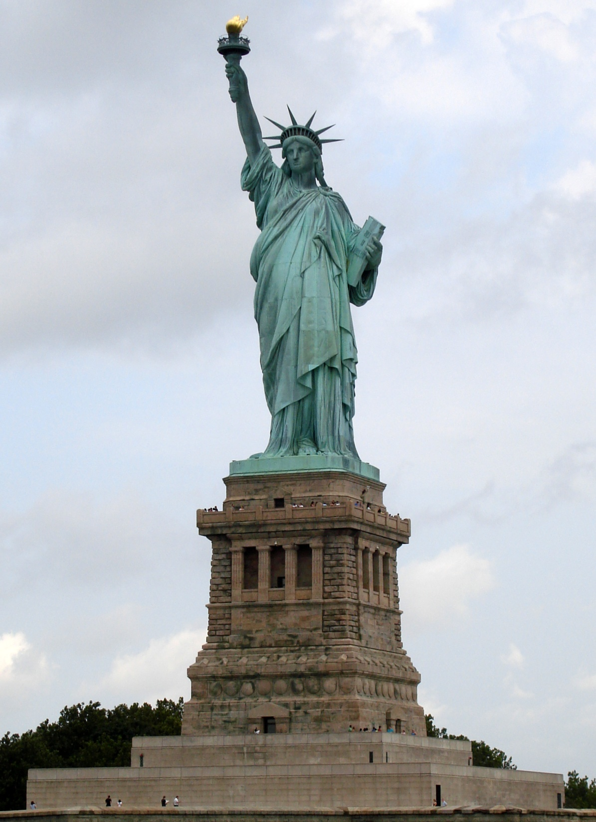
Statue of Liberty Today

Slide 56
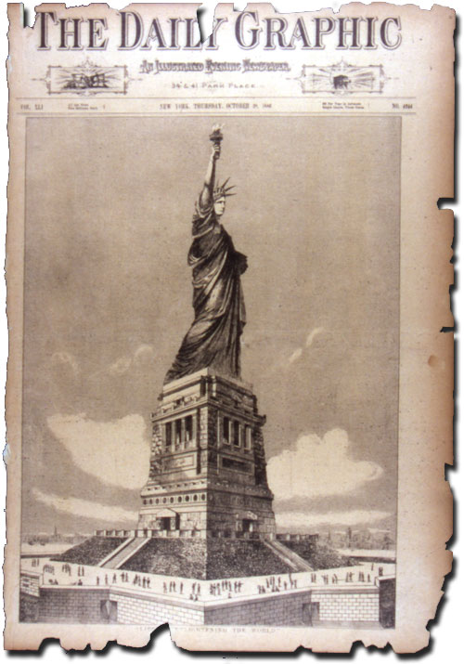
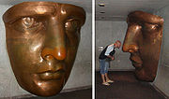
Original Statue of Liberty
What happened to the Statue of Liberty?

Slide 57
 | Mixed with water | Mixed with vinegar | Mixed with iodine solution
substance
Substance | Change | Property | Change | Property | Change | Property
Baking powder
Baking soda
Cornstarch Sugar
Table 2: Changes and Properties

