Slide 1
Resources
Chapter Presentation
Bellringers
Transparencies
Standardized Test Prep
Image and Math Focus Bank
CNN Videos
Visual Concepts

Slide 2
Chapter 1
The Atmosphere
Table of Contents
Section 1 Characteristics of the Atmosphere
Section 2 Atmospheric Heating
Section 3 Global Winds and Local Winds
Section 4 Air Pollution
Section 5 Maintaining Air Quality
Notes:
Header – dark yellow 24 points Arial Bold
Body text – white 20 points Arial Bold, dark yellow highlights
Bullets – dark yellow
Copyright – white 12 points Arial
Size:
Height: 7.52"
Width: 10.02"
Scale: 70%
Position on slide:
Horizontal - 0"
Vertical - 0"

Slide 3
Section 1 Characteristics of the Atmosphere
Chapter 1
Bellringer
List the ways that the atmosphere is different from outer space.
Write your list in your science journal.
Notes:
Header – dark yellow 24 points Arial Bold
Body text – white 20 points Arial Bold, dark yellow highlights
Bullets – dark yellow
Copyright – white 12 points Arial
Size:
Height: 7.52"
Width: 10.02"
Scale: 70%
Position on slide:
Horizontal - 0"
Vertical - 0"

Slide 4
Section 1 Characteristics of the Atmosphere
Chapter 1
Objectives
Describe the composition of Earth’s atmosphere.
Explain why air pressure changes with altitude.
Explain how air temperature changes with atmospheric composition.
Describe the layers of the atmosphere.

Slide 5
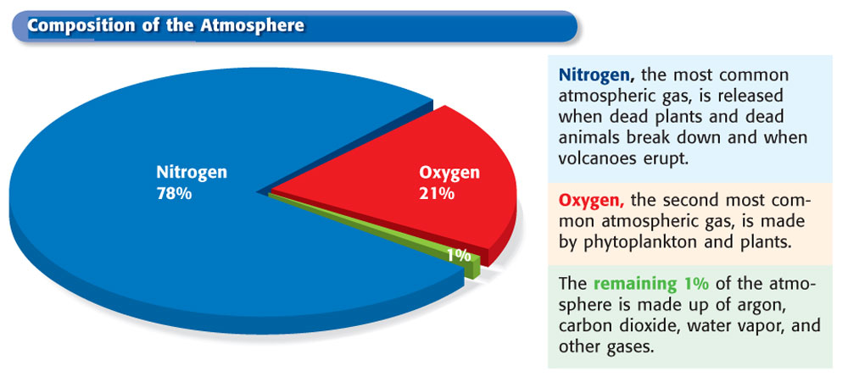
Section 1 Characteristics of the Atmosphere
Chapter 1
The Composition of the Atmosphere
The atmosphere is made up mostly of nitrogen gas. Oxygen makes up a little more than 20% of the atmosphere.

Slide 6
Section 1 Characteristics of the Atmosphere
Chapter 1
Atmospheric Pressure and Temperature
The atmosphere is held around the Earth by gravity. Gravity pulls gas molecules in the atmosphere toward the Earth’s surface, causing air pressure.
As altitude increases, air pressure decreases.
Air temperature decreases as altitude increases. Lower parts of the atmosphere are warmer because they contain a high percentage of gases that absorb solar energy.

Slide 7
Section 1 Characteristics of the Atmosphere
Chapter 1
Layers of the Atmosphere
The Troposphere: The Layer in Which We Live The lowest layer of the atmosphere, which lies next to the Earth’s surface, is called the troposphere.
The Stratosphere: Home of the Ozone Layer The atmospheric layer above the troposphere is called the stratosphere.
The Mesosphere: The Middle Layer The mesosphere is the middle layer of the atmosphere. It is also the coldest layer.

Slide 8
Section 1 Characteristics of the Atmosphere
Chapter 1
Layers of the Atmosphere, continued
The Thermosphere: The Edge of the Atmosphere The uppermost atmospheric layer is called the thermosphere.
The Ionosphere: Home of the Auroras In the upper mesosphere and the lower thermosphere, nitrogen and oxygen atoms absorb harmful solar energy. This area is called the ionosphere.

Slide 9
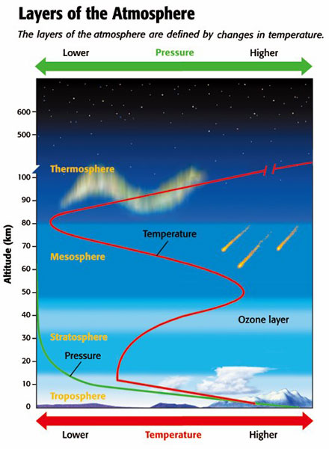
Chapter 1
Section 1 Characteristics of the Atmosphere

Slide 10
Chapter 1
Section 2 Atmospheric Heating
Bellringer
How is food heated in an oven?
Record your response in your science journal.

Slide 11
Chapter 1
Section 2 Atmospheric Heating
Objectives
Describe what happens to solar energy that reaches Earth.
Summarize the processes of radiation, conduction, and convection.
Explain the relationship between the greenhouse effect and global warming.

Slide 12
Chapter 1
Section 2 Atmospheric Heating
Energy in the Atmosphere
Radiation: Energy Transfer by Waves The Earth receives energy from the sun by radiation. Radiation is the transfer of energy as electromagnetic waves.
Conduction: Energy Transfer by Contact Thermal conduction is the transfer of thermal energy through a material.
Convection: Energy Transfer by Circulation Convection is the transfer of thermal energy by the circulation or movement of a liquid or gas.

Slide 13
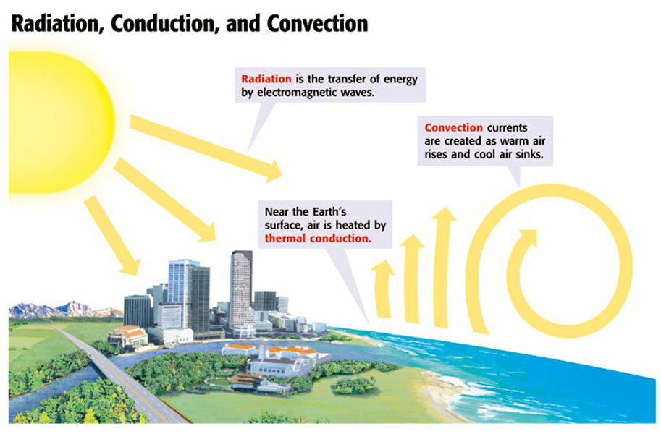
Chapter 1
Section 2 Atmospheric Heating

Slide 14
Chapter 1
Section 2 Atmospheric Heating
Energy in the Atmosphere, continued
The Greenhouse Effect and Life on Earth The greenhouse effect is the process by which gases in the atmosphere absorb thermal energy and radiate it back to Earth.

Slide 15
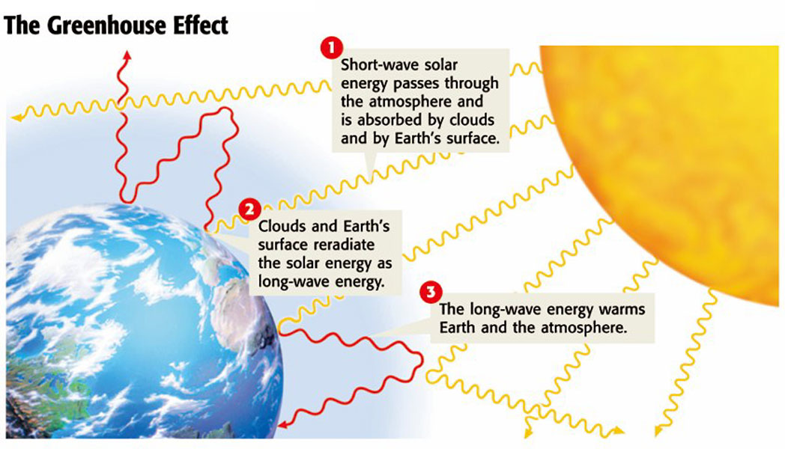
Chapter 1
Section 2 Atmospheric Heating

Slide 16
Chapter 1
Section 2 Atmospheric Heating
Energy in the Atmosphere, continued
Greenhouse Gases and Global Warming Some scientists think that an increase of greenhouse gases in the atmosphere may be the cause of global warming.
The Radiation Balance: Energy In, Energy Out The amount of energy Earth receives and the amount of energy returned to space must be approximately equal.

Slide 17
Section 3 Global Winds and Local Winds
Chapter 1
Bellringer
Write a poem about moving air. The poem should include an explanation of why air moves.
Record your response in your science journal.

Slide 18
Section 3 Global Winds and Local Winds
Chapter 1
Objectives
Explain the relationship between air pressure and wind direction.
Describe global wind patterns.
Explain the causes of local wind patterns.

Slide 19
Section 3 Global Winds and Local Winds
Chapter 1
Why Air Moves
Air Rises at the Equator and Sinks at the Poles As the cold air sinks, it creates areas of high pressure around the poles. This cold polar air then flows toward the equator.
Pressure Belts Are Found Every 30º Convection cells are separated by pressure belts, bands of high and low pressure.

Slide 20
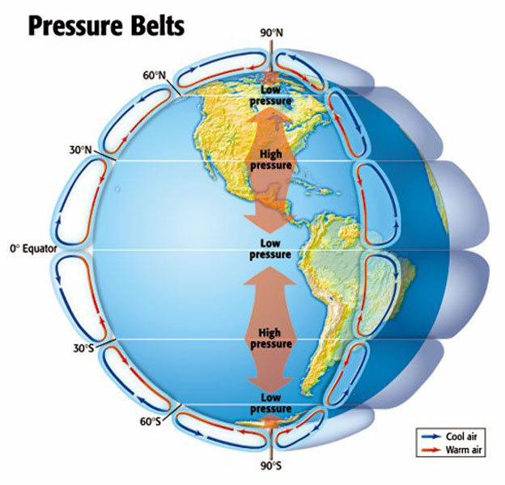
Chapter 1
Section 3 Global Winds and Local Winds

Slide 21
Section 3 Global Winds and Local Winds
Chapter 1
Why Air Moves, continued
The Coriolis Effect The apparent curving of the path of currents due to the Earth’s rotation is called the Coriolis effect.

Slide 22
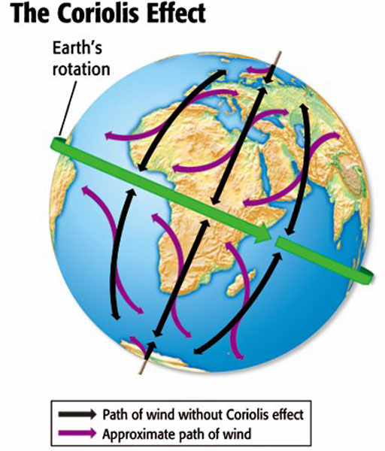
Chapter 1
Section 3 Global Winds and Local Winds

Slide 23
Section 3 Global Winds and Local Winds
Chapter 1
Global Winds
Polar Easterlies are the wind belts that extend from the poles to 60° latitude in both hemispheres.
Westerlies are the wind belts found between 30° and 60° latitude in both hemispheres.
Trade Winds are the winds that blow from 30° latitude almost to the equator in both hemispheres.

Slide 24
Section 3 Global Winds and Local Winds
Chapter 1
Global Winds, continued
The Doldrums The trade winds of the Northern and Southern Hemispheres meet in an area around the equator called the doldrums.
The Horse Latitudes At about 30° north and 30° south latitude, sinking air creates an area of high pressure called the horse latitudes.
Jet Streams are narrow belts of high-speed winds that blow in the upper troposphere and lower stratosphere.

Slide 25
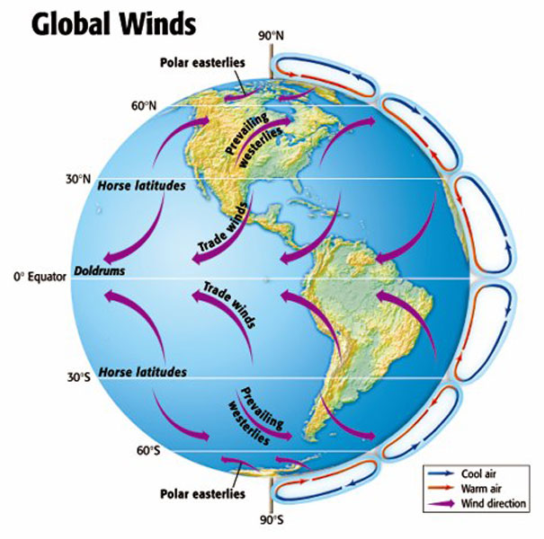
Chapter 1
Section 3 Global Winds and Local Winds

Slide 26
Section 3 Global Winds and Local Winds
Chapter 1
Local Winds
Local winds generally move short distances and can blow from any direction.
Mountain and valley breezes are examples of local winds caused by an area’s geography.
Sea and land breezes are affected by temperature.

Slide 27
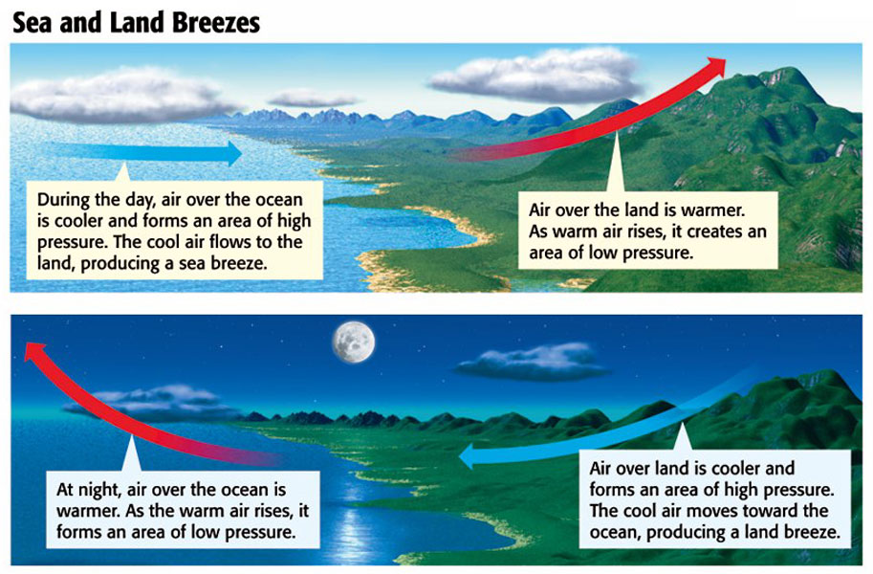
Chapter 1
Section 3 Global Winds and Local Winds

Slide 28
Chapter 1
Section 4 Air Pollution
Bellringer
Examine the filter mask. Make a list of three situations in which one might wear such a mask.
Write your list in your science journal.

Slide 29
Chapter 1
Section 4 Air Pollution
Objectives
Compare primary and secondary air pollution.
Identify the major sources of pollution.
Explain the effects of the ozone hole.
List five effects of air pollution on the human body.
Identify ways to reduce air pollution.

Slide 30
Chapter 1
Section 4 Air Pollution
Primary Pollutants
Pollutants that are put directly into the air by human or natural activity are primary pollutants.
Primary pollutants from human sources include carbon monoxide, dust, smoke, and chemicals from paint and other substances.

Slide 31
Chapter 1
Section 4 Air Pollution
Secondary Pollutants
Pollutants that form when primary pollutants react with other primary pollutants or with naturally occurring substances, such as water vapor, are secondary pollutants.
Smog is a secondary pollutant that forms when ozone and vehicle exhaust react with sunlight, as shown in the next slide.

Slide 32
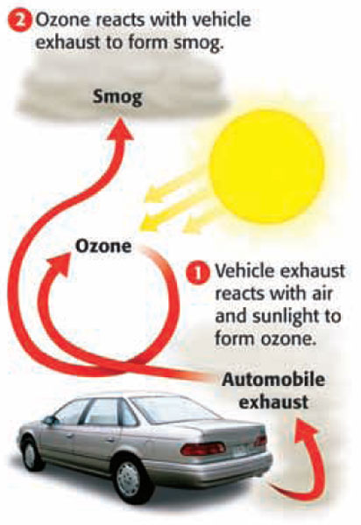
Chapter 1
Section 4 Air Pollution
Secondary Pollutants, continued

Slide 33
Chapter 1
Section 4 Air Pollution
Sources of Human-Caused Air Pollution
Industrial Air Pollution Many industrial plants and electric power plants burn fossil fuels, such as coal, to produce energy. Burning some types of coal without pollution controls can release large amounts of air pollution.
Indoor Air Pollution Sometimes, the air inside a building can be more polluted than the air outside. Sources of indoor air pollution are shown on the next slide.

Slide 34
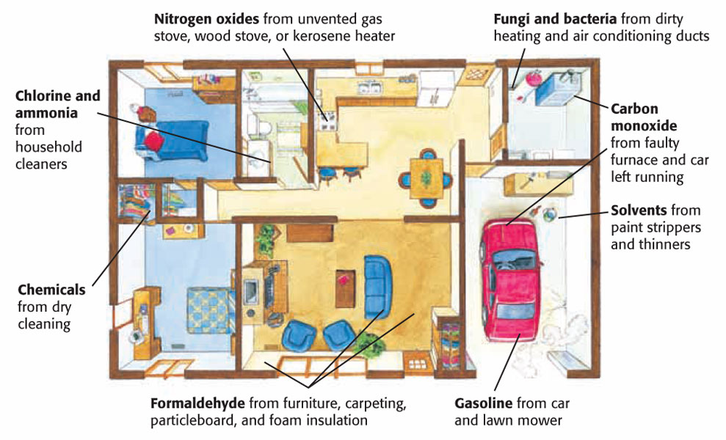
Chapter 1
Section 4 Air Pollution
Indoor Air Pollution, continued

Slide 35
Chapter 1
Section 4 Air Pollution
Acid Precipitation
Rain, sleet or snow that contains a high concentration of acids is called acid precipitation.
Acid Precipitation and Plants Acid precipitation can cause the acidity of soil to increase. This process, called acidification, changes the balance of a soil’s chemistry and negatively affects plants.

Slide 36
Chapter 1
Section 4 Air Pollution
Acid Precipitation, continued
The Effects of Acid Precipitation on Forests In some areas of the world, acid precipitation has damaged large areas of forest.
Acid Precipitation and Aquatic Ecosystems If acid precipitation increases the acidity of a lake or stream, aquatic plants, fish, and other aquatic organisms may die.

Slide 37
Chapter 1
Section 4 Air Pollution
The Ozone Hole
The Earth’s protective ozone layer is thinning over the Arctic and Antarctic regions. These ozone holes allow more UV radiation, which damages genes and can cause skin cancer, to reach the earth’s surface.
Cooperation to Reduce the Ozone Hole In 1987, many nations agreed to reduce the use of CFCs, the chemicals that cause ozone depletion. Because CFCs remain active for 60 to 120 years, however, it will take many years for the ozone layer to recover.

Slide 38
Chapter 1
Section 4 Air Pollution
Ozone and Ozone Holes
Click below to watch the Visual Concept.
You may stop the video at any time by pressing the Esc key.
Visual Concept

Slide 39
Chapter 1
Section 4 Air Pollution
Air Pollution and Human Health
Short-Term Effects of air pollution, such as coughing, headaches, and eye irritation can be avoided by staying indoors on days when the air quality is poor.
Long-Term Effects of air pollution, such as lung cancer, are particularly dangerous because they may not be noticed until many years after exposure.

Slide 40
Chapter 1
Section 4 Air Pollution
Cleaning up Air Pollution
The EPA sets air quality standards to protect against the effects of air pollution on human health as well as on crops, vegetation, and buildings.
Controlling Air Pollution from Industry The Clean Air Act requires many industries to use pollution-control devices.

Slide 41
Chapter 1
Section 4 Air Pollution
Reducing Air Pollution
The Allowance Trading System Companies are fined for exceeding limits and rewarded for low emissions.
Reducing Motor Vehicle Emissions The EPA requires car makers to meet a certain standard for vehicle exhaust. New technology to reduce emissions is under development.
People can make choices to reduce air pollution, such as car-pooling and conserving electricity.

Slide 42
Chapter 1
The Atmosphere
Concept Map
Use the terms below to complete the concept map on the next slide.
radiation pressure mesosphere atmosphere | nitrogen troposphere oxygen thermosphere

Slide 43
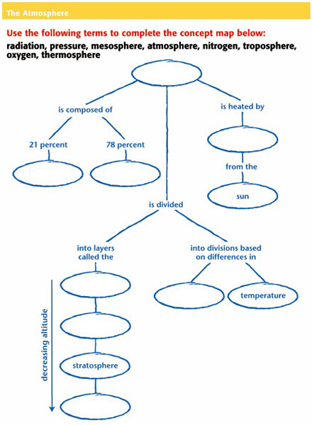
Chapter 1
Concept Map

Slide 44
Chapter 1
The Atmosphere
CNN Videos
Eye on the Environment: Global Warming
Eye on the Environment: CO₂ and the Artic Ocean
Multicultural Connections: China Coal
Scientists in Action: Tracking Mercury in the Everglades
Eye on the Environment: Hazy Days

Slide 45
Chapter 1
Standardized Test Preparation
Reading
Read each of the passages. Then, answer the questions that follow each passage.

Slide 46
Chapter 1
Standardized Test Preparation
Passage 1 An important part of the EPA’s Acid Rain Program is the allowance trading system, which is designed to reduce sulfur dioxide emissions. In this system, 1 ton of sulfur dioxide (SO₂ )emission is equivalent to one allowance. A limited number of allowances are allocated for each year. Companies purchase the allowances from the EPA and are allowed to produce as many tons of SO₂ as they have allowances for the year.
Continued on the next slide

Slide 47
Chapter 1
Standardized Test Preparation
Passage 1, continued Companies can buy, sell, or trade allowances, but if they exceed their allowances, they must pay a fine. The system allows a company to determine the most cost-effective ways to comply with the Clean Air Act. A company can reduce emissions by using technology that conserves energy, using renewable energy sources, or updating its pollution-control devices and using low-sulfur fuels.

Slide 48
Chapter 1
Standardized Test Preparation
1. According to the passage, which of the following methods can a company use to reduce emissions?
A preserving wildlife habitat
B lobbying Congress
C using high-sulfur fuels
D using technology that conserves energy

Slide 49
Chapter 1
Standardized Test Preparation
1. According to the passage, which of the following methods can a company use to reduce emissions?
A preserving wildlife habitat
B lobbying Congress
C using high-sulfur fuels
D using technology that conserves energy

Slide 50
Chapter 1
Standardized Test Preparation
2. In the passage, what does allowance mean?
F an allotment for a pollutant
G an allocation of money for reducing pollution
H an alleviation of pollution
I an allegation of pollution

Slide 51
Chapter 1
Standardized Test Preparation
2. In the passage, what does allowance mean?
F an allotment for a pollutant
G an allocation of money for reducing pollution
H an alleviation of pollution
I an allegation of pollution

Slide 52
Chapter 1
Standardized Test Preparation
Passage 2 The chinook, or “snow eater,” is a dry wind that blows down the eastern side of the Rocky Mountains from New Mexico to Alaska. Arapaho Indians gave the chinook its name because of its ability to melt large amounts of snow very quickly. Chinooks form when moist air is forced over a mountain range. The air cools as it rises. As the air cools, it releases moisture by raining or snowing.
Continued on the next slide

Slide 53
Chapter 1
Standardized Test Preparation
Passage 2, continued As the dry air flows over the mountaintop, it compresses and heats the air below. The warm, dry wind that results is worthy of the name “snow eater” because it melts a half meter of snow in a few hours! The temperature change caused when a chinook rushes down a mountainside can also be dramatic. In 1943 in Spearfish, South Dakota, the temperature at 7:30 in the morning was –4°F. But two minutes later, a chinook caused the temperature to soar 49° to 45°F.

Slide 54
Chapter 1
Standardized Test Preparation
1. Which of the following descriptions best explains why the chinook is called “the snow eater”?
A The chinook is so cold that it prevents the formation of snow in the atmosphere.
B The chinook is so warm that it prevents the formation of snow in the atmosphere.
C The chinook is a warm wind that has high humidity.
D The chinook is a warm wind that has low humidity.

Slide 55
Chapter 1
Standardized Test Preparation
1. Which of the following descriptions best explains why the chinook is called “the snow eater”?
A The chinook is so cold that it prevents the formation of snow in the atmosphere.
B The chinook is so warm that it prevents the formation of snow in the atmosphere.
C The chinook is a warm wind that has high humidity.
D The chinook is a warm wind that has low humidity.

Slide 56
Chapter 1
Standardized Test Preparation
2. According to the passage, at what time did the temperature reach 45°F in Spearfish, South Dakota?
F 7:30 p.m.
G 7:32 p.m.
H 7:30 a.m.
I 7:32 a.m.

Slide 57
Chapter 1
Standardized Test Preparation
2. According to the passage, at what time did the temperature reach 45°F in Spearfish, South Dakota?
F 7:30 p.m.
G 7:32 p.m.
H 7:30 a.m.
I 7:32 a.m.

Slide 58
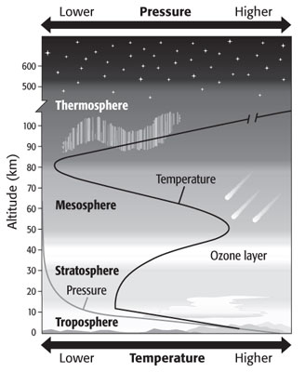
Chapter 1
Standardized Test Preparation
Interpreting Graphics
Use the illustration below to answer the questions that follow.

Slide 59
Chapter 1
Standardized Test Preparation
1. Which of the following statements describes how temperature changes in the mesosphere?
A Temperature increases as altitude increases.
B Temperature decreases as altitude increases.
C Temperature decreases as pressure increases.
D Temperature does not change as pressure increases.

Slide 60
Chapter 1
Standardized Test Preparation
1. Which of the following statements describes how temperature changes in the mesosphere?
A Temperature increases as altitude increases.
B Temperature decreases as altitude increases.
C Temperature decreases as pressure increases.
D Temperature does not change as pressure increases.

Slide 61
Chapter 1
Standardized Test Preparation
2. In which layers does temperature decrease as pressure decreases?
F the troposphere and the mesosphere
G the troposphere and the stratosphere
H the ozone layer and the troposphere
I the ozone layer and the thermosphere

Slide 62
Chapter 1
Standardized Test Preparation
2. In which layers does temperature decrease as pressure decreases?
F the troposphere and the mesosphere
G the troposphere and the stratosphere
H the ozone layer and the troposphere
I the ozone layer and the thermosphere

Slide 63
Chapter 1
Standardized Test Preparation

Slide 64
Chapter 1
Standardized Test Preparation
3. A research balloon took measurements at 23 km, 35 km, 52 km, 73 km, 86 km, 92 km, 101 km, and 110 km. Which measurements were taken in the mesosphere?
A measurements at 23 km and 35 km
B measurements at 52 km and 73 km
C measurements at 86 km and 92 km
D measurements at 101 km and 110 km

Slide 65
Chapter 1
Standardized Test Preparation
3. A research balloon took measurements at 23 km, 35 km, 52 km, 73 km, 86 km, 92 km, 101 km, and 110 km. Which measurements were taken in the mesosphere?
A measurements at 23 km and 35 km
B measurements at 52 km and 73 km
C measurements at 86 km and 92 km
D measurements at 101 km and 110 km

Slide 66
Chapter 1
Standardized Test Preparation
Math
Read each question and choose the best answer.

Slide 67
Chapter 1
Standardized Test Preparation
1. An airplane is flying at a speed of 500 km/h when it encounters a jet stream moving in the same direction at 150 km/h. If the plane flies with the jet stream, how much farther will the plane travel in 1.5 h?
A 950 km
B 525 km
C 225 km
D 150 km

Slide 68
Chapter 1
Standardized Test Preparation
1. An airplane is flying at a speed of 500 km/h when it encounters a jet stream moving in the same direction at 150 km/h. If the plane flies with the jet stream, how much farther will the plane travel in 1.5 h?
A 950 km
B 525 km
C 225 km
D 150 km

Slide 69
Chapter 1
Standardized Test Preparation
2. Today’s wind speed was measured at 18 km/h. What was the wind speed in meters per hour?
F 1.8 m/h
G 180 m/h
H 1,800 m/h
I 18,000 m/h

Slide 70
Chapter 1
Standardized Test Preparation
2. Today’s wind speed was measured at 18 km/h. What was the wind speed in meters per hour?
F 1.8 m/h
G 180 m/h
H 1,800 m/h
I 18,000 m/h

Slide 71
Chapter 1
Standardized Test Preparation
3. Rockport received 24.1 cm of rain on Monday, 12.5 cm of rain on Tuesday, and 5.8 cm of rain on Thursday. The rest of the week, it did not rain. How much rain did Rockport receive during the week?
A 18.3 cm
B 36.6 cm
C 42.4 cm
D 45.7 cm

Slide 72
Chapter 15
Standardized Test Preparation
3. Rockport received 24.1 cm of rain on Monday, 12.5 cm of rain on Tuesday, and 5.8 cm of rain on Thursday. The rest of the week, it did not rain. How much rain did Rockport receive during the week?
A 18.3 cm
B 36.6 cm
C 42.4 cm
D 45.7 cm

Slide 73
Chapter 1
Standardized Test Preparation
4. A weather station recorded the following temperatures during a 5 h period: 15°C, 18°C, 13°C, 15°C, and 20°C. What was the average temperature during this period?
F 14.2°C
G 15.2°C
H 16.2°C
I 20.2°C

Slide 74
Chapter 1
Standardized Test Preparation
4. A weather station recorded the following temperatures during a 5 h period: 15°C, 18°C, 13°C, 15°C, and 20°C. What was the average temperature during this period?
F 14.2°C
G 15.2°C
H 16.2°C
I 20.2°C

Slide 75
Chapter 1
Standardized Test Preparation
5. The temperature in Waterford, Virginia, increased 1.3°C every hour for 5 h. If the temperature in the morning was –4°C, what was the temperature 4 h later?
A 2.5°C
B 2.3°C
C 1.3°C
D 1.2°C

Slide 76
Chapter 1
Standardized Test Preparation
5. The temperature in Waterford, Virginia, increased 1.3°C every hour for 5 h. If the temperature in the morning was –4°C, what was the temperature 4 h later?
A 2.5°C
B 2.3°C
C 1.3°C
D 1.2°C

Slide 77
Section 1 Characteristics of the Atmosphere
Chapter 1

Slide 78
Chapter 1
Section 4 Air Pollution

Slide 79
Chapter 1
Section 4 Air Pollution

Slide 80
Chapter 1
Standardized Test Preparation
Use the illustration below to answer the questions that follow.

