Slide 1
Review
What is the difference between mass and weight?

Slide 2
Weight of an object depends on gravity, while mass of an object does not.
Weight of an object will change if the object is moved to the moon or to other planets, but mass will remain the same.
Because mass and weight are constant on Earth, people tend to confuse the two concepts.

Slide 3
Matter in Motion
Reference point-object that appears to stay in place.
Motion-when an object changes position over time relative to a reference point.
How can you describe an object’s motion?

Slide 4
By using direction: N, S, E, W, up, or down
By using the earth’s surface
Nonmoving objects like buildings and trees
A moving object like a bird
Look at figure 1 on page 4

Slide 5
World’s Most Widely used System of Units
SI units- International system of units. It is the modern form of the metric system.
It is listed on page 217.

Slide 6
Speed- the distance traveled by an object divided by the time taken to travel that distance.
Look at the picture again and suppose the time interval between the pictures was 10 seconds (time) and the balloon traveled 50 meters (distance) in that time.
To calculate the speed of the balloon :
Distance = speed
Time

Slide 7
SI units for speed:
Meters per second
Kilometers per hour
Feet per second
Miles per hour

Slide 8
Calculating Average Speed:
Most objects are not going to travel at a constant speed, so you can use this to calculate the average speed.
average speed= total distance
total time

Slide 9
Look at the graph on Figure 2 on page 5
The blue line shows the total distance traveled during a 4 hour period. The distance traveled during each hour is different. Why does the distance vary?

Slide 10
Because the speed is not constant
Average speed for the trip can be calculated as follows:
average speed = 360 km = 90 km/h
4h

Slide 11
Math Focus
1. Kira jogs to a store 72 m away in a time of
36 s. What is Kira’s average speed?

Slide 12
If you travel 7.5 km and walk for 1.5 h, what is your average speed?

Slide 13
An airplane traveling from San Francisco to Chicago travels 1,260 km in 3.5 h. What is the airplane’s average speed?

Slide 14
Imagine that two birds leave the same tree at the same time. They both fly at 10km/h for 5 min., 12km/h for 8 min., and 5km/h for 10 min. Why don’t they end up at the same place?

Slide 15
Because the birds went in different directions. Their speeds were the same, but they had different velocities.
velocity-the speed of an object in a particular direction.
Speed and velocity are not the same. Velocity must have a direction.

Slide 16
If you say an airplane’s velocity is 500 km/h, it is not correct, but if you say the airplane’s velocity is:
500 km/h south, it is correct.

Slide 17
Changing Velocity
constant velocity-motion along a straight line
An object’s velocity changes if the speed or direction changes.

Slide 18
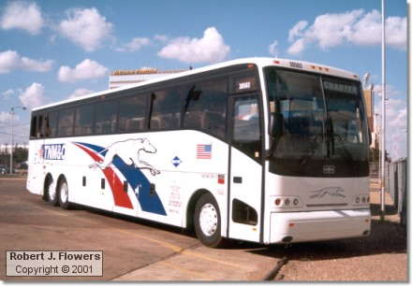
Resultant Velocity-combining velocities of more than one moving object
Bus traveling east at 15 m/s.
You stand up and walk in the same
direction that the bus is moving
Bus is traveling east at 15 m/s. You stand
up and walk in the opposite direction
that the bus is moving.
15 m/s east + 1 m/s east = 16 m/s east
15 m/s east – 1 m/s west = 14 m/s east
When you combine two velocities that
are in the same direction, add them
together to find the resultant velocity.
When you combine two velocities that
are in opposite directions, subtract the
smaller velocity from the larger velocity
to find the resultant velocity.

Slide 19
Acceleration-
Is the rate at which velocity changes.
Velocity changes if speed changes, direction changes, or both.
So, an object accelerates if it’s speed, direction, or both change.

Slide 20
positive acceleration-increase in velocity
negative acceleration (deceleration)-decrease in velocity
The faster the velocity changes, the greater
the acceleration is.

Slide 21
Calculating Average Acceleration
average acceleration = final velocity – starting velocity
time it takes to change velocity
Acceleration is expressed in meters/second/second
m/s/s or m/s²
Why? Velocity is expressed in meters/second (m/s)
and time is expressed in seconds (s).

Slide 22
Look at page 8 figure 5
With each second that the cyclist travels
southward, his velocity increases by 1 m/s. The calculation is as follows:
average acceleration = 5 m/s – 1 m/s = 1 m/s²
4 s south

Slide 23
Look at the graph on page 8
In the first 8 seconds, would you be traveling up or down a hill?
How do you know?

Slide 24
Because the acceleration is positive.
What happens the last 2 seconds?

Slide 25
During the last 2 seconds, your car starts climbing the next hill. The acceleration is negative because your velocity decreases as time passes.

Slide 26
Do you have acceleration if you are completely still?

Slide 27
You are traveling in a circle as the Earth rotates.
An object traveling in a circular motion is always changing its direction.
Because its direction is always changing, it is accelerating.

Slide 28
centripetal acceleration-acceleration that occurs in a circular motion.
Examples are:
ferris wheels and windmills

Slide 29
force-a push or a pull
It can change the acceleration of an object.
All forces have size and direction.
It is expressed in a unit called a newton (N).
All forces act on objects.
Examples are opening a book, picking up keys, sitting in a chair, and bulldozing dirt.

Slide 30
Unknown Forces
Look at figure 2 on page 11. It is not always easy to determine what is exerting a force and what is receiving a force.

Slide 31
Gravity-a force of attraction between objects that is due to their masses.

Slide 32
Net Force-
The combination of all the forces acting on an object.
How do you determine net force?
It depends on the direction of the forces.
The net force tells you whether the forces on
the object are balanced or unbalanced.

Slide 33
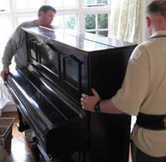
If the forces are in the same direction like the piano on page 11, then the two forces are added together to determine net force.
30N + 25N = 55 N Total Net Force
30 N
25N

Slide 34
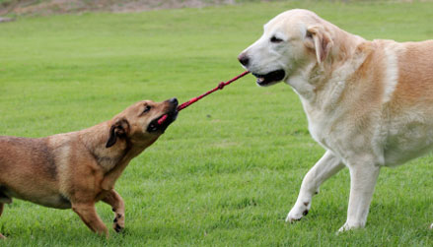
If forces are in different directions:
Subtract the smaller force from the larger force. Look at page 12 figure 4
8N
Net Force
15N – 8N = 7N
to the right
15N

Slide 35
Balanced and Unbalanced Forces
If the net force is 0, then the forces are balanced.
If the net force is not 0, then the forces are unbalanced.
If there is an unbalanced force, there will be a change in motion (change in speed or direction).
These are necessary to cause nonmoving objects to move.

Slide 36
Unbalanced forces and Balanced forces
Interactive Video

Slide 37
http://www.seekscience.org/interact/
Amusement Park Game (computer lab)

Slide 38
Friction-
A force that opposes motion between two surfaces that are in contact.
It is a force that can cause a moving object to slow down or stop.

Slide 39
The amount of friction between 2 surfaces depends on many factors:
1. The force pushing the surfaces together.
If the force increases, the hills and valleys come
into closer contact. This increases the friction.
Objects that weigh less exert less friction
between surfaces.
The roughness of the surface.
Rough surfaces have more hills and valleys than smooth surfaces causing greater friction.
A ball rolling on the ground slows down because of friction.
What would happen if the ball was rolled on ice vs. grass?

Slide 40
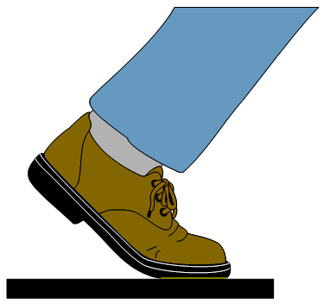
Friction Video

Slide 41
Friction Websites
Friction
Forces in Action BBC

Slide 42
Friction: Luge
Magnetic Train
Bill Nye
Friction Video
Bill Nye

Slide 43
Types of Friction
Kinetic – means moving. It is a friction
between moving surfaces.

Slide 44
Amount of Kinetic Friction depends on if it is:
1. Sliding(usually greater friction because more
contact between surfaces)
Types: applying brakes on a bike, writing with your pencil, scratching an itch
2. Rolling(usually easier to more objects on wheels)
Important in transportation, and anything else that has wheels

Slide 45
Second Type of Friction:
Static Friction- means not moving. When a
force is applied to an object but does not
cause the object to move.
Why doesn’t it move? The force applied balances the static friction.
Static Friction disappears when the object starts to move, then kinetic friction occurs.

Slide 46
Harmful Friction
Friction between moving engine parts increases the temperature and causes the parts to wear down.
Friction causes holes in your socks and jeans.
Friction by wind and water causes erosion.

Slide 47
Helpful Friction
Friction allows the tires to push against the ground to move the car.
It allows you to hold a pencil.
Without it you could not walk.

Slide 48
Ways to Reduce Friction
Lubricants-substances that are applied to surfaces to reduce the friction between surfaces.
Examples are: oil, wax, and grease
Switching from sliding kinetic friction to rolling kinetic friction.
Make surfaces that rub against each other smoother.

Slide 49
Ways to Increase Friction
Make the surface rougher.
ie. Scatter sand on icy roads to keep cars from sliding.
Baseball players wearing textured batting gloves to increase the friction between their hands and the bat.
Increasing the force pushing the surfaces together. Ie. Sanding wood-the harder you sand (push), the faster you sand.

Slide 50
Section 4: Gravity
Gravity- a force of attraction between objects that is due to their masses.
All matter is affected by gravity. Why?
Because matter has mass.
The gravitational force pulls objects toward each other.

Slide 51
Why don’t you see the effects of the attraction between objects?
The mass of the objects are too small to cause a force large enough to move objects toward each other.
One object that is large enough to cause a noticeable attraction is Earth.
Because of it is the largest mass around us, we have to apply forces to overcome Earth’s gravitational force.

Slide 52
More on Gravitational Force
Earth’s gravitational force pulls everything toward the center of the Earth.
That is why dropped objects fall toward the Earth.

Slide 53
Bill Nye: Gravity

Slide 54
Sir Issac Newton 1665
People wanted two questions answered:
Why do objects fall toward the Earth?
What keeps the planets moving in the sky?

Slide 55
Core of an Idea
He made the connection when he watched an apple fall.
He knew that unbalanced forces are needed to change the motion of an object.
An unbalanced force made the apple fall just like an unbalanced force on the moon continues to keep it moving round Earth in a circular motion.
He called this force gravity.

Slide 56
Look at Page 21 figure 2

Slide 57
The Birth of the Law
He called it the Law of Universal Gravitation.
It describes the relationships between gravitational force, mass, and distance.
Why universal?

Slide 58
It applies to all objects.

Slide 59
The Law of Universal Gravitation
All objects in the universe attract each other through gravitational force.
The size of the force depends on the masses of the objects and the distance between the objects.

Slide 60
Part 1
Gravitational Force Increases as Mass Increases
elephant vs. cat
The elephant has a much larger mass than the cat (more gravity), so the cat is easier to pick up.
Astronauts bounce around on the moon because the moon has less mass than Earth does, so the moon’s gravitational force is less than Earth’s.
Look at page 22 figure 3

Slide 61
Part 2
Gravitational Force Decreases as Distance Increases
The sun is 300,000 times more massive than Earth.
Why doesn’t the sun’s gravitational force affect you more than Earth’s does?
It is because it is so far away.
If you could stand on the sun, you would find it impossible to move. The gravitational force on you would be so strong that you could not move.

Slide 62
Look at figure 4 on Page 23
Venus and Earth are approximately the same mass. Venus is closer to the sun, so the gravitational force between Venus and the sun is greater.
If the sun’s gravitational force did not have such an effect on the planets, they would not stay in orbit around the sun.
Look at figure 5 on page 23

Slide 63
Weight-is a measure of the gravitational force
on an object
Mass-amount of matter in an object

Slide 64
How are weight and mass different?
Weight Mass
*Changes when gravitational *Amount of matter
force changes. in an object.
*measured in Newtons *Does not change
*measured in g, mg, & kg
*100 g object = about 1 N
*Because mass and weight are constant on Earth, these terms are often used to mean the same thing.
*Look at figure 6 on Page 24

