Slide 1
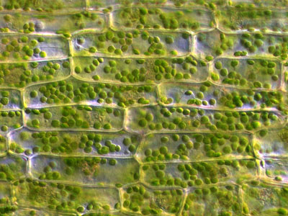
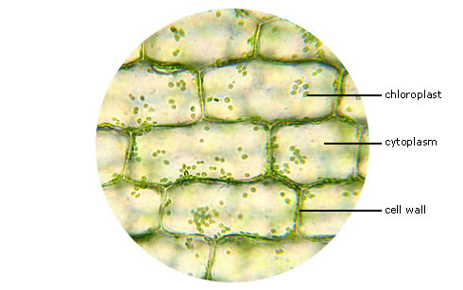
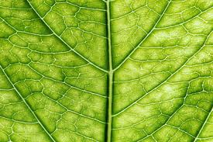
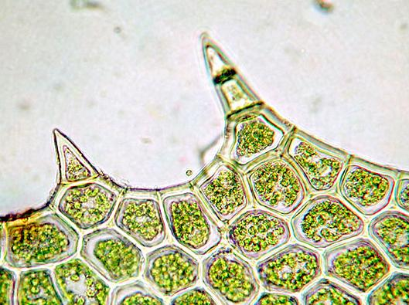
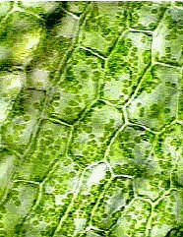
Magnified Leaf Cells

Slide 2
How did the first person see cells?
By accident
Because of their size, cells were not discovered until microscopes were invented in the mid- 1600s.

Slide 3
Cells
They are the smallest unit that can perform all the processes necessary for life.
All living things are made of these tiny structures.

Slide 4
Robert Hooke
1st Person to describe cells
In 1665, he built he built a microscope to look at the tiny objects.
Look at the cork on page 4.
The cork looked like it was made of tiny boxes, so he named them cells (little rooms).
He also looked at the thin slices of living plants.
He mainly looked at plants and fungi because they have a cell wall.
Animal cells do not have a cell wall, so he thought they were not made out of cells.

Slide 5
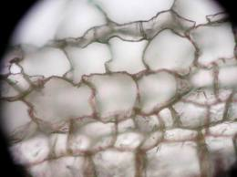
Cork Slide

Slide 6
Anton van Leeuwenhoek
A Dutch merchant who made his own microscope.
He looked at pond scum.
He saw small organisms in the water, and called them animalcules (little animals).
Today, we call them:
protists-single-celled organisms
Look at figure 2: protists in pond scum
He also looked at animal blood and noticed differences between different kinds of animals
fish & frogs oval
humans & dogs round and flat
He was the 1st person to see bacteria.
He also discovered that yeast which make bread rise is a single-celled organism.

Slide 7
Matthias Schleiden
He concluded that all plant parts were made of cells.
Theodor Schwann
Concluded that all animal tissues were made of cells.
He wrote the first two parts of what is now known as the
Cell Theory:
1. All organisms are made of one or more cells.
The cell is the basic unit of all living things.

Slide 8
Rudolf Virchow
He added the third part of the cells theory:
3. All cells come from existing cells.

Slide 9
Cell Size
It would take 50 human cells to cover the dot on the letter i on page 6.
Most cells are small, but some are big like the
egg
Why can it be this big? Because it does not have to take in more nutrients.
Why are most cells so small?
Cells take in food and get rid of wastes through their outer surface.
As the cells volume increases, its surface area grows too.
The volume grows faster than the surface area.
The area of a cell’s surface limits the cell’s size.

Slide 10
Surface area-to-volume ratio
The ratio of the cell’s outer surface area to the cell’s volume
To find use the following calculation:
surface area-to-volume ratio= surface area
volume

Slide 11
Math Focus
Calculate the surface area-to-volume ratio of a cube whose sides measure 2 cm.
1. Number of sides x Area of side = surface area of the cube
Surface Area of the Cube = 24cm
2. Calculate volume:
volume of cube = side x side x side
volume of cube = 2 cm x 2 cm x 2 cm
volume of cube = 8 cm
3. Calculate the surface area-to-volume ratio:
surface area-to-volume ratio = surface area
24 = 3 volume
8 1

Slide 12
Calculate the surface area-to-volume ratio of a
cube whose sides are 3 cm long.

Slide 13
Calculate the surface area-to volume ratio of a cube whose sides are 4 cm long.

Slide 14
Parts of the Cell
cell-membrane-a protective layer that covers the cell’s surface and acts as a barrier
It controls the materials going into and out of the cell.
cytoplasm-fluid inside the cell and all of its contents
organelles-structures that perform specific functions within the cell

Slide 15
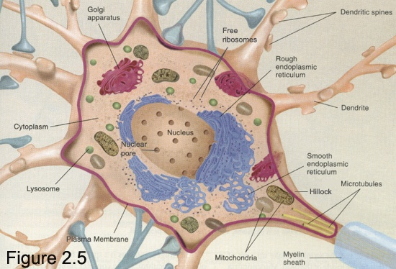

Slide 16
More Parts of the Cell
All cells contain DNA (deoxyribonucleic acid) at some point in their life.
DNA-genetic material that carries information needed to make new cells and new organisms.
It is passed on from parent cells to new cells and controls the activities of the cell.
Nucleus-a membrane-bound organelle that contains the cell’s DNA and that has a role in processes such as growth, metabolism, and reproduction
Not all cells have a nucleus. It depends on the type.

Slide 17
Two Kinds of Cells
Prokaryotes-single-celled organisms that do not have a nucleus or membrane-bound organelles
Eukaryotes-made of eukaryotic cells and has a nucleus

Slide 18
2 types of Prokaryotes
Eubacteria
Archaebacteria

Slide 19
Types of Prokaryotes
Eubacteria (bacteria)-the most common prokaryote. Bacteria are the world’s smallest cells.
They do not have a nucleus, but they do have
DNA.
A bacteria’s DNA is a long, circular molecule shaped like a rubber band.
They do not have membrane-covered organelles.

Slide 20
More on Bacteria
They have ribosomes.
ribosomes-round organelles made of protein and other material.
Strong cell wall-helps retain its shape
Cell membrane is just inside the cell wall.
These two allow materials into and out of the cell.

Slide 21
Where do they live?
Soil & Water
In or on organisms, like your teeth or skin
Digestive system: They help in the process of digestion.

Slide 22
2. Archaebacteria
Also called archaea
What do they have in common with Eubacteria?
Single-celled organisms
Ribosomes
a cell membrane
Circular DNA
lacks a nucleus
Membrane-bound organelles

Slide 23
How are Archaebacteria different?
Their cell wall and cell membranes are different which allows extreme conditions.
There are three types of archaebacteria:
heat-loving
salt-loving
methane-making
Extremophiles-live in places where conditions are
Extreme like hot springs (high salt & high temps.) and
volcanic vents in the ocean

Slide 24
Prokaryotes
http://library.thinkquest.org/12413/prokaryotes.html

Slide 25
Bacteria in Your Lunch
Most of the time, you don’t want bacteria in your food. Many bacteria make toxins that will make you sick. However, some foods, such as yogurt, are supposed to have bacteria in them! The bacteria in these foods are not dangerous.
In yogurt, masses of rod-shaped bacteria feed on the sugar (lactose) in milk. The bacteria convert the sugar into lactic acid. Lactic acid causes the milk to thicken. This thickened milk makes yogurt.

Slide 26
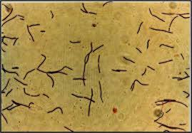
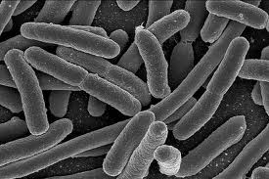
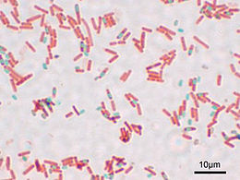
What does yogurt look like under a microscope?
It is a rod-shaped bacteria.

Slide 27
What are these live and active cultures
Lactobacillus bulgaricus and Streptococcus thermophilus, which convert pasteurized milk to yogurt during fermentation. All yogurts are required to be made with these two cultures. In addition, some yogurts contain Lactobacillus acidophilus,Bifidus and other cultures. In heat-treated yogurt, these cultures are killed during post-fermentation heating.

Slide 28
Why should consumers choose yogurt with live and active cultures?
Researchers around the world are studying the potential attributes of live and active culture yogurt in preventing gastrointestinal infections, boosting the body's immune system, fighting certain types of cancer and preventing osteoporosis. More research must be done to establish a definitive link between live and active culture yogurt and these health effects, but the results to date are encouraging.
Additionally, the live and active cultures found in yogurt break down lactose in milk. This allows lactose intolerant individuals who commonly experience gastrointestinal discomfort when they consume milk products to eat yogurt and receive the nutrients contained in the milk product without the side effects of abdominal cramping, bloating and diarrhea.

Slide 29
What's the difference between yogurt with live and active cultures and heat-treated yogurt?
A very important difference among yogurts is whether they contain live and active cultures. Although all yogurts initially contain live and active cultures, some are heated after they are made, thereby destroying the cultures. Also, some yogurts are initially formulated with a low level of cultures. Consumers can be certain they are getting yogurt with significant levels of live and active cultures by looking for the National Yogurt Association (NYA) Live & Active Cultures Yogurt seal on the package.

Slide 30
Eukaryotes-made of eukaryotic cells and
have a nucleus

Slide 31
Eukaryotes-Organisms made of eukaryotic cells
They are the largest cells.
Most are still microscopic, but 10 times larger than bacterial cells.
Look at figure 8 on page 10
The nucleus is membrane-bound and holds the DNA.
Organelles are like the organs in your body.

Slide 32
Eukaryotes
Many are multicellular (many cells)
What types of things are eukaryotes?
Animals
Humans
Plants
Some protists like amoebas and green algae
Fungi (mushroom and yeast)

Slide 33
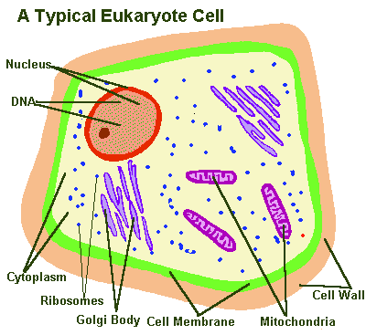
Parts of Eukaryotic Cells
cell wall-a rigid structure that surrounds the cell membrane and provides support to the cell.
Cell walls allow plants to stand upright.
Not all eukaryotic cells have a cell wall.
Cellulose-plants and algae have cell walls made out of this. It is a complex sugar that most animals cannot digest.

Slide 34
Cell Membrane
It is a protective barrier that encloses a cell.
If a cell lacks a cell wall, then the cell membrane is the outermost covering.

Slide 35
Cell Membrane contains:
Proteins
Lipids-which include fats and cholesterol & do not dissolve in water.
Phospholipids-a lipid that contains phosphorus
2 Parts
Part 1: Hydrophobic lipids-lipids are “water fearing”.
Part 2: Hydrophilic lipids-”water loving”
Outer membrane
These two layers allow nutrients and water to enter and
wastes to exit.

Slide 36
Hydrophilic heads
“water loving”
Hydrophobic tails
“water fearing”

Slide 37
Cytoskeleton
A web of proteins in the cytoplasm.
It acts as a muscle and a skeleton.
It keeps the cell membrane from collapsing.

Slide 38
Nucleus
A large organelle in the eukaryotic cell.
It contains the cell’s DNA and is the control center of the cell.
Nucleolus-dark area of the nucleus where a cell begins to make its ribosomes.

Slide 39
Ribosomes
The smallest of the organelles .
They make proteins.
amino acids-proteins are made of these. Any one of about 20 different organic molecules are used to make proteins.
All cells have ribosomes because they need protein to live.

Slide 40
Endoplasmic Reticulum
A system of folded membranes in which proteins, lipids, and other material are made.
Look at figure 5 on page 15.
ER is either rough or smooth.
Rough *covered in ribosomes
*makes cell’s proteins
*delivers proteins throughout the cell
Smooth *lacks ribosomes
*make lipids

Slide 41
Mitochondria
The main power source of a cell.
It is the organelle where sugar is broken down to produce energy.
Energy released is stored in a substance called ATP (adenosine triphosphate).
Look at figure 6 on page 16

Slide 42
Chloroplasts
Organelles in plants photosynthesis takes place.
They use the energy of the sun to make food.
Chlorophyll-a green pigment that traps the sun’s energy
Look at figure 7 on page 16

Slide 43
Photosynthesis
Process by which plants and algae use sunlight, carbon dioxide, and water to make sugar and oxygen

Slide 44
Golgi Complex
Organelle that packages and transports proteins to other parts of the cell.
It pinches off to form a small bubble.
Proteins from the ER are delivered here.
It looks like smooth ER. Look at figure 8 on page 17.

Slide 45
Vesicle (bubble)
A small sac that surrounds material to be moved into or out of a cell.
Takes material from Golgi Complex to other parts of the cell.
Transports new protein from ER to Golgi Complex.

Slide 46
Lysosomes
Vesicles that are responsible for digesting food particles, wastes, cell parts, and foreign invaders.
Found mostly in animal cells

Slide 47
Vacuoles
A large organelle that stores water.

Slide 48
Interactive Cell Site
http://www.wiley.com/legacy/college/boyer/0470003790/animations/cell_structure/cell_structure.htm
Inside a cell
Contruct a Cell Membrane
Animal Cell Model

Slide 49
Multicellular
It means that you are made of many cells.
These organisms grow by making more cells not larger ones.
Compare an Elephant and you:
Elephant is larger, but has about the same size cell as you just more of them.

Slide 50
Benefits of being Multi-cellular
Larger size
Longer Life-It is not limited to the life span of any single cell.
Specialization-each type of cell has a particular job. This makes the organism more efficient.
ie. cardiac muscle

Slide 51
Tissue
A group of cells that work together to perform a specific job.
Animals have 4 basic types of tissue:
nerve, muscle, connective, and protective.
Plants have 3 basic types of tissue:
transport (moves water and nutrients), protective (covers), and ground (photsynthesis takes place here).

Slide 52
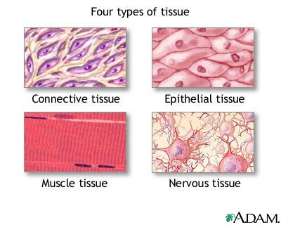

Slide 53
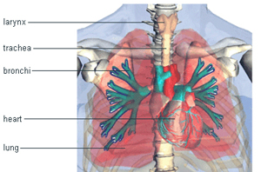
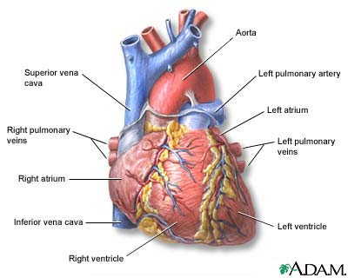
Organ
A structure that is made up of two or more tissues working together to perform a specific function
Your heart is an example. It is made of cardiac muscle but also has nerve tissue and blood vessels that work together.

Slide 54
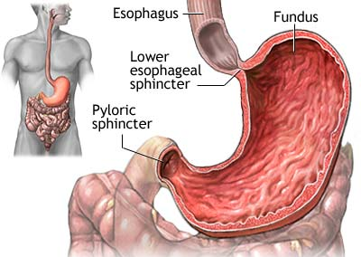
Stomach
An organ that has several different types of tissue.
Muscle tissue makes food move in and through the stomach.
Special tissues make chemicals that help digest your food.
Connective tissue holds the stomach together.
Nervous tissue carries messages back and forth between the stomach and the brain.

Slide 55
Plants
Also have different kinds of tissue that work together as organs.
A leaf is a plant organ that contains tissue that traps light energy to make food.
Other organs of a plant are stems and roots.

Slide 56
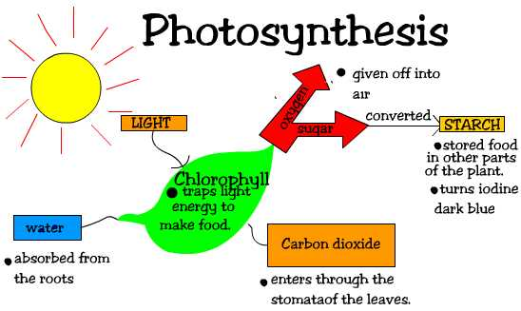

Slide 57
Organ System
A group of organs working together to perform a particular function.
Examples of organ systems:
1. Digestive System: includes the stomach
and intestines. It breaks down food which
acts as fuel for our body.
2. Respiratory System
3. Circulatory System

Slide 58
Organisms
Anything that can perform life processes by itself.
unicellular organism-an organism made of a single cell like bacteria, protists, and some fungi

Slide 59
Structure and Function Relationship
Function
Structure
It is the arrangement of parts in an organism.
For example, the structure of the lungs is a large spongy sac. There are
millions of tiny air sacs called alveoli.
Is the job the part does.
For example, the alveoli is responsible for the exchange of gases.
The alveoli and blood vessels bring oxygen to the body and gets rid of CO2

Slide 60
http://members.enchantedlearning.com/subjects/anatomy/lungs/label/labelanswers.shtml
http://www.bishopstopford.com/faculties/science/arthur/Heart drag&drop.swf

Slide 61
Identifying organisms

