Slide 1
How to Use
This Presentation
• To View the presentation as a slideshow with effects
select “View” on the menu bar and click on “Slide Show”,
or simply press F5 on the top row of your keyboard.
• To advance to the next slide click the left mouse button once.
• From the Chapter screen you can click on any section to go directly to that section’s presentation.
• Blank or “missing” areas of a slide will remain hidden until the left mouse button is clicked.
• You may exit the slide show at any time by pressing the Esc key
Copyright © by Holt, Rinehart and Winston. All rights reserved.
Notes:
Header – white 24 points Arial Bold
Body text – white 20 points Arial Bold, dark yellow highlights
Bullets – dark yellow
Copyright – white 12 points Arial
Background name: HST-Presentation_blue.jpg,
Size:
Height: 7.52"
Width: 10.02"
Scale: 70%
Position on slide:
Horizontal - 0"
Vertical - 0"

Slide 2
Chapter 14
Animals and Behavior
Section 1: What Is an Animal?
Section 2: Animal Behavior
Section 3: Social Relationships
End of Slide
Copyright © by Holt, Rinehart and Winston. All rights reserved.
Notes:
Header first line (section#) – white 24 points Arial Bold
Header second line (title) – white 28 points Arial Bold
Title – yellow 28 points Arial Bold
Body text – white24 points Arial and Arial Bold
Bullets – yellow
Copyright – white 12 points Arial
Background name: HST-Presentation_blue.jpg,
Size:
Height: 7.52"
Width: 10.02"
Scale: 70%
Position on slide:
Horizontal - 0"
Vertical - 0"

Slide 3
Section 1
What Is an Animal?
Bellringer
What is the best material for washing a car—a cotton rag, a scratch pad, or an animal skeleton? Explain your answer in your science journal. How do people use animal products in their daily lives?
Copyright © by Holt, Rinehart and Winston. All rights reserved.
Notes:
Header first line (section#) – white 24 points Arial Bold
Header second line (title) – white 28 points Arial Bold
Title – yellow 28 points Arial Bold
Body text – white24 points Arial and Arial Bold
Bullets – yellow
Copyright – white 12 points Arial
Background name: HST-Presentation_blue.jpg,
Size:
Height: 7.52"
Width: 10.02"
Scale: 70%
Position on slide:
Horizontal - 0"
Vertical - 0"

Slide 4
Section 1
What Is an Animal?
Objectives
Describe the difference between vertebrates and invertebrates.
Describe the five characteristics that all animals share.
End of Slide
Copyright © by Holt, Rinehart and Winston. All rights reserved.
Notes:
Header first line (section#) – white 24 points Arial Bold
Header second line (title) – white 28 points Arial Bold
Title – yellow 28 points Arial Bold
Body text – white24 points Arial and Arial Bold
Bullets – yellow
Copyright – white 12 points Arial
Background name: HST-Presentation_blue.jpg,
Size:
Height: 7.52"
Width: 10.02"
Scale: 70%
Position on slide:
Horizontal - 0"
Vertical - 0"

Slide 5
Section 1
What Is an Animal?
Animal Diversity
Vertebrates A vertebrate is an animal that has a backbone.
Invertebrates Most animal species are insects, snails, jellyfish, worms, and other invertebrates, or animals without backbones.
End of Slide
Copyright © by Holt, Rinehart and Winston. All rights reserved.
Notes:
Header first line (section#) – white 24 points Arial Bold
Header second line (title) – white 28 points Arial Bold
Title – yellow 28 points Arial Bold
Body text – white24 points Arial and Arial Bold
Bullets – yellow
Copyright – white 12 points Arial
Background name: HST-Presentation_blue.jpg,
Size:
Height: 7.52"
Width: 10.02"
Scale: 70%
Position on slide:
Horizontal - 0"
Vertical - 0"

Slide 6
Section 1
What Is an Animal?
Animal Characteristics
Multicellular Makeup All animals are multicellular, which means they are made of many cells.
Reproduction and Development Head Almost all animals reproduce sexually. These animals make sex cells—eggs or sperm. When an egg and a sperm join during fertilization, they form the first cell of a new organism.
Many Specialized Parts An animal’s body has distinct parts that do different things. The next slide illustrates the many specialized parts of a shark.
End of Slide
Copyright © by Holt, Rinehart and Winston. All rights reserved.
Notes:
Header first line (section#) – white 24 points Arial Bold
Header second line (title) – white 28 points Arial Bold
Title – yellow 28 points Arial Bold
Body text – white24 points Arial and Arial Bold
Bullets – yellow
Copyright – white 12 points Arial
Background name: HST-Presentation_blue.jpg,
Size:
Height: 7.52"
Width: 10.02"
Scale: 70%
Position on slide:
Horizontal - 0"
Vertical - 0"

Slide 7
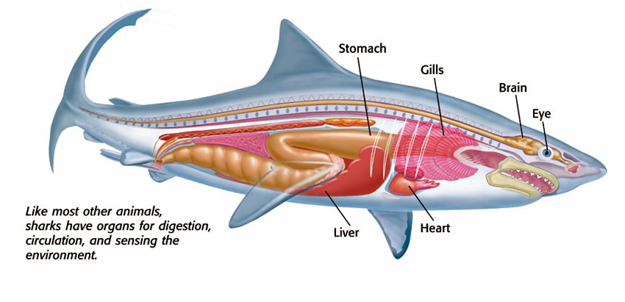
Section 1
Organs of a Shark
Copyright © by Holt, Rinehart and Winston. All rights reserved.
Notes:
Header first line (section#) – white 24 points Arial Bold
Header second line (title) – white 28 points Arial Bold
Title – navy 28 points Arial Bold
Body text – black 24 points Arial and Arial Bold
Bullets – navy
Copyright – white 12 points Arial
Background name: HST-Presentation_white.jpg
Size:
Height: 7.52"
Width: 10.02"
Scale: 70%
Position on slide:
Horizontal - 0"
Vertical - 0"

Slide 8
Section 1
What Is an Animal?
Animal Characteristics continued
Movement Most animals can move from place to place. Nearly all animals use movement to search for food, shelter, or mates at some stage of life.
Consuming All animals survive by eating other organisms or parts and products of other organisms. In other words, animals are consumers.
End of Slide
Copyright © by Holt, Rinehart and Winston. All rights reserved.
Notes:
Header first line (section#) – white 24 points Arial Bold
Header second line (title) – white 28 points Arial Bold
Title – yellow 28 points Arial Bold
Body text – white24 points Arial and Arial Bold
Bullets – yellow
Copyright – white 12 points Arial
Background name: HST-Presentation_blue.jpg,
Size:
Height: 7.52"
Width: 10.02"
Scale: 70%
Position on slide:
Horizontal - 0"
Vertical - 0"

Slide 9
Section 2
Animal Behavior
Bellringer
Write a sentence to describe each of the following terms:
predator
prey
After each sentence, list three animals that are predators and three that are prey. Are humans predators or prey? How can you tell?
Write your answers in your science journal.
Copyright © by Holt, Rinehart and Winston. All rights reserved.
Notes:
Header first line (section#) – white 24 points Arial Bold
Header second line (title) – white 28 points Arial Bold
Title – yellow 28 points Arial Bold
Body text – white24 points Arial and Arial Bold
Bullets – yellow
Copyright – white 12 points Arial
Background name: HST-Presentation_blue.jpg,
Size:
Height: 7.52"
Width: 10.02"
Scale: 70%
Position on slide:
Horizontal - 0"
Vertical - 0"

Slide 10
Section 2
Animal Behavior
Objectives
Explain the difference between learned and innate behavior.
Describe five kinds of behaviors that help animals survive.
Name three cycles that are influenced by biological clocks.
End of Slide
Copyright © by Holt, Rinehart and Winston. All rights reserved.
Notes:
Header first line (section#) – white 24 points Arial Bold
Header second line (title) – white 28 points Arial Bold
Title – yellow 28 points Arial Bold
Body text – white24 points Arial and Arial Bold
Bullets – yellow
Copyright – white 12 points Arial
Background name: HST-Presentation_blue.jpg,
Size:
Height: 7.52"
Width: 10.02"
Scale: 70%
Position on slide:
Horizontal - 0"
Vertical - 0"

Slide 11
Section 2
Animal Behavior
Kinds of Behavior
Innate Behavior Behavior that doesn’t depend on learning or experience is known as innate behavior.
Learned Behavior Innate behaviors can be modified. Animals can use learning to change a behavior. Learned behavior is behavior that has been learned from experience or from observing other animals.
End of Slide
Copyright © by Holt, Rinehart and Winston. All rights reserved.
Notes:
Header first line (section#) – white 24 points Arial Bold
Header second line (title) – white 28 points Arial Bold
Title – yellow 28 points Arial Bold
Body text – white24 points Arial and Arial Bold
Bullets – yellow
Copyright – white 12 points Arial
Background name: HST-Presentation_blue.jpg,
Size:
Height: 7.52"
Width: 10.02"
Scale: 70%
Position on slide:
Horizontal - 0"
Vertical - 0"

Slide 12
Section 2
Animal Behavior
Survival Behavior
Finding Food Animals find food in many ways. Animals that eat other animals are known as predators.
Marking Territory Sometimes, members of the same species must compete for food and mates. Some animals claim territories to save energy by avoiding this competition.
Defensive Action Defensive behavior allows animals to protect resources, including territories, from other animals. Animals defend food, mates, and offspring.
End of Slide
Copyright © by Holt, Rinehart and Winston. All rights reserved.
Notes:
Header first line (section#) – white 24 points Arial Bold
Header second line (title) – white 28 points Arial Bold
Title – yellow 28 points Arial Bold
Body text – white24 points Arial and Arial Bold
Bullets – yellow
Copyright – white 12 points Arial
Background name: HST-Presentation_blue.jpg,
Size:
Height: 7.52"
Width: 10.02"
Scale: 70%
Position on slide:
Horizontal - 0"
Vertical - 0"

Slide 13
Section 2
Animal Behavior
Survival Behavior continued
Courtship Animals need to find mates to reproduce. Reproduction is essential for the survival of an individual’s genes. Animals have special behaviors, called courtship, that help them find a mate.
Parenting Some animals, such as caterpillars, begin life with the ability to take care of themselves. But many young animals depend on their parents for survival.
End of Slide
Copyright © by Holt, Rinehart and Winston. All rights reserved.
Notes:
Header first line (section#) – white 24 points Arial Bold
Header second line (title) – white 28 points Arial Bold
Title – yellow 28 points Arial Bold
Body text – white24 points Arial and Arial Bold
Bullets – yellow
Copyright – white 12 points Arial
Background name: HST-Presentation_blue.jpg,
Size:
Height: 7.52"
Width: 10.02"
Scale: 70%
Position on slide:
Horizontal - 0"
Vertical - 0"

Slide 14
Section 2
Animal Behavior
Seasonal Behavior
Migration Many animals avoid cold weather by traveling to warmer places. These animals migrate to find food, water, or safe nesting grounds.
Slowing Down Some animals deal with food and water shortages by hibernating.
A Biological Clock The internal control of an animal’s natural cycles is called a biological clock.
Cycles of Change Some biological clocks control long cycles. Seasonal cycles are nearly universal for animals.
End of Slide
Copyright © by Holt, Rinehart and Winston. All rights reserved.
Notes:
Header first line (section#) – white 24 points Arial Bold
Header second line (title) – white 28 points Arial Bold
Title – yellow 28 points Arial Bold
Body text – white24 points Arial and Arial Bold
Bullets – yellow
Copyright – white 12 points Arial
Background name: HST-Presentation_blue.jpg,
Size:
Height: 7.52"
Width: 10.02"
Scale: 70%
Position on slide:
Horizontal - 0"
Vertical - 0"

Slide 15
Section 3
Social Relationships
Bellringer
Humans use lots of cues to size up their environment and each other. Name one piece of information that might be learned from a smell and one piece of information that could be learned from a sound. For example, you might know that dinner is ready if you smell food from your kitchen.
Record your ideas in your science journal.
Copyright © by Holt, Rinehart and Winston. All rights reserved.
Notes:
Header first line (section#) – white 24 points Arial Bold
Header second line (title) – white 28 points Arial Bold
Title – yellow 28 points Arial Bold
Body text – white24 points Arial and Arial Bold
Bullets – yellow
Copyright – white 12 points Arial
Background name: HST-Presentation_blue.jpg,
Size:
Height: 7.52"
Width: 10.02"
Scale: 70%
Position on slide:
Horizontal - 0"
Vertical - 0"

Slide 16
Section 3
Social Relationships
Objectives
Describe four ways that animals communicate.
List the advantages and disadvantages of living in groups.
End of Slide
Copyright © by Holt, Rinehart and Winston. All rights reserved.
Notes:
Header first line (section#) – white 24 points Arial Bold
Header second line (title) – white 28 points Arial Bold
Title – yellow 28 points Arial Bold
Body text – white24 points Arial and Arial Bold
Bullets – yellow
Copyright – white 12 points Arial
Background name: HST-Presentation_blue.jpg,
Size:
Height: 7.52"
Width: 10.02"
Scale: 70%
Position on slide:
Horizontal - 0"
Vertical - 0"

Slide 17
Section 3
Social Relationships
Communication
Sending a Signal In communication, a signal must travel from one animal to another, and the receiver of the signal must respond in some way. Communication helps animals survive. Many animals communicate to defend a territory from other members of the species.
End of Slide
Copyright © by Holt, Rinehart and Winston. All rights reserved.
Notes:
Header first line (section#) – white 24 points Arial Bold
Header second line (title) – white 28 points Arial Bold
Title – yellow 28 points Arial Bold
Body text – white24 points Arial and Arial Bold
Bullets – yellow
Copyright – white 12 points Arial
Background name: HST-Presentation_blue.jpg,
Size:
Height: 7.52"
Width: 10.02"
Scale: 70%
Position on slide:
Horizontal - 0"
Vertical - 0"

Slide 18
Section 3
Social Relationships
Ways to Communicate
Sound Many animals communicate by making noises.
Touch Animals may also use touch to communicate.
Chemicals One way to communicate is through chemicals. The chemicals that animals use to communicate are called pheromones.
Sight Animals also use visual communication. When we smile at a friend, we are sending a visual message with body language. As shown on the next slide, bees use body language, along with other forms of communication, to spread news about food.
End of Slide
Copyright © by Holt, Rinehart and Winston. All rights reserved.
Notes:
Header first line (section#) – white 24 points Arial Bold
Header second line (title) – white 28 points Arial Bold
Title – yellow 28 points Arial Bold
Body text – white24 points Arial and Arial Bold
Bullets – yellow
Copyright – white 12 points Arial
Background name: HST-Presentation_blue.jpg,
Size:
Height: 7.52"
Width: 10.02"
Scale: 70%
Position on slide:
Horizontal - 0"
Vertical - 0"

Slide 19
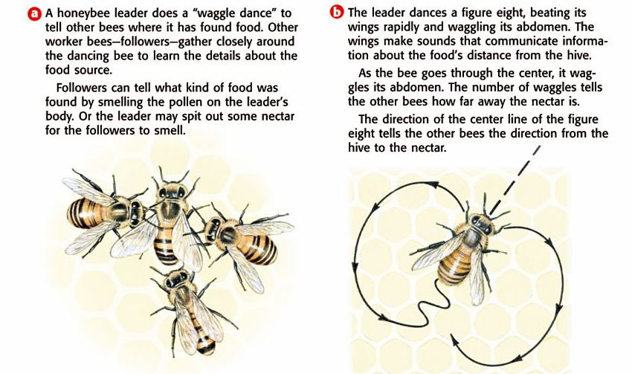
Section 3
The Dance of the Bees
Copyright © by Holt, Rinehart and Winston. All rights reserved.
Notes:
Header first line (section#) – white 24 points Arial Bold
Header second line (title) – white 28 points Arial Bold
Title – navy 28 points Arial Bold
Body text – black 24 points Arial and Arial Bold
Bullets – navy
Copyright – white 12 points Arial
Background name: HST-Presentation_white.jpg
Size:
Height: 7.52"
Width: 10.02"
Scale: 70%
Position on slide:
Horizontal - 0"
Vertical - 0"

Slide 20
Section 3
Social Relationships
Living Together
The Benefits of Living in Groups Living in groups can be safer than living alone. Large groups can spot a predator quickly because they have so many pairs of eyes watching for danger.
The Downside of Living in Groups Living in groups causes problems as well. Animals living in large groups must compete with each other for food and mates. An area that has enough food for one animal may not have enough food for a group of animals.
End of Slide
Copyright © by Holt, Rinehart and Winston. All rights reserved.
Notes:
Header first line (section#) – white 24 points Arial Bold
Header second line (title) – white 28 points Arial Bold
Title – yellow 28 points Arial Bold
Body text – white24 points Arial and Arial Bold
Bullets – yellow
Copyright – white 12 points Arial
Background name: HST-Presentation_blue.jpg,
Size:
Height: 7.52"
Width: 10.02"
Scale: 70%
Position on slide:
Horizontal - 0"
Vertical - 0"

Slide 21
Chapter 14
Animals and Behavior
Concept Map
Use the following terms to complete the concept map on the next slide: biological clock, animals, hibernation, migration, circadian rhythms.
Copyright © by Holt, Rinehart and Winston. All rights reserved.
Notes:
Header first line (section#) – white 24 points Arial Bold
Header second line (title) – white 28 points Arial Bold
Title – yellow 28 points Arial Bold
Body text – white24 points Arial and Arial Bold
Bullets – yellow
Copyright – white 12 points Arial
Background name: HST-Presentation_blue.jpg,
Size:
Height: 7.52"
Width: 10.02"
Scale: 70%
Position on slide:
Horizontal - 0"
Vertical - 0"

Slide 22
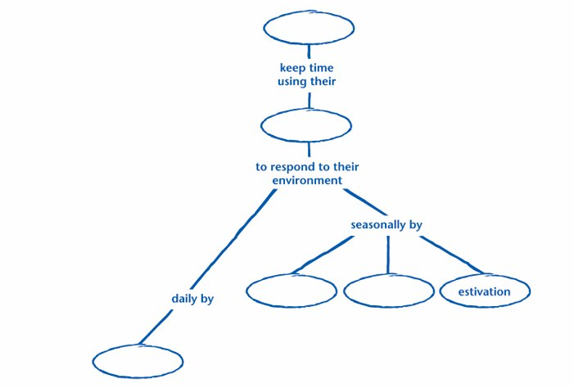
Chapter 14
Concept Map
Copyright © by Holt, Rinehart and Winston. All rights reserved.
Notes:
Header first line (section#) – white 24 points Arial Bold
Header second line (title) – white 28 points Arial Bold
Title – navy 28 points Arial Bold
Body text – black 24 points Arial and Arial Bold
Bullets – navy
Copyright – white 12 points Arial
Background name: HST-Presentation_white.jpg
Size:
Height: 7.52"
Width: 10.02"
Scale: 70%
Position on slide:
Horizontal - 0"
Vertical - 0"

Slide 23
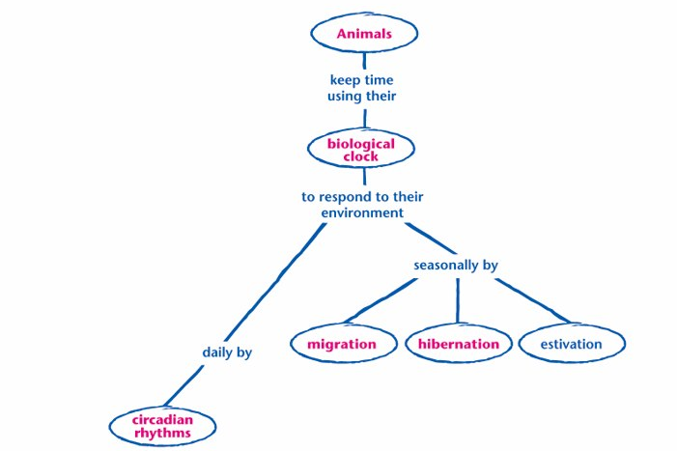
Chapter 14
Concept Map
Copyright © by Holt, Rinehart and Winston. All rights reserved.
Notes:
Header first line (section#) – white 24 points Arial Bold
Header second line (title) – white 28 points Arial Bold
Title – navy 28 points Arial Bold
Body text – black 24 points Arial and Arial Bold
Bullets – navy
Copyright – white 12 points Arial
Background name: HST-Presentation_white.jpg
Size:
Height: 7.52"
Width: 10.02"
Scale: 70%
Position on slide:
Horizontal - 0"
Vertical - 0"

